Slide 1
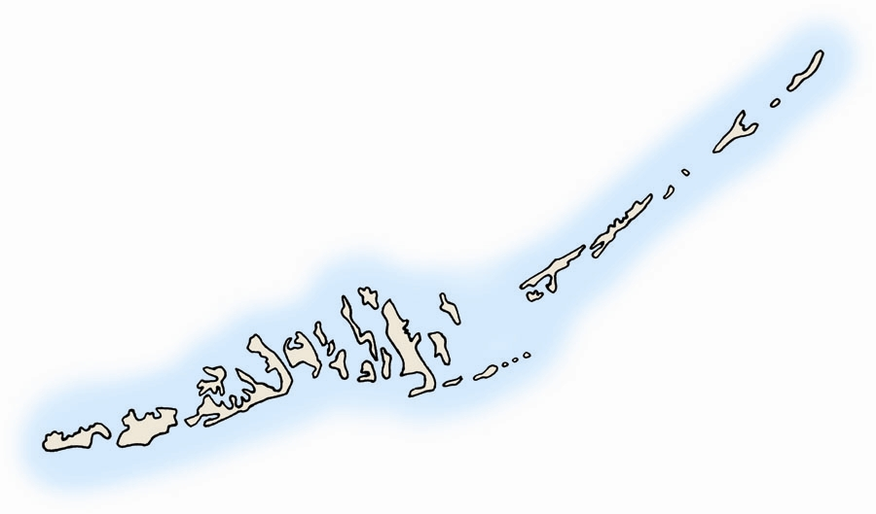

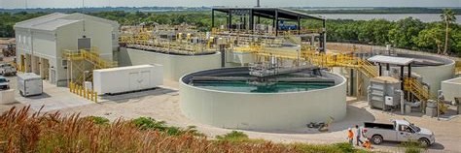
Florida Keys
Aqueduct Authority
SOUTHEAST FLORIDA REGIONAL CLIMATE CHANGE COMPACT OCTOBER 6, 2025 FKAA ISLAMORADA TRANSMISSION MAIN ADAPTATION PROJECT DAVID HACKWORTH DIRECTOR OF ENGINEERING

Slide 2
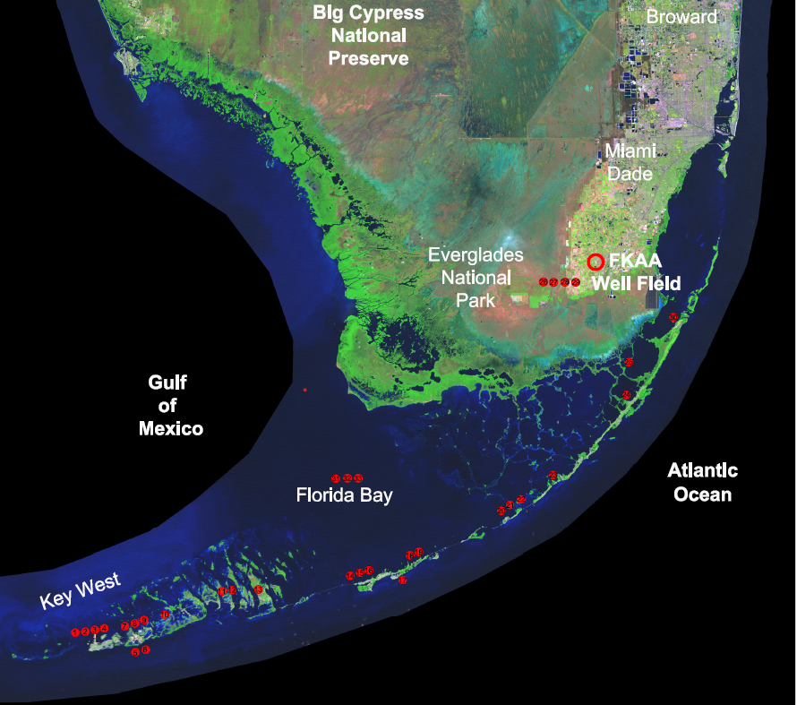
FKAA’s Approach to Improved Resiliency
Parallel pipeline
New Desalination Plants
Key Largo Booster
Pump Station
Islamorada Transmission Main
Future Crawl Key Reverse
Osmosis Plant
Ramrod Booster
Pump Station
Long Key Booster
Pump Station
Marathon Booster
Pump Station
Stock Island Reverse Osmosis Plant

Slide 3
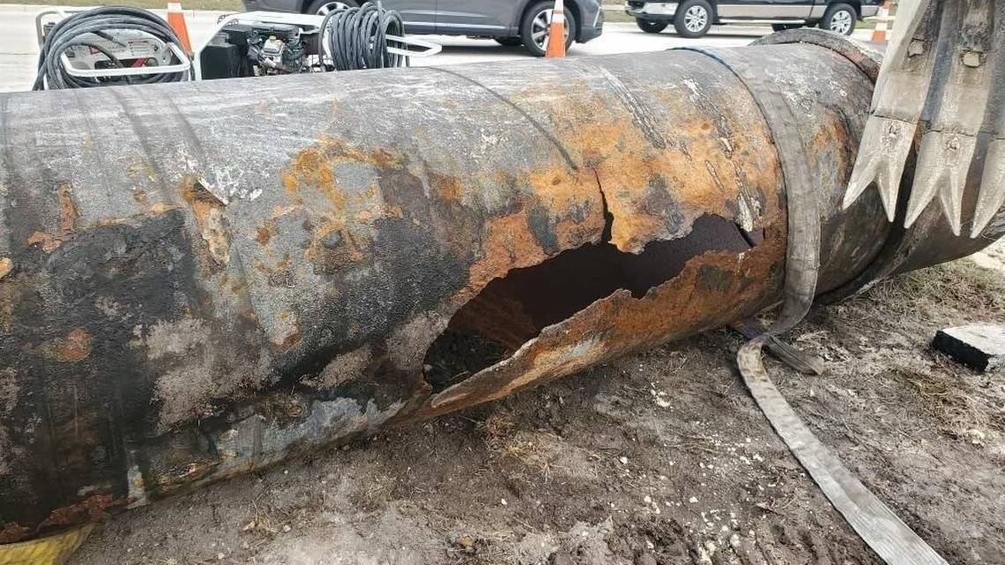
Project Justification
Susceptible to water hammer during power interruptions
Ductile Iron Pipe
Approx 45 years old
Exposed to tidal seawater
No redundancy – repairs must be made within 24 hours

Slide 4
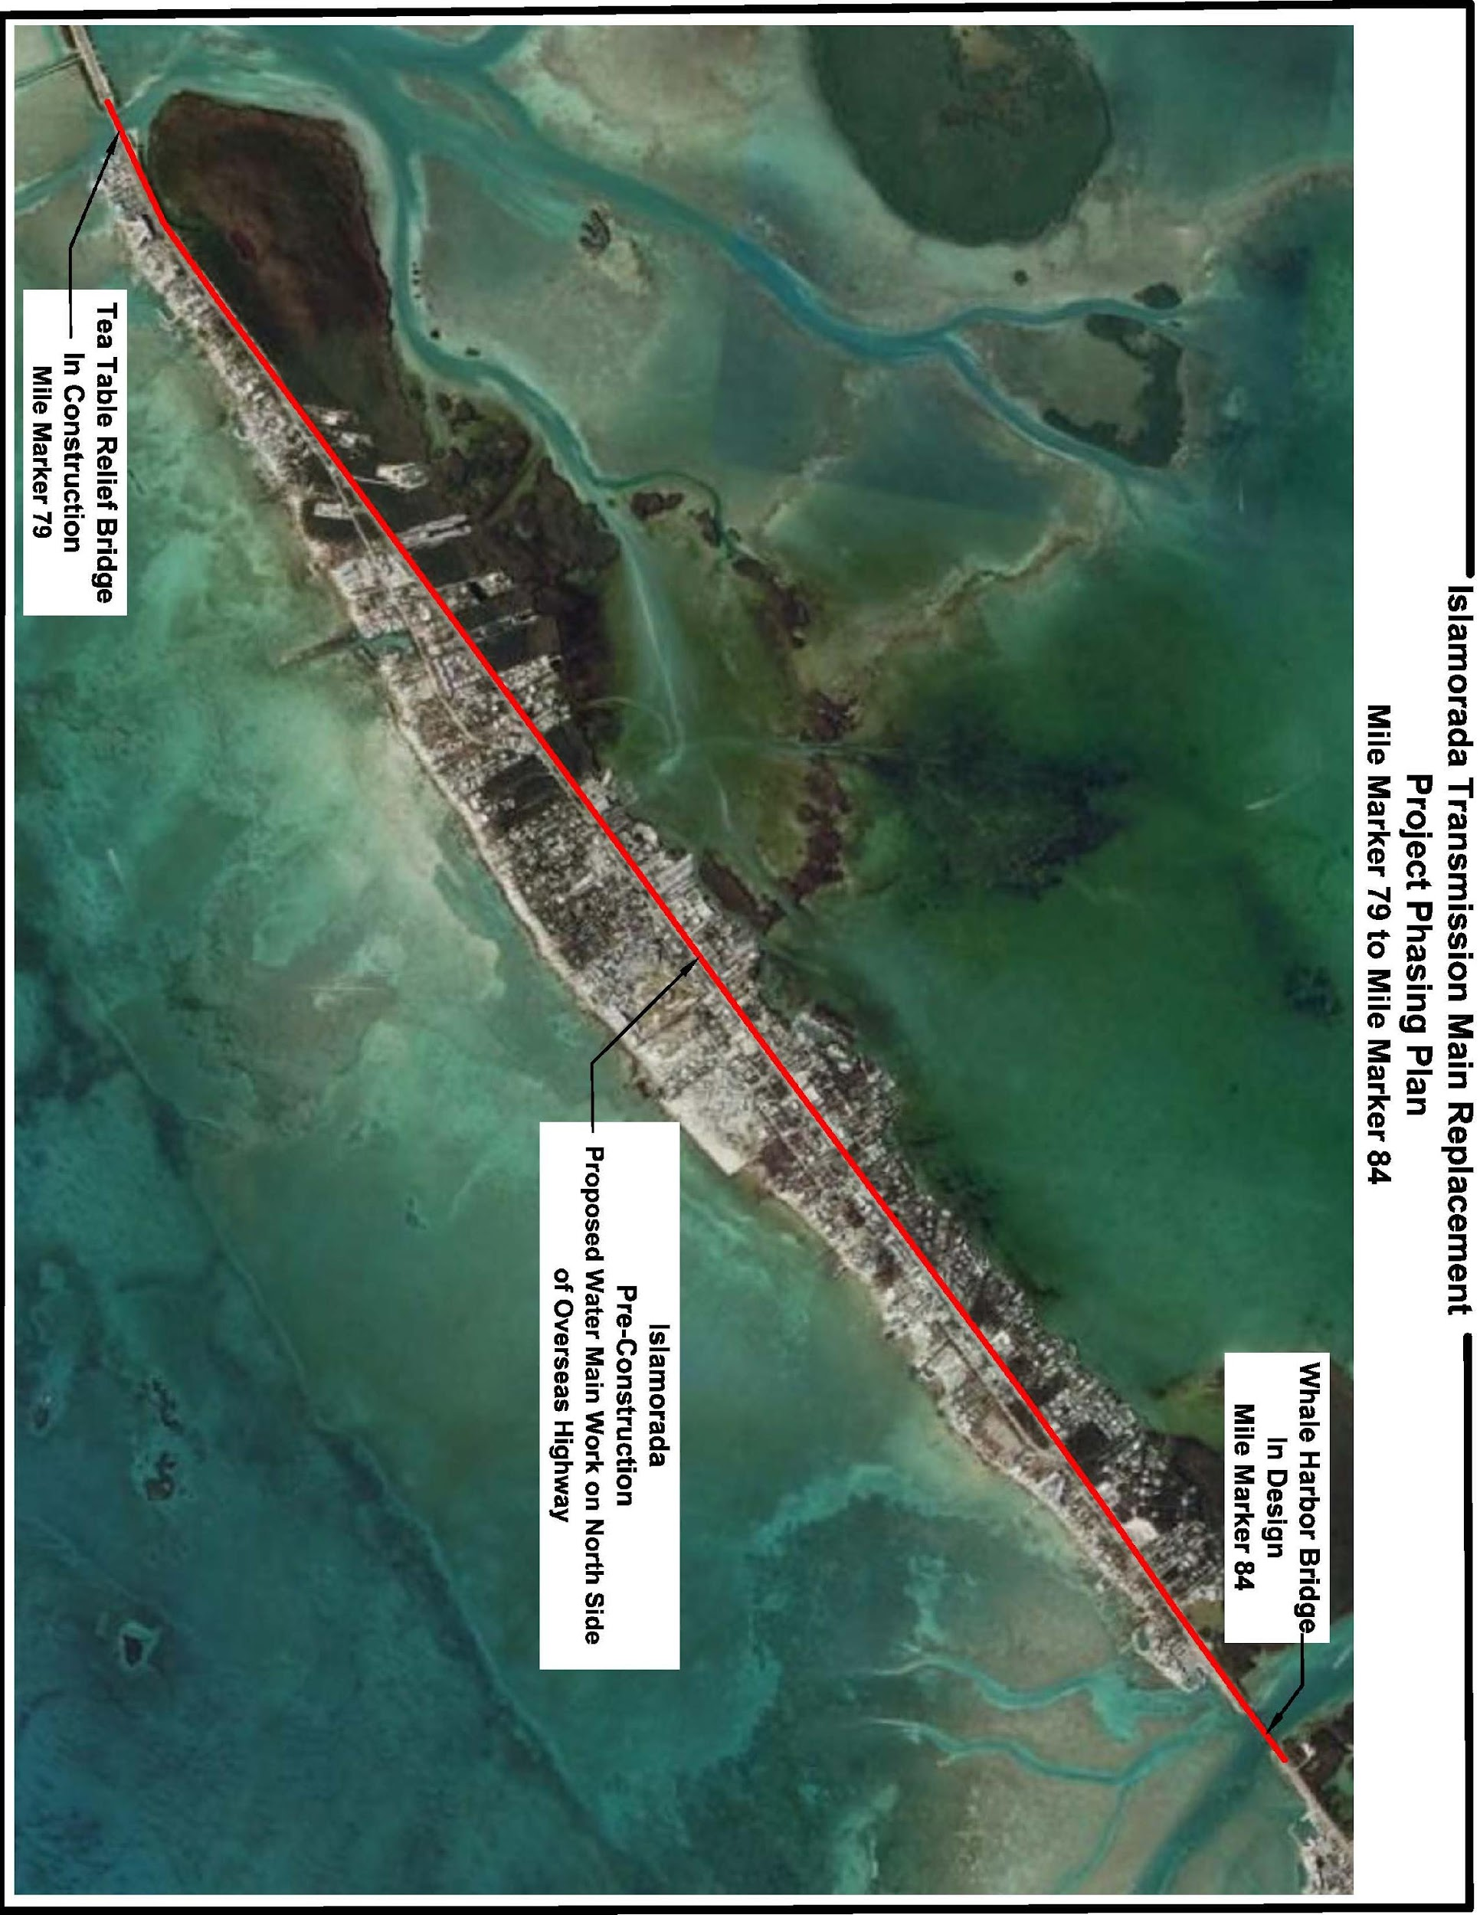

Project Overview
Approximately 4 miles of 36-inch cathodically protected welded steel pipe
$39 million total project cost. $17.5 million funded by Resilient Florida Implementation Grant
$21.5 million match from WIFIA Loan and revenue loans
Design/Bidding/Award –14 months
Construction –23 months
This project is part of long-term plan to install approximately 130 miles of new pipeline

Slide 5
Project Prioritization Process
Regulatory Requirements
Asset Rehabilitation and Replacement
System Capacity Requirements

Slide 6
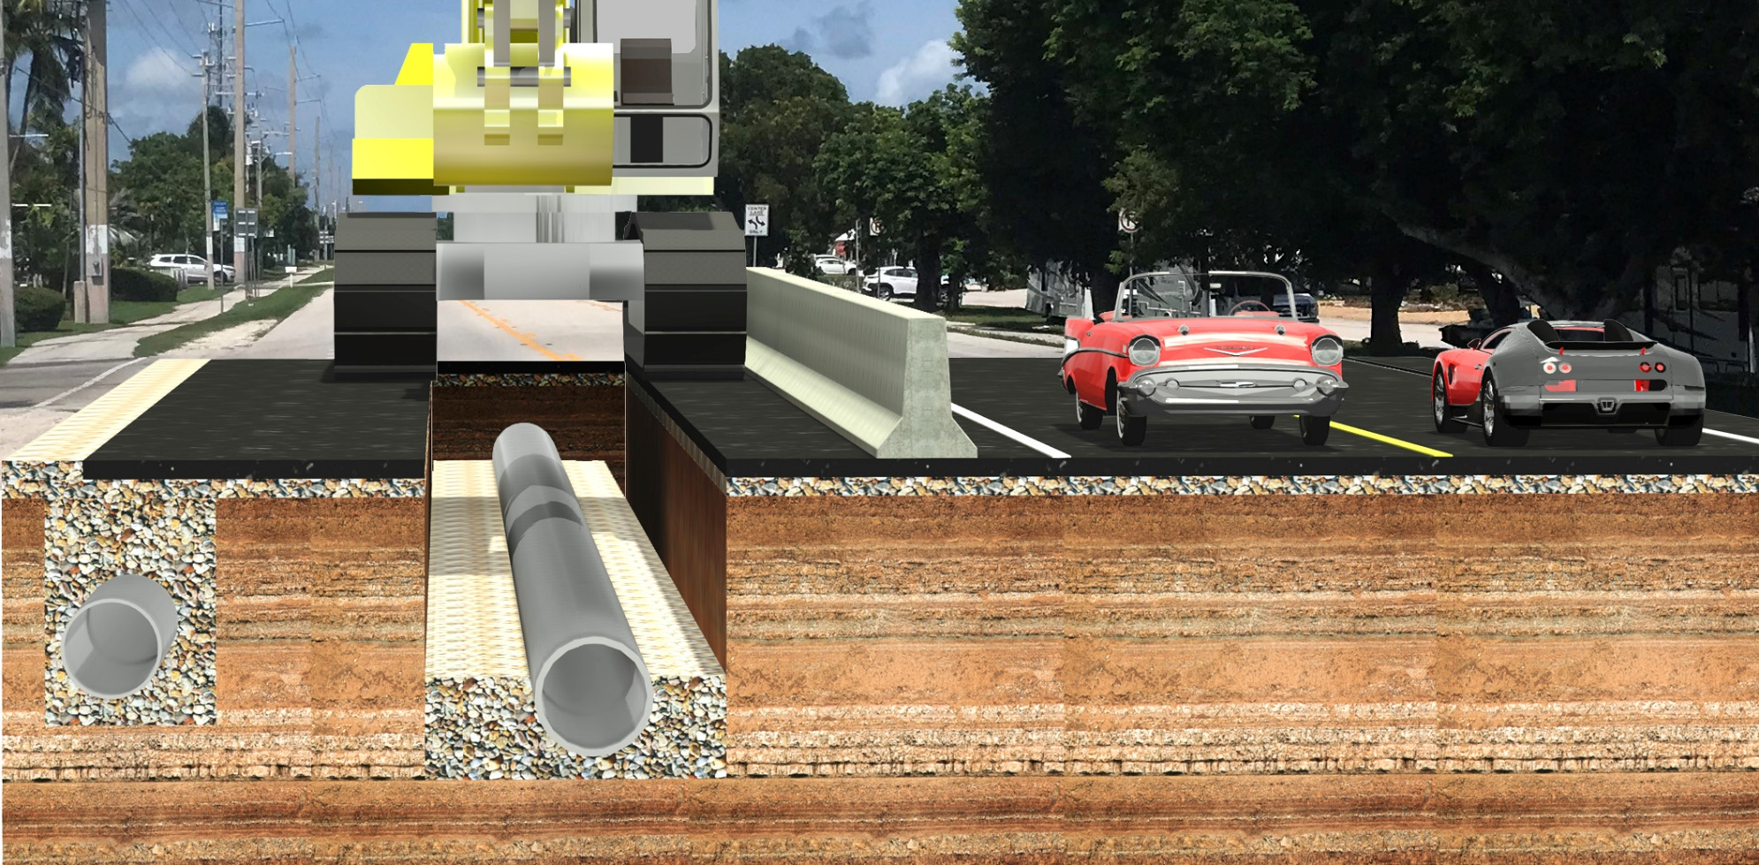
Primary Challenge
Existing Transmission Main
Southbound US-1
Replacement Transmission Main

Slide 7
Innovations and Lessons Learned
Owner Direct Purchase of Materials
Interlocal Agreement with FDOT for Landscape Restoration
Utilized Public Relations Firm

