Slide 1
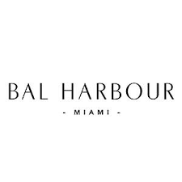
Resilient Florida Grant Award #25SRP17 Harbourfront park & living shoreline project Resilient Florida Implementation Workshop – October 6, 2025 Presenters: Mattie Reyes, Capital Programs Director & Kristina Brown, Grants and Project Support

Slide 2
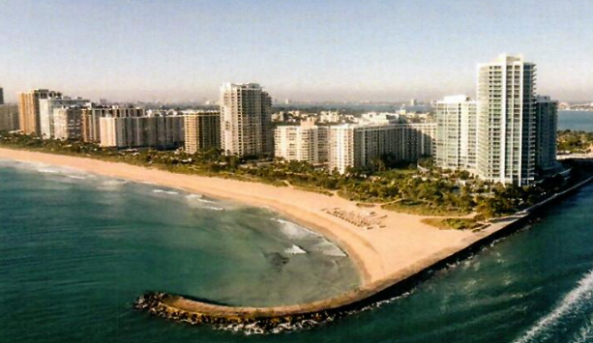
Where Land Meets Sea: Harbourfront Park
Project Overview
Applied in August 2023 for the Resilient Florida Grant.
Awarded $8M in August 2024 for seawall, living shoreline, and resiliency features.
Total project presently estimated at $32 million.
Location Overview
Located on the south side of Baker’s Haulover Inlet.
Continuous shoreline corridor with access to the beach.
Project elevates and fortifies shoreline infrastructure.
Adjacent to critical evacuation routes (Collins Ave, 96th St).

Slide 3
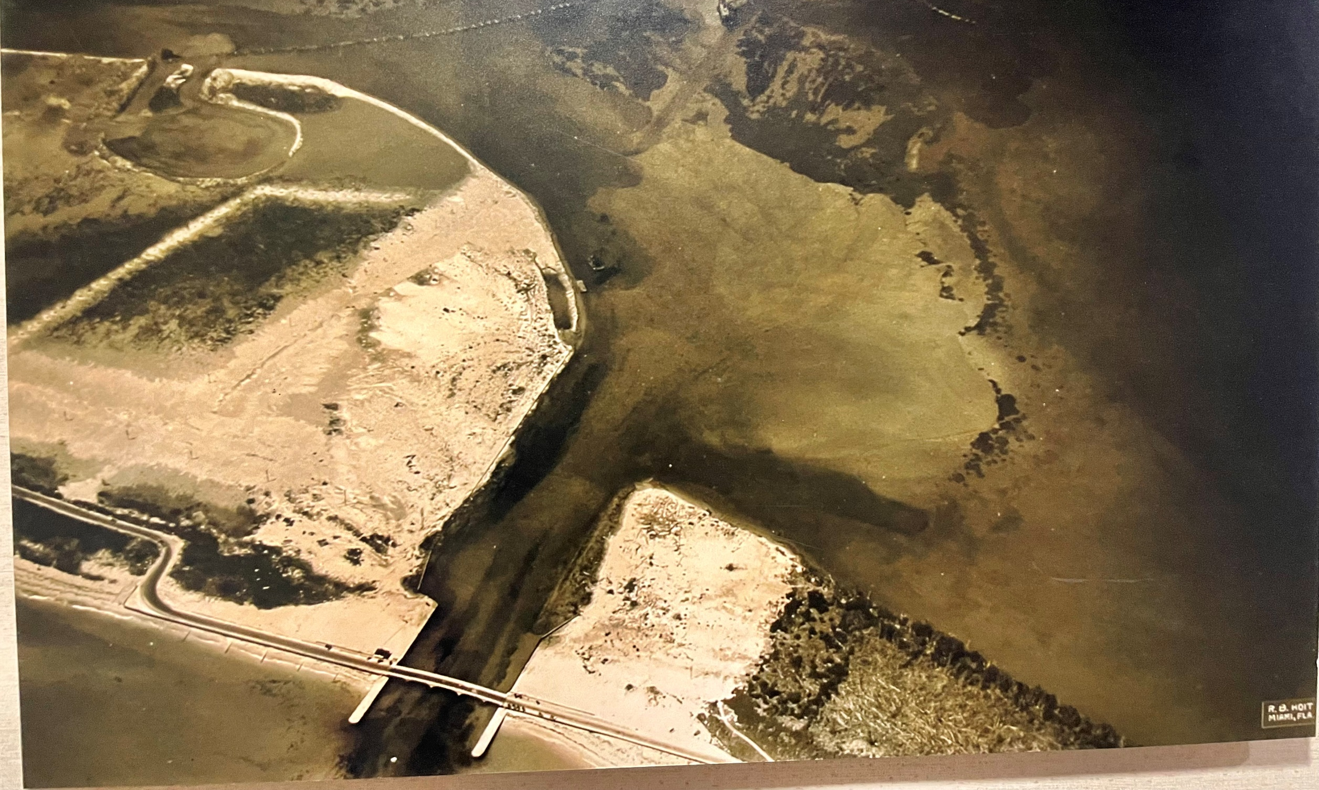
1930 picture of baker’s Haulover

Slide 4
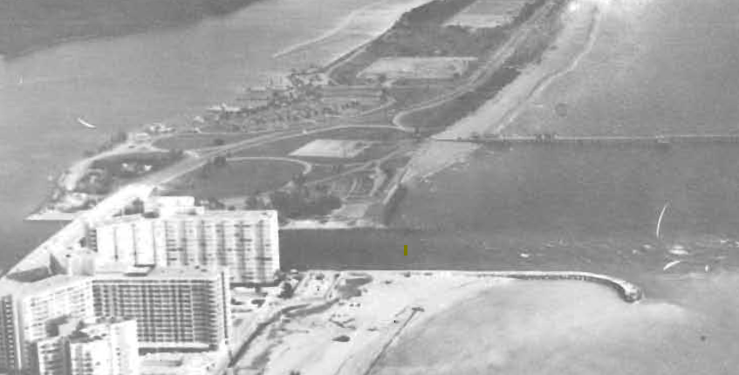
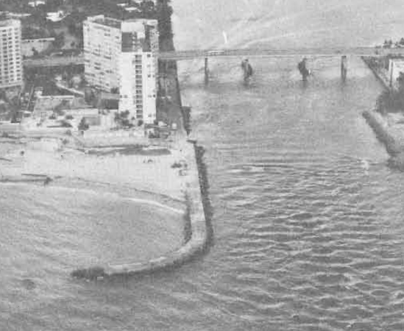
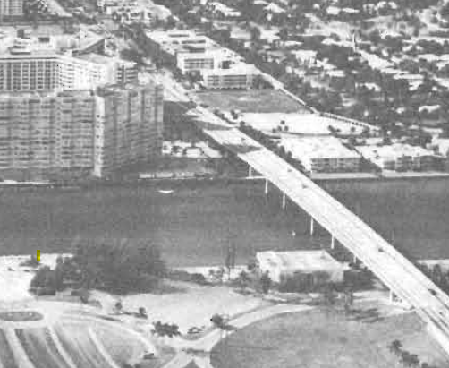
1975 General Design Memorandum Photos

Slide 5
From Planning to Application: How We Got Here
Part of a Larger Effort
Rooted in Bal Harbour’s Capital Improvement Program.
Direct outcome of the 2024 Vulnerability Assessment & Coastal Adaptation Plan.
Information Gathering
Technical studies: structural evaluations, benthic surveys, environmental reports.
Public outreach sessions shaped community priorities.
Coordination with FDEP, USACE, FWC, and Miami-Dade RER for data and permit inputs.

Slide 6
Securing Funding
The Village has been pursuing funding for this project since 2020. After five years of effort, we have now secured the majority of the resources needed to move forward.
Funding Sources:
$8.0M Resilient Florida Grant – 25%
$5.0M FIND Grants - 15%
$7.5M GOB Bond – 23%
$7.0M Resort Tax – 22%
$4.0M Developer Contribution – 13%
Appropriations – 2%

Slide 7
ALLOCATION OF FUNDING
Grant-Funded (FDEP 25SRP17)
Seawall reconstruction
Structure elevation and armoring
Construction engineering & administration
Environmental surveys, monitoring, and compliance
Coral relocation and living shoreline implementation
Other Funding
Hardscape
Shade canopies
Safety railings and access to the beach
Site furnishings and wayfinding signage
Lighting and aesthetic enhancements

Slide 8
Increasing Community Resilience
Elevates and reinforces the shoreline protection structure to meet projected storm-surge/SLR conditions.
Adds a living shoreline with coral relocation to absorb wave energy and improve habitat.
Protects Collins Ave, evacuation routes, and nearby upland assets.
Directly reduces risks identified in the Village’s vulnerability assessment.

Slide 9
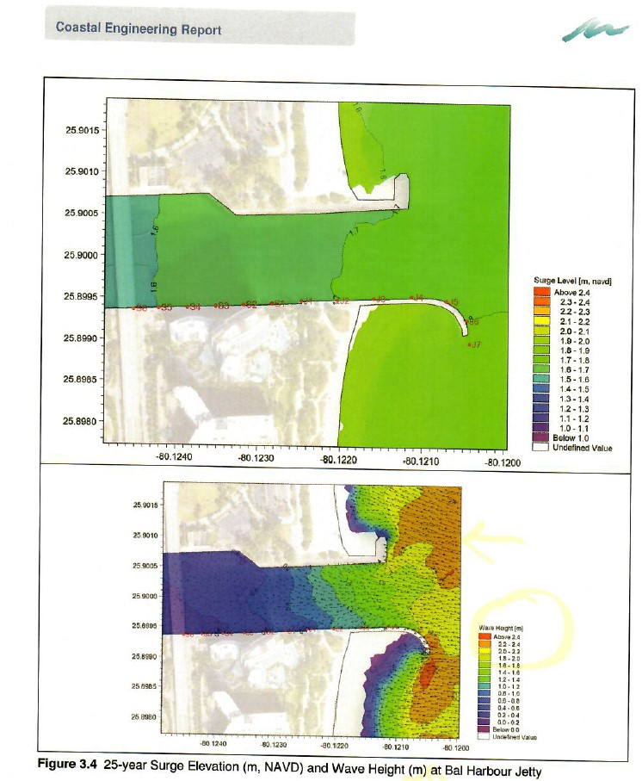
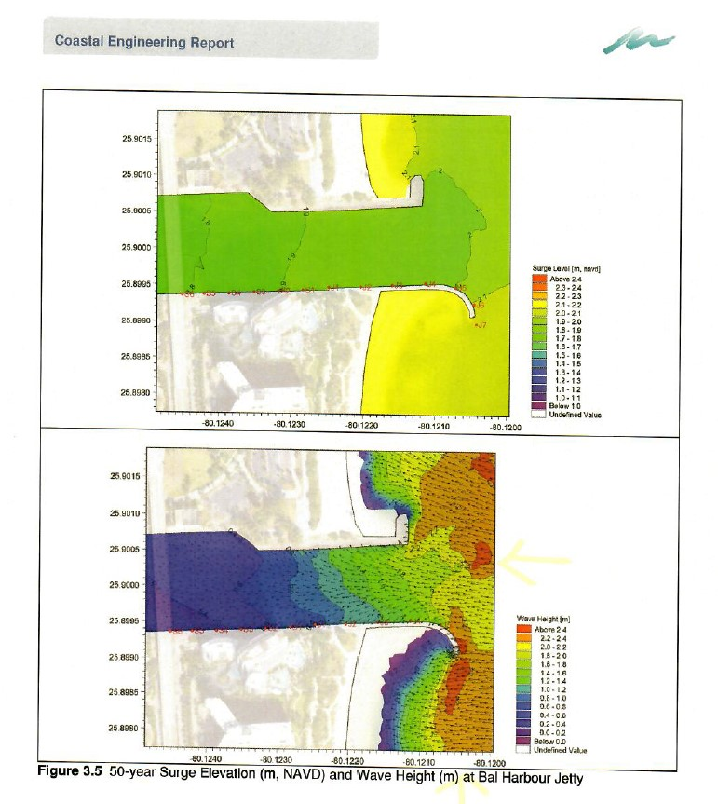
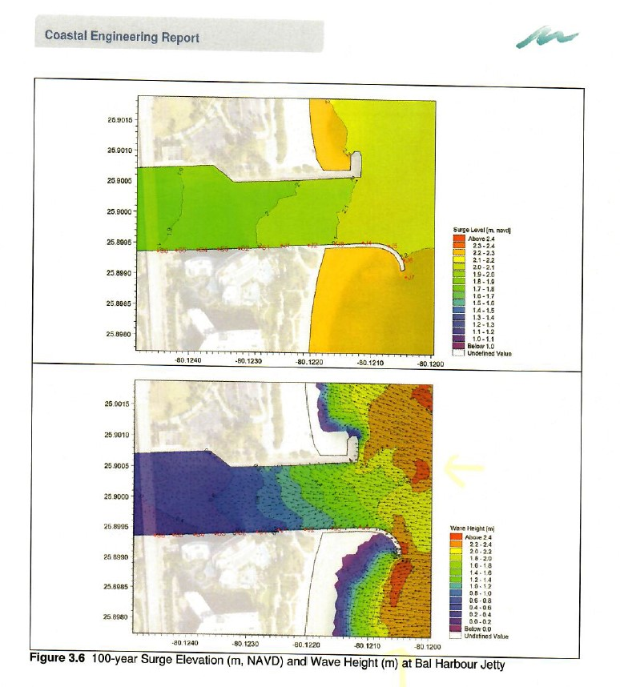
Surge Elevation (m, NAVD) and Wave Height (m)
25-yr
50-yr
100-yr
The 25-year wave height projection is 1.2-2.4 meters (equivalent to 4-8 feet).

Slide 10
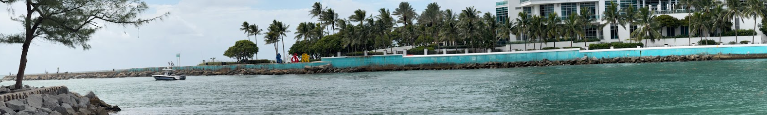
Project site EXISTING CONDITIONS

Slide 11
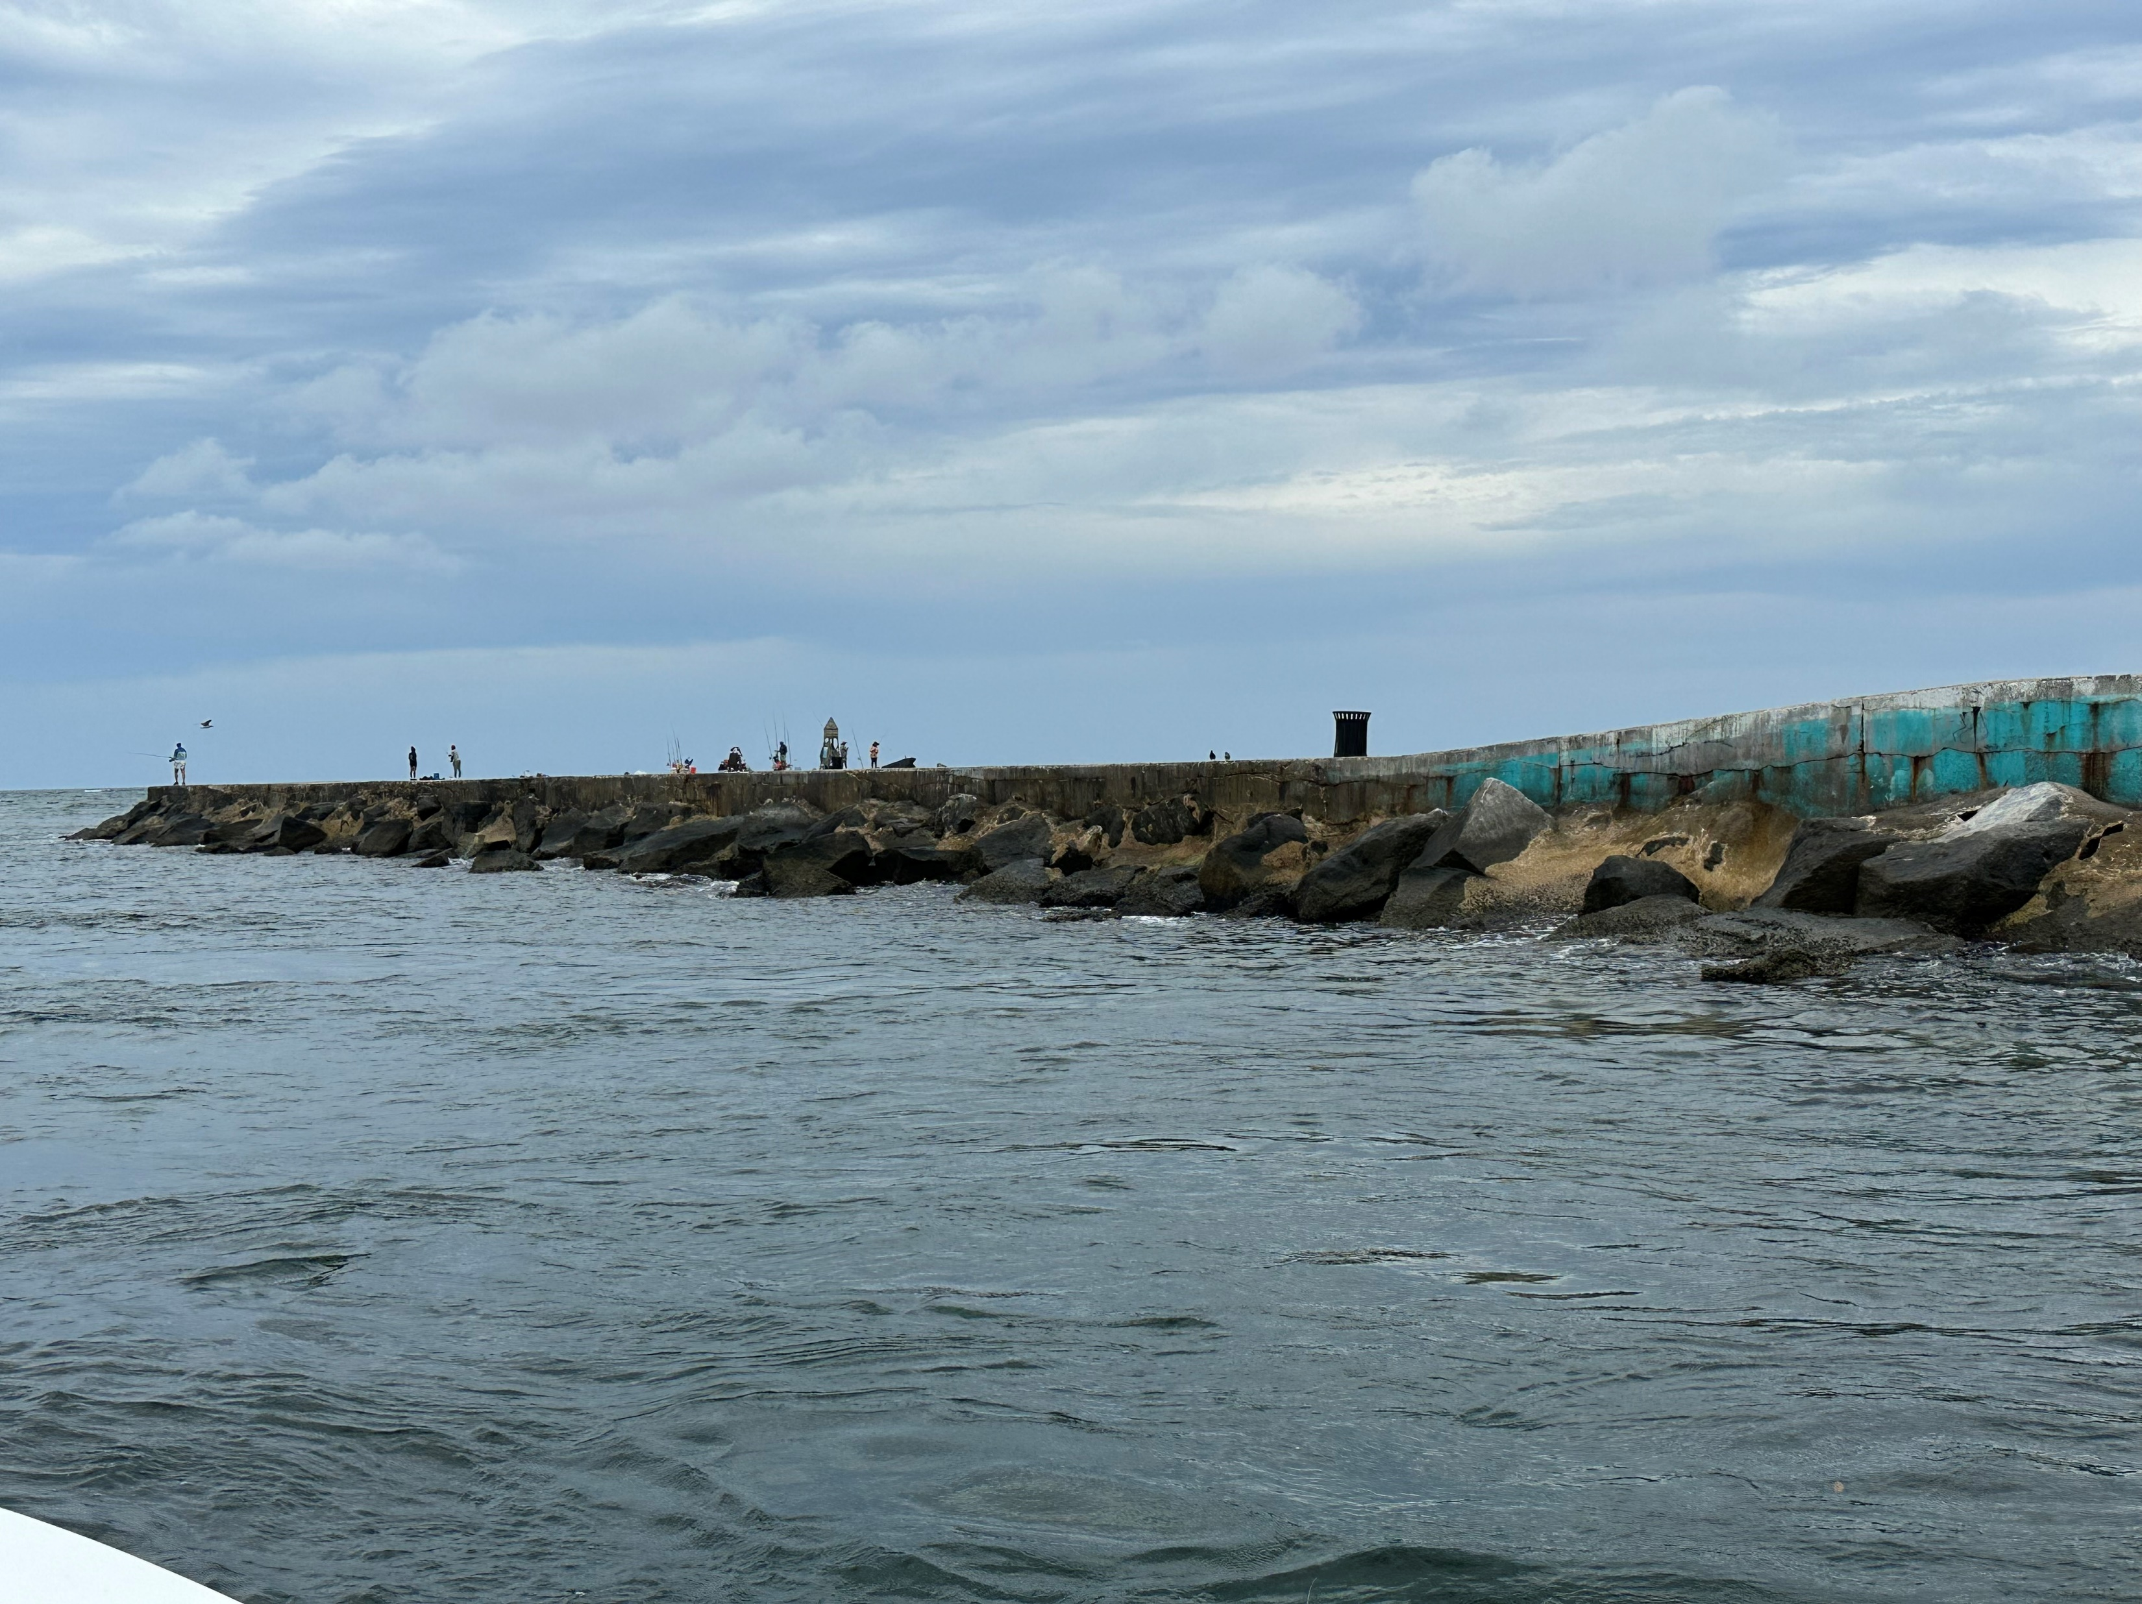
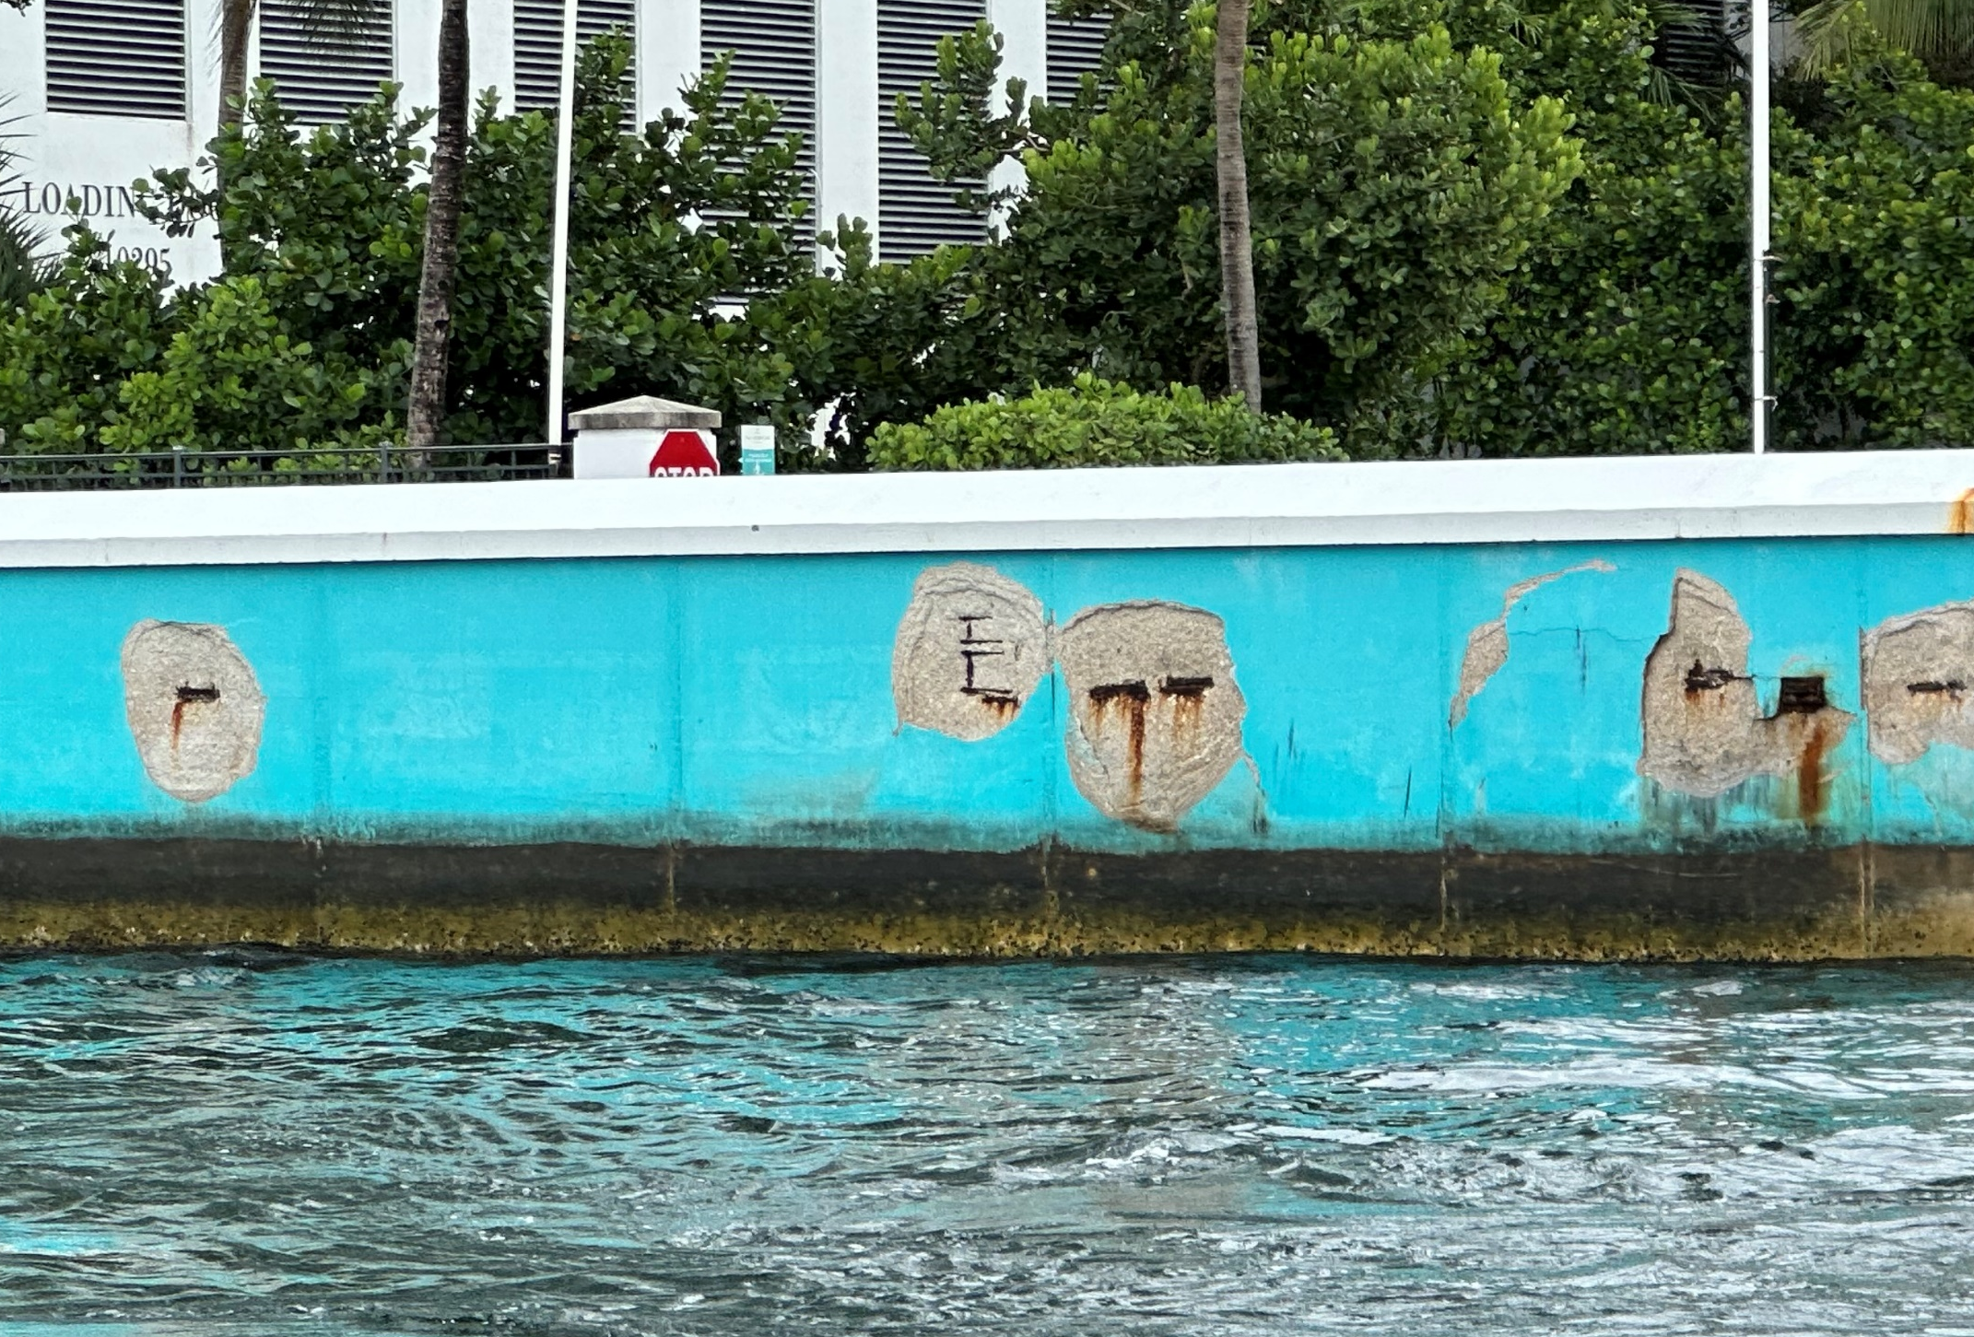
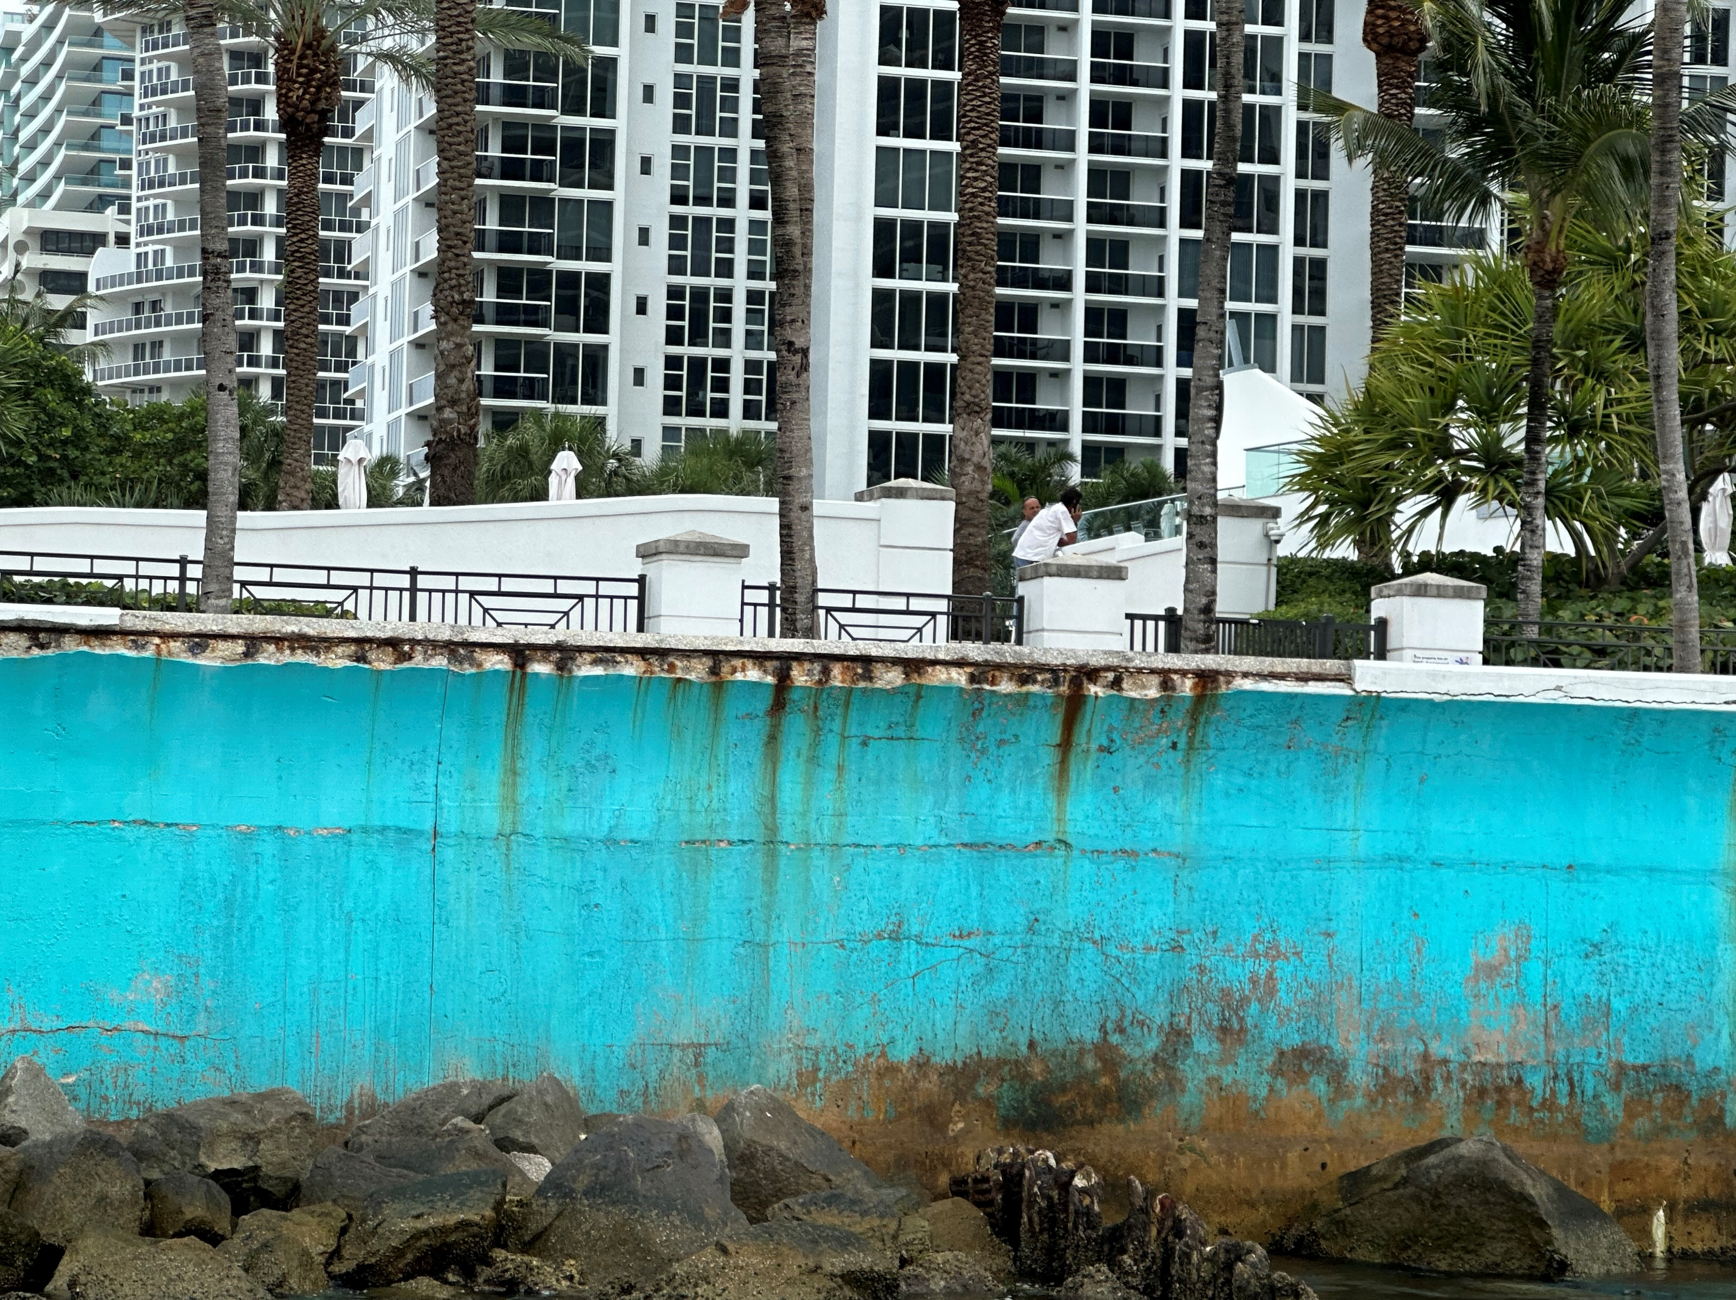
Project site EXISTING CONDITIONS

Slide 12
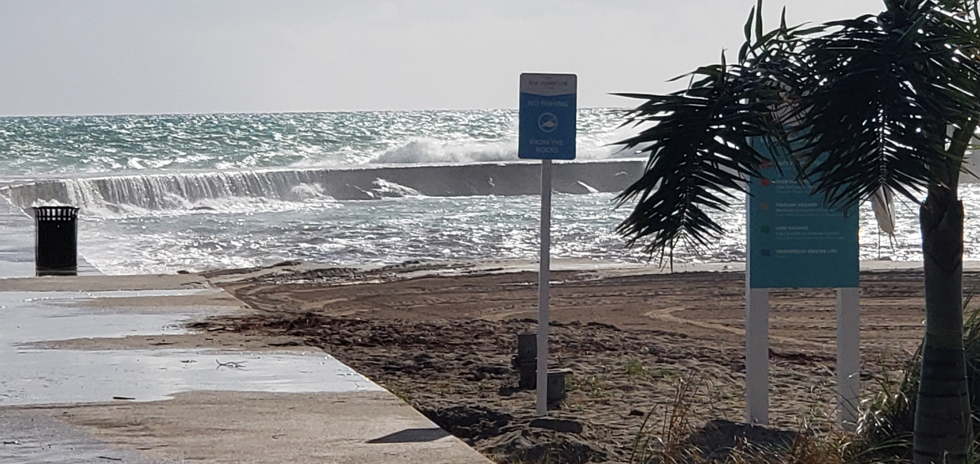
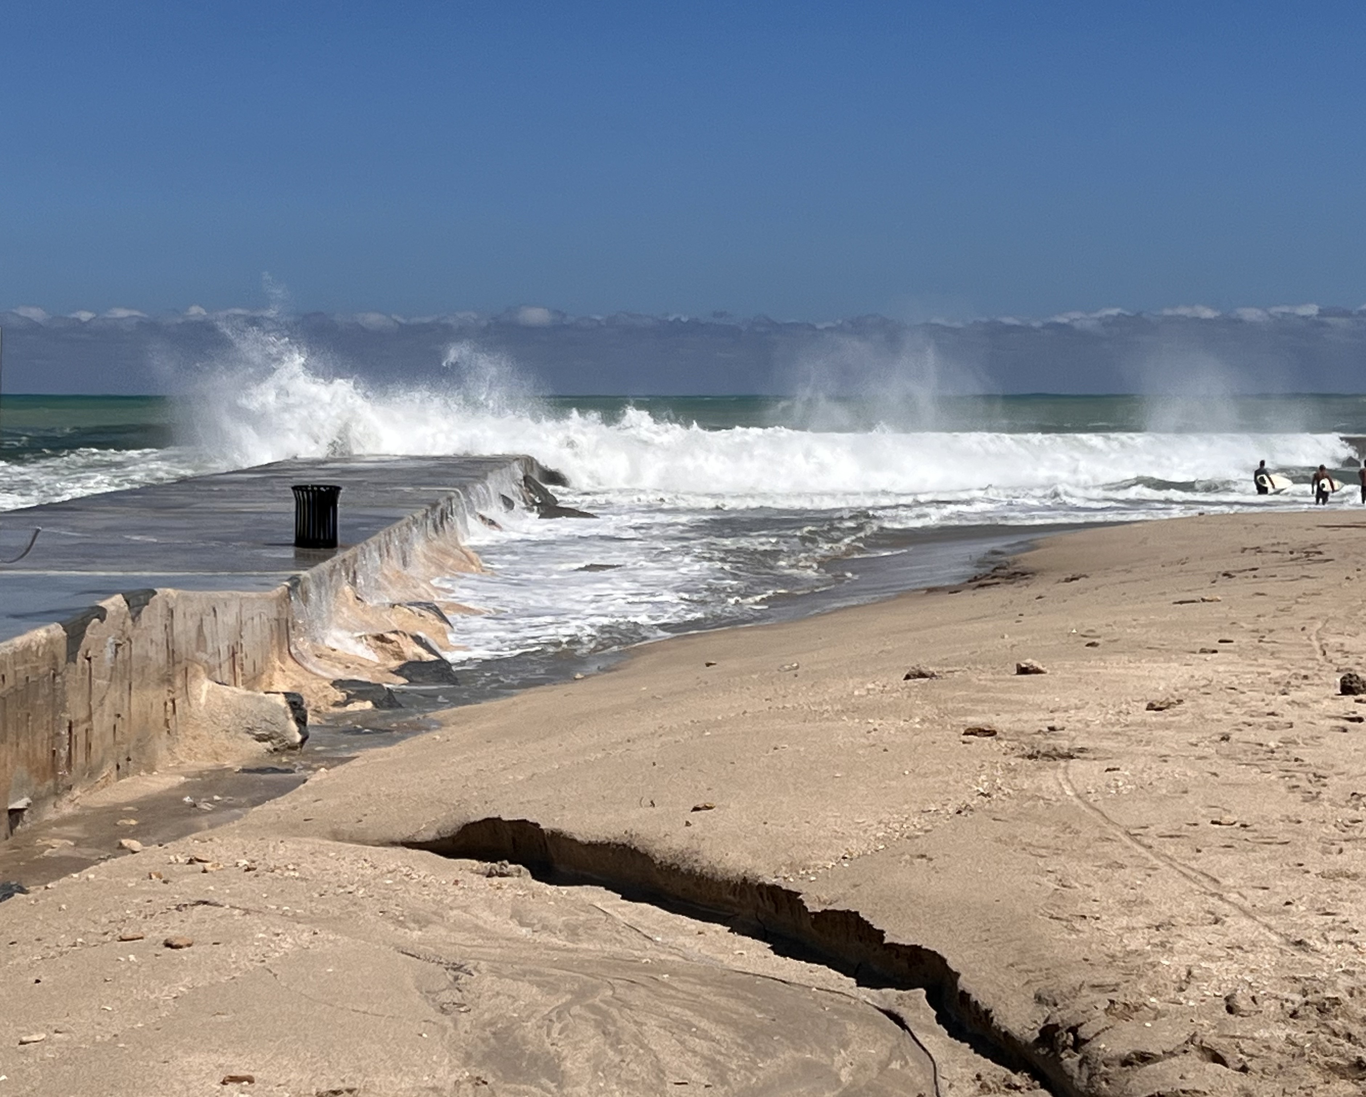
Existing conditions

Slide 13
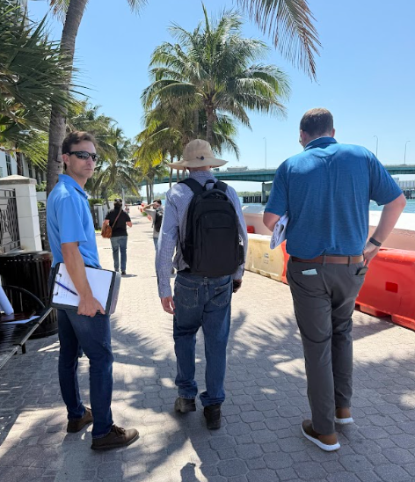
From Assessment to Innovation: How We Made It Happen
Prioritizing from the VA
Vulnerability Assessment identified Harbourfront Park as high-risk, high-priority.
Moved from VA → Adaptation Plan → shovel-ready design with permits and funding.
Collaboration Across the Village
Capital Programs, Public Works, Finance, and Legal worked in tandem.
Environmental consultants guided compliance and coral relocation.
Multi-department coordination ensured scope alignment and grant eligibility.
Innovative Approach
Hybrid structure elevation + living shoreline.
Combines engineered protection with ecological restoration.
Model for blending resilience infrastructure with environmental stewardship.

Slide 14




What We Learned & What’s Next
Key Challenges
Extensive permitting across multiple agencies required time and coordination.
Scope refinement to better integrate the living shoreline components.
Balancing resilience infrastructure with community amenities.
Lessons Learned
Early Vulnerability Assessment was critical to justify funding.
Community outreach built lasting support.
Diversified funding sources made the project possible.
Next Steps
Final design, permitting, and procurement underway now.
Construction begins early 2026.
Will deliver an elevated shoreline protection structure, living shoreline with coral relocation, and a safer, more resilient waterfront corridor.

Slide 15
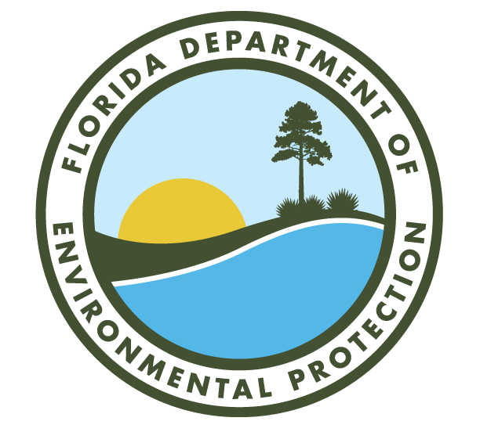

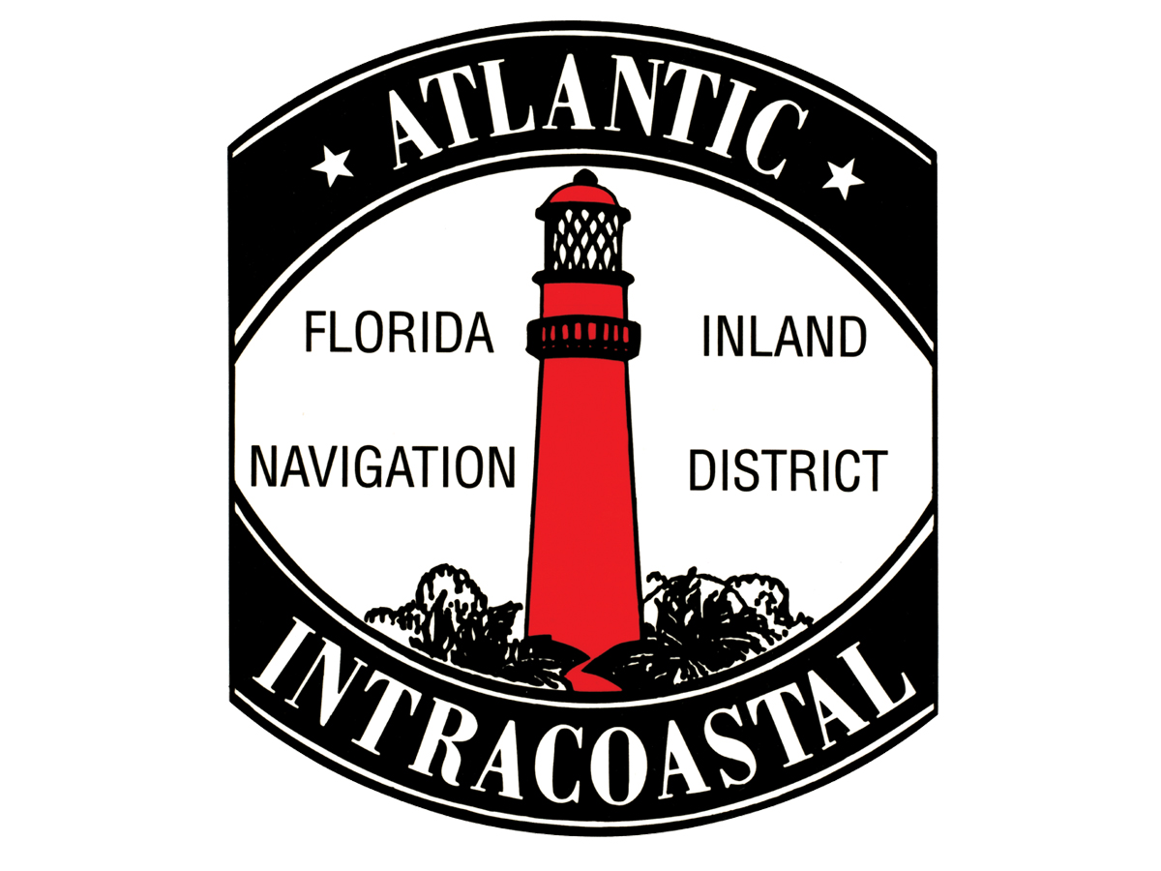

Special Thanks to

