Slide 1
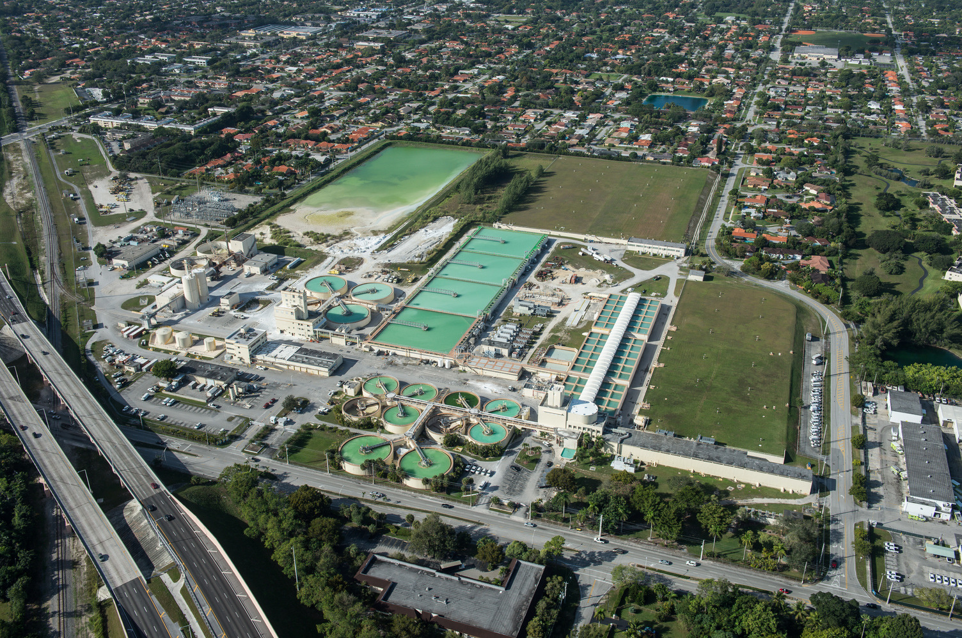
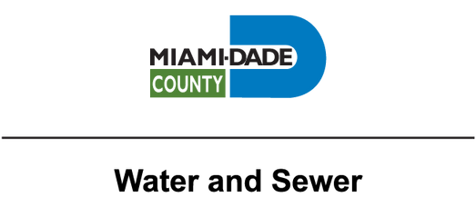

Compact Implementation Workshop:
Resilient Florida Implementation Grant Project Showcase
Debbie Griner, Chief Resilience and Sustainability Officer

Slide 2

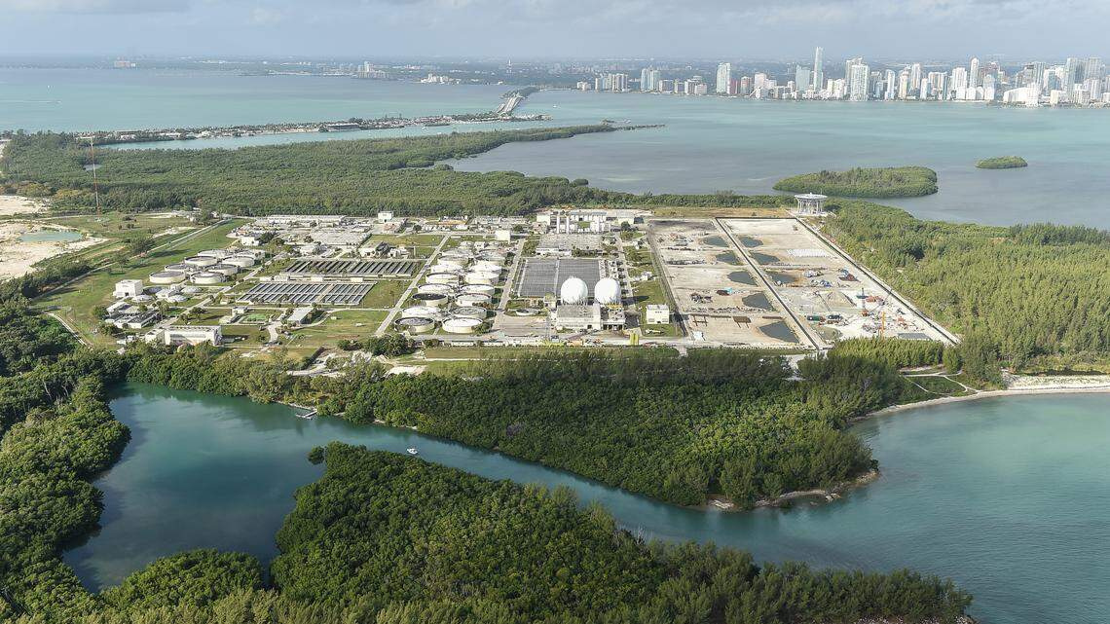

Our
Agenda
01
About Us
04
Lessons Learned
02
05
Questions
Project
Overview
03
Strategic Alignment

Slide 3
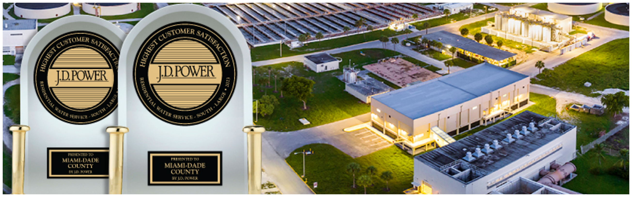


About Us
-Our Water system
300+
3
96
6,200
MGD Water Treatment
Water Treatment Plants
Production Wells
Miles of transmission and distribution
Our Wastewater system
Almost
300
3
1,000+
40
47,000
2.8
Million
Population Serviced
MGD Wastewater Treatment
Wastewater Treatment
Plants
Pump
Stations & Booster Stations
Deep Injection Wells
Miles of collection and transmission

Slide 4
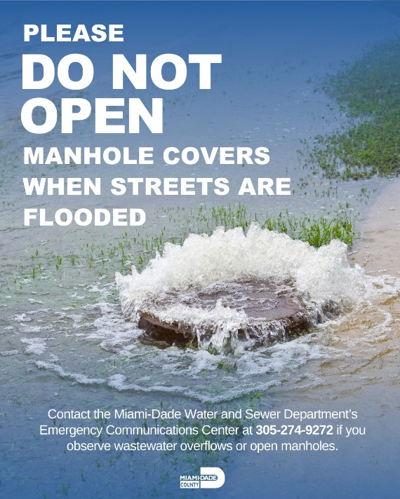
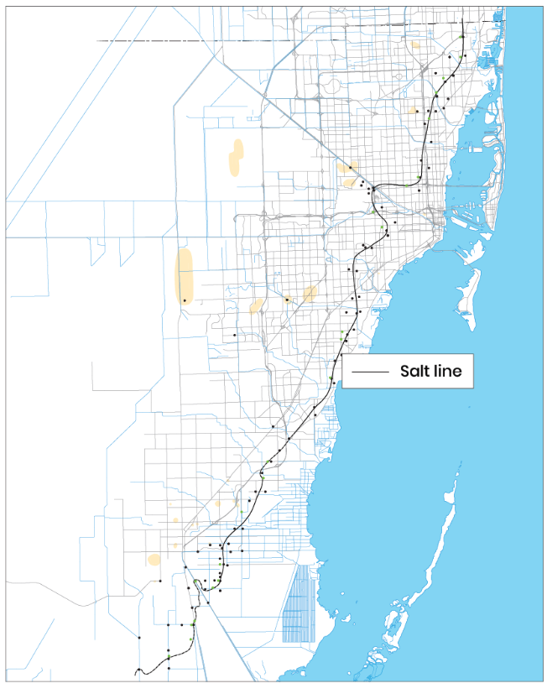
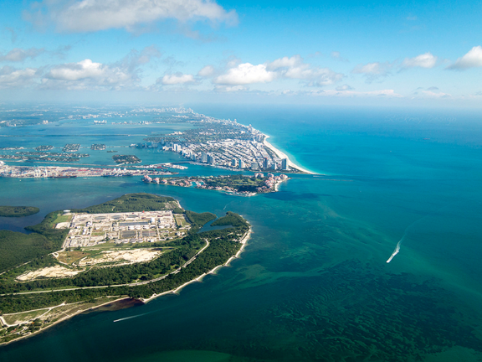
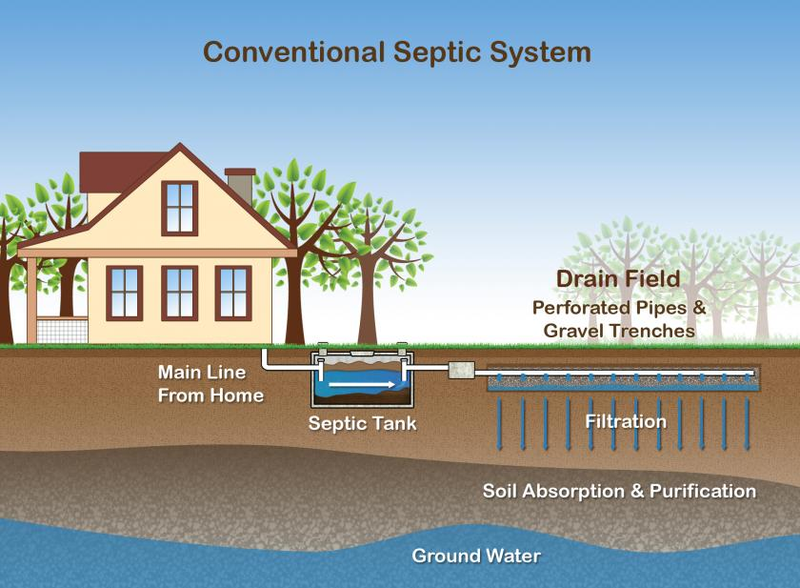
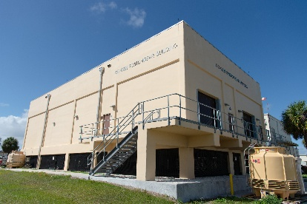
Resilient Florida Program
- a powerful tool for water utility challenges
“The legislation will yield the largest investment in Florida’s history to prepare communities for the impacts of sea level rise, intensified storms and flooding.”
Groundwater infiltration into pipes through cracks and defective joints – beyond design capacity
Stormwater inflow into the sewer collection system – beyond design capacity
Landward migration of the salt front line threatening drinking water wells
Infrastructure vulnerability to higher storm surge
Groundwater and floodwater interference with septic tank function
Inflow & Infiltration
Salt Front Line
Three Coastal Wastewater Plants
Compromised Septic Tanks
Notes:
he project addresses the vulnerability of wastewater pump stations and the collection system to flooding from high intensity rainfall events, storm surge, and seal level rise. The three pump stations addressed in this project experience flooding that impacts station operations and the ability for staff to access the station for repairs, These issues will be addressed by relocating the stations to higher elevations, converting to submersible motors, elevating electrical panels and instrumentation, and installing watertight hatches.. These resiliency measures also help to prevent sewer overflows from enhancing the continuity of service during rain events. The collection system experiences inflow and infiltration during heavy rainfall events and extreme high tide events. The project proposes to install flow meters in the collection system that conveys the wastewater to and from the pump stations, in areas impacted by rain and tidal events to provide an understanding of peak flow conditions for optimizing operations of the collection system, including pump stations, and prevent impacts that lead to sanitary sewer overflows.
lood depths for a 100-year storm event with 3.1 feet of sea level rise:
PS 407: 4.16 feet
PS 408: 1.78 feet
PS 409: 3.85 feet
Additionally, page 12 of the report indicates that PS 407 is the 12th most vulnerable “Critical Priority 2 Pump Station” at risk from sea level rise coastal and flooding alone.
Additionally, the three pump stations provide wastewater service to a total of four critical facilities including adult care service centers and educational facilities.
Pump stations 407 and 408 experience the highest severity of flooding during rain events. They have experienced flooding more than 3 times in the last three years. The Pump Station Division staff report flooding of an estimated depth greater than 1 foot in the last five years during Tropical Storms Eta (2020) and Alex (2022) and during an extended rain event in April 2023.
They also report flooding of at least 3 inches but less than a foot in the current and each of the last three calendar years, which can be seen in the photos below. Flooding lasted more than seven consecutive days following Tropical Storm Eta in 2020.
Project at 30% design when applied.
Necessary permits and easements have been identified
All permits have been applied for or at least one permit has been approved All necessary permit(s) and easement(s) have been authorized/obtained No permits or easements are required for the project
The project includes the installation of flow meters at locations along the conveyance system (collection gravity and force main pipes) to collect flow data for the purpose of detecting higher flows from stormwater inflow and infiltration into the wastewater collection system. The wastewater conveyance and pump station system are not designed to accommodate stormwater and can cause catastrophic failure of systems that lead to a sanitary sewer overflow leading to untreated sewage to spill on open ground and surface waters and may cause backup into homes and businesses. Monitoring real time conditions of flow during rain events and wet weather periods, allows for optimizing operation of the collection system to prevent these overflows. The use of these meters on the collection system is an innovative approach that can be shared with other utilities. In addition, MIami-Dade County is a member of the four-county Southeast Florida Regional Climate Change Compact. WASD can share this best practice with utilities across the four counties that are also dealing with the impacts of increased inflow and infiltration in part from rising groundwater from sea level rise.
The project addresses the vulnerability of wastewater pump stations and the collection system to flooding from high intensity rainfall events, storm surge, and seal level rise. The three pump stations addressed in this project experience flooding that impacts station operations and the ability for staff to access the station for repairs, These issues will be addressed by relocating the stations to higher elevations, converting to submersible motors, elevating electrical panels and instrumentation, and installing watertight hatches.. These resiliency measures also help to prevent sewer overflows from enhancing the continuity of service during rain events. The collection system experiences inflow and infiltration during heavy rainfall events and extreme high tide events. The project proposes to install flow meters in the collection system that conveys the wastewater to and from the pump stations, in areas impacted by rain and tidal events to provide an understanding of peak flow conditions for optimizing operations of the collection system, including pump stations, and prevent impacts that lead to sanitary sewer overflows.

Slide 5
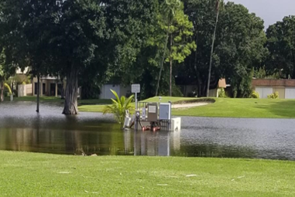
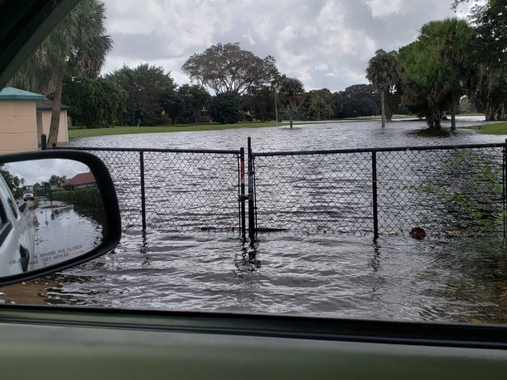
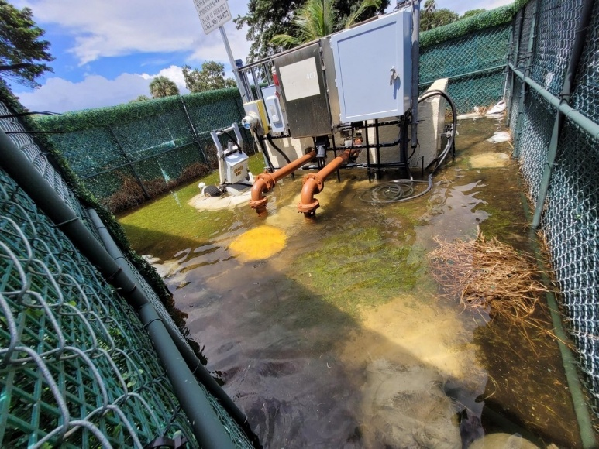
Project Overview
​25SRP13​: Harden Vulnerable Wastewater Pump Stations
Needs Addressed:
Scope of Project:
Relocate three stations vulnerable to stormwater flooding
Design to withstand SLR and storm surge through 2040.
Provide flood mitigation measures including elevating electrical panels and installing floodproof hatches.
Funding
Miami-Dade County Multi-Year Capital Plan: $3,361,000
FDEP Resilient Florida Grant
$3,361,000
Status
Finalizing Workplan
In Procurement
Prioritization: Past events, photos of impacts from
Tropical Storm Eta (‘20) and Tropical Storm Alex (‘22)
Flood vulnerability analysis of ~1,000 pump stations
Notes:
he project addresses the vulnerability of wastewater pump stations and the collection system to flooding from high intensity rainfall events, storm surge, and seal level rise. The three pump stations addressed in this project experience flooding that impacts station operations and the ability for staff to access the station for repairs, These issues will be addressed by relocating the stations to higher elevations, converting to submersible motors, elevating electrical panels and instrumentation, and installing watertight hatches.. These resiliency measures also help to prevent sewer overflows from enhancing the continuity of service during rain events. The collection system experiences inflow and infiltration during heavy rainfall events and extreme high tide events. The project proposes to install flow meters in the collection system that conveys the wastewater to and from the pump stations, in areas impacted by rain and tidal events to provide an understanding of peak flow conditions for optimizing operations of the collection system, including pump stations, and prevent impacts that lead to sanitary sewer overflows.
lood depths for a 100-year storm event with 3.1 feet of sea level rise:
PS 407: 4.16 feet
PS 408: 1.78 feet
PS 409: 3.85 feet
Additionally, page 12 of the report indicates that PS 407 is the 12th most vulnerable “Critical Priority 2 Pump Station” at risk from sea level rise coastal and flooding alone.
Additionally, the three pump stations provide wastewater service to a total of four critical facilities including adult care service centers and educational facilities.
Pump stations 407 and 408 experience the highest severity of flooding during rain events. They have experienced flooding more than 3 times in the last three years. The Pump Station Division staff report flooding of an estimated depth greater than 1 foot in the last five years during Tropical Storms Eta (2020) and Alex (2022) and during an extended rain event in April 2023.
They also report flooding of at least 3 inches but less than a foot in the current and each of the last three calendar years, which can be seen in the photos below. Flooding lasted more than seven consecutive days following Tropical Storm Eta in 2020.
Project at 30% design when applied.
Necessary permits and easements have been identified
All permits have been applied for or at least one permit has been approved All necessary permit(s) and easement(s) have been authorized/obtained No permits or easements are required for the project
The project includes the installation of flow meters at locations along the conveyance system (collection gravity and force main pipes) to collect flow data for the purpose of detecting higher flows from stormwater inflow and infiltration into the wastewater collection system. The wastewater conveyance and pump station system are not designed to accommodate stormwater and can cause catastrophic failure of systems that lead to a sanitary sewer overflow leading to untreated sewage to spill on open ground and surface waters and may cause backup into homes and businesses. Monitoring real time conditions of flow during rain events and wet weather periods, allows for optimizing operation of the collection system to prevent these overflows. The use of these meters on the collection system is an innovative approach that can be shared with other utilities. In addition, MIami-Dade County is a member of the four-county Southeast Florida Regional Climate Change Compact. WASD can share this best practice with utilities across the four counties that are also dealing with the impacts of increased inflow and infiltration in part from rising groundwater from sea level rise.
The project addresses the vulnerability of wastewater pump stations and the collection system to flooding from high intensity rainfall events, storm surge, and seal level rise. The three pump stations addressed in this project experience flooding that impacts station operations and the ability for staff to access the station for repairs, These issues will be addressed by relocating the stations to higher elevations, converting to submersible motors, elevating electrical panels and instrumentation, and installing watertight hatches.. These resiliency measures also help to prevent sewer overflows from enhancing the continuity of service during rain events. The collection system experiences inflow and infiltration during heavy rainfall events and extreme high tide events. The project proposes to install flow meters in the collection system that conveys the wastewater to and from the pump stations, in areas impacted by rain and tidal events to provide an understanding of peak flow conditions for optimizing operations of the collection system, including pump stations, and prevent impacts that lead to sanitary sewer overflows.

Slide 6
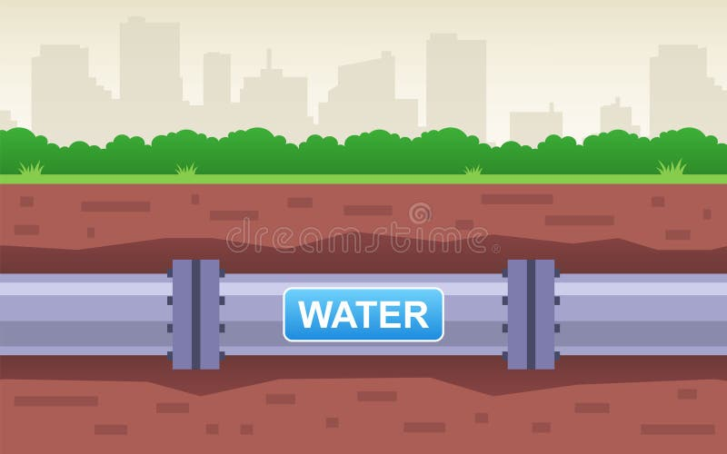
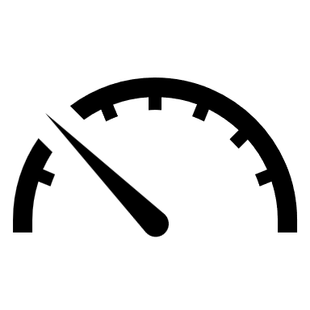
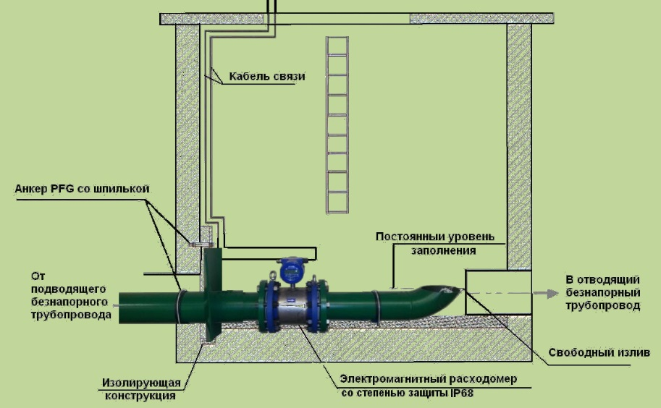
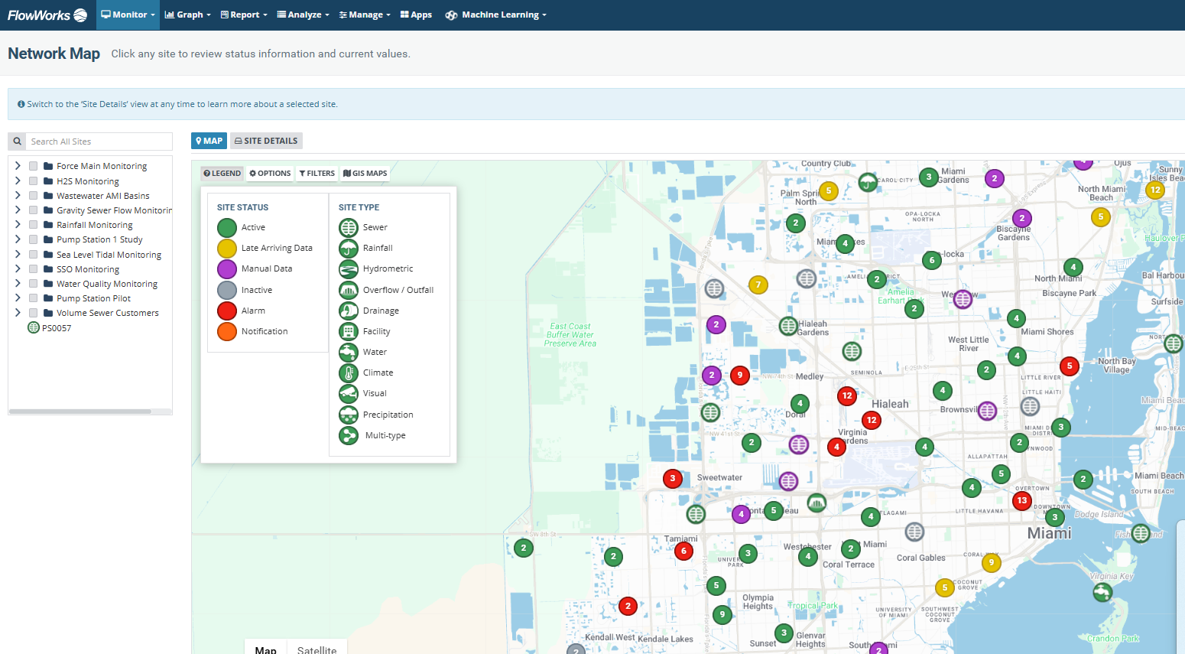
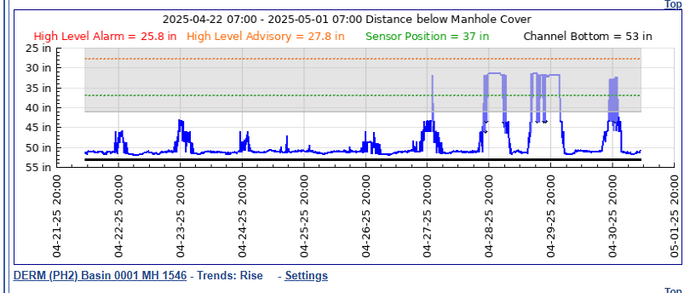
Project Overview
​25SRP13​: Real-time Flow Metering of the Sewer Collection System
Needs Addressed:
Stormwater enters the sewer collection system exceeding design capacities, which can cause sanitary sewer overflows.
Flow meters monitor levels to prevent overflows and optimize pump operations.
The system alerts staff to flow anomalies or equipment failures
Data characterizes the inflow and infiltration (I&I) in basins to understand capacities and conditions
Scope of Project:
Install ~50 additional flow meters to a network of 240 meters
Funding
Miami-Dade County Multi-Year Capital Plan: $500,000
FDEP Resilient Florida Grant: $500,000
Status
Finalizing Workplan
Responded to over 900 alerts since 2024
Significant reduction in SSOs
Notes:
he project addresses the vulnerability of wastewater pump stations and the collection system to flooding from high intensity rainfall events, storm surge, and seal level rise. The three pump stations addressed in this project experience flooding that impacts station operations and the ability for staff to access the station for repairs, These issues will be addressed by relocating the stations to higher elevations, converting to submersible motors, elevating electrical panels and instrumentation, and installing watertight hatches.. These resiliency measures also help to prevent sewer overflows from enhancing the continuity of service during rain events. The collection system experiences inflow and infiltration during heavy rainfall events and extreme high tide events. The project proposes to install flow meters in the collection system that conveys the wastewater to and from the pump stations, in areas impacted by rain and tidal events to provide an understanding of peak flow conditions for optimizing operations of the collection system, including pump stations, and prevent impacts that lead to sanitary sewer overflows.
lood depths for a 100-year storm event with 3.1 feet of sea level rise:
PS 407: 4.16 feet
PS 408: 1.78 feet
PS 409: 3.85 feet
Additionally, page 12 of the report indicates that PS 407 is the 12th most vulnerable “Critical Priority 2 Pump Station” at risk from sea level rise coastal and flooding alone.
Additionally, the three pump stations provide wastewater service to a total of four critical facilities including adult care service centers and educational facilities.
Pump stations 407 and 408 experience the highest severity of flooding during rain events. They have experienced flooding more than 3 times in the last three years. The Pump Station Division staff report flooding of an estimated depth greater than 1 foot in the last five years during Tropical Storms Eta (2020) and Alex (2022) and during an extended rain event in April 2023.
They also report flooding of at least 3 inches but less than a foot in the current and each of the last three calendar years, which can be seen in the photos below. Flooding lasted more than seven consecutive days following Tropical Storm Eta in 2020.
Project at 30% design when applied.
Necessary permits and easements have been identified
All permits have been applied for or at least one permit has been approved All necessary permit(s) and easement(s) have been authorized/obtained No permits or easements are required for the project
The project includes the installation of flow meters at locations along the conveyance system (collection gravity and force main pipes) to collect flow data for the purpose of detecting higher flows from stormwater inflow and infiltration into the wastewater collection system. The wastewater conveyance and pump station system are not designed to accommodate stormwater and can cause catastrophic failure of systems that lead to a sanitary sewer overflow leading to untreated sewage to spill on open ground and surface waters and may cause backup into homes and businesses. Monitoring real time conditions of flow during rain events and wet weather periods, allows for optimizing operation of the collection system to prevent these overflows. The use of these meters on the collection system is an innovative approach that can be shared with other utilities. In addition, MIami-Dade County is a member of the four-county Southeast Florida Regional Climate Change Compact. WASD can share this best practice with utilities across the four counties that are also dealing with the impacts of increased inflow and infiltration in part from rising groundwater from sea level rise.
The project addresses the vulnerability of wastewater pump stations and the collection system to flooding from high intensity rainfall events, storm surge, and seal level rise. The three pump stations addressed in this project experience flooding that impacts station operations and the ability for staff to access the station for repairs, These issues will be addressed by relocating the stations to higher elevations, converting to submersible motors, elevating electrical panels and instrumentation, and installing watertight hatches.. These resiliency measures also help to prevent sewer overflows from enhancing the continuity of service during rain events. The collection system experiences inflow and infiltration during heavy rainfall events and extreme high tide events. The project proposes to install flow meters in the collection system that conveys the wastewater to and from the pump stations, in areas impacted by rain and tidal events to provide an understanding of peak flow conditions for optimizing operations of the collection system, including pump stations, and prevent impacts that lead to sanitary sewer overflows.

Slide 7
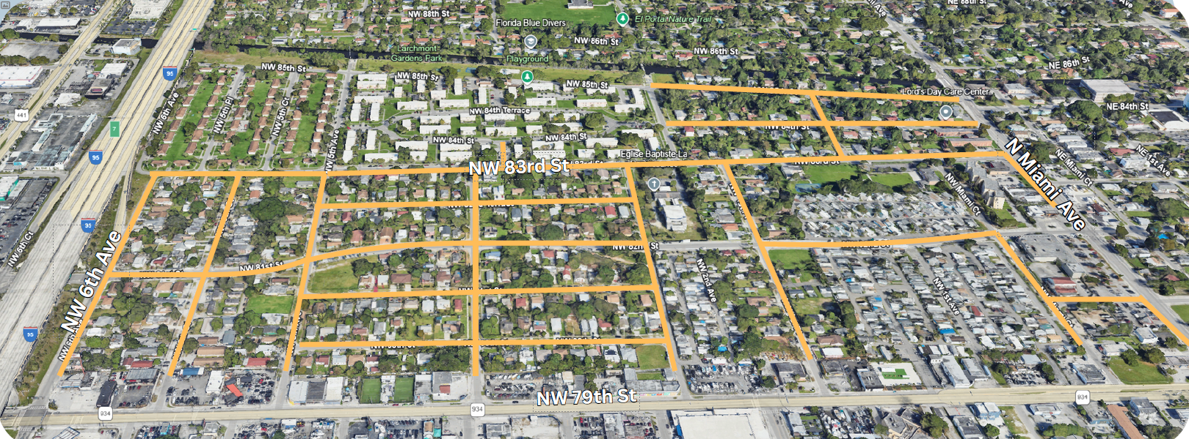
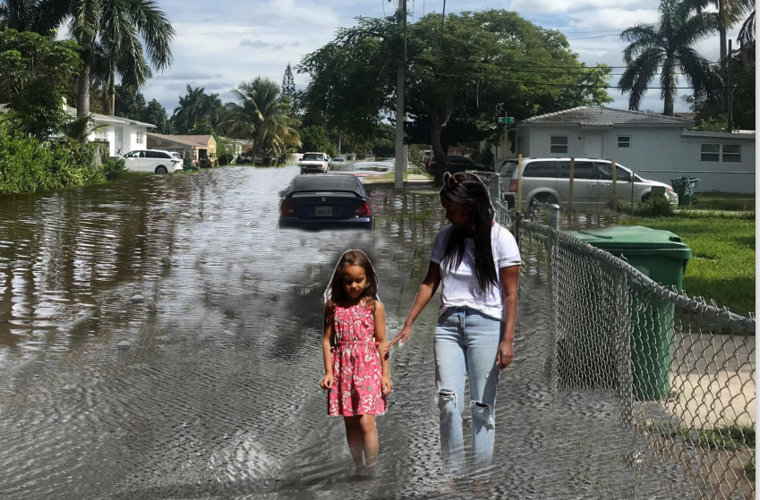
Project Overview
22FRP60: Connect 2 Protect Sewer Conversion
Needs Addressed:
Scope of Project:
Sewer expansion to ~370 homes in the Little River Adaptation Action Area Connect the private properties
Sewer expansion to key commercial corridors
Funding
Miami-Dade County Building Better Communities General Obligation Bond - $27.5M
FDEP Resilient Florida Grant - $27.5M
FDEP Biscayne Bay Water Quality Improvement Grant – private connections
When it rains, we have to go stay with our aunt. The plumbing backs up into the house and the shower every time – so we just leave.”
“We spend $275 at least twice a year to have our septic system pumped out. It works for a few days but then the problems come right back.”
Status
In construction – 37 homes connected
C-7 Little River Canal
Prioritization & Innovation: groundwater modeling performed to identify compromised systems
9,000 currently
14,000 by 2040 w/ SLR
Notes:
he project addresses the vulnerability of wastewater pump stations and the collection system to flooding from high intensity rainfall events, storm surge, and seal level rise. The three pump stations addressed in this project experience flooding that impacts station operations and the ability for staff to access the station for repairs, These issues will be addressed by relocating the stations to higher elevations, converting to submersible motors, elevating electrical panels and instrumentation, and installing watertight hatches.. These resiliency measures also help to prevent sewer overflows from enhancing the continuity of service during rain events. The collection system experiences inflow and infiltration during heavy rainfall events and extreme high tide events. The project proposes to install flow meters in the collection system that conveys the wastewater to and from the pump stations, in areas impacted by rain and tidal events to provide an understanding of peak flow conditions for optimizing operations of the collection system, including pump stations, and prevent impacts that lead to sanitary sewer overflows.
lood depths for a 100-year storm event with 3.1 feet of sea level rise:
PS 407: 4.16 feet
PS 408: 1.78 feet
PS 409: 3.85 feet
Additionally, page 12 of the report indicates that PS 407 is the 12th most vulnerable “Critical Priority 2 Pump Station” at risk from sea level rise coastal and flooding alone.
Additionally, the three pump stations provide wastewater service to a total of four critical facilities including adult care service centers and educational facilities.
Pump stations 407 and 408 experience the highest severity of flooding during rain events. They have experienced flooding more than 3 times in the last three years. The Pump Station Division staff report flooding of an estimated depth greater than 1 foot in the last five years during Tropical Storms Eta (2020) and Alex (2022) and during an extended rain event in April 2023.
They also report flooding of at least 3 inches but less than a foot in the current and each of the last three calendar years, which can be seen in the photos below. Flooding lasted more than seven consecutive days following Tropical Storm Eta in 2020.
Project at 30% design when applied.
Necessary permits and easements have been identified
All permits have been applied for or at least one permit has been approved All necessary permit(s) and easement(s) have been authorized/obtained No permits or easements are required for the project
The project includes the installation of flow meters at locations along the conveyance system (collection gravity and force main pipes) to collect flow data for the purpose of detecting higher flows from stormwater inflow and infiltration into the wastewater collection system. The wastewater conveyance and pump station system are not designed to accommodate stormwater and can cause catastrophic failure of systems that lead to a sanitary sewer overflow leading to untreated sewage to spill on open ground and surface waters and may cause backup into homes and businesses. Monitoring real time conditions of flow during rain events and wet weather periods, allows for optimizing operation of the collection system to prevent these overflows. The use of these meters on the collection system is an innovative approach that can be shared with other utilities. In addition, MIami-Dade County is a member of the four-county Southeast Florida Regional Climate Change Compact. WASD can share this best practice with utilities across the four counties that are also dealing with the impacts of increased inflow and infiltration in part from rising groundwater from sea level rise.
The project addresses the vulnerability of wastewater pump stations and the collection system to flooding from high intensity rainfall events, storm surge, and seal level rise. The three pump stations addressed in this project experience flooding that impacts station operations and the ability for staff to access the station for repairs, These issues will be addressed by relocating the stations to higher elevations, converting to submersible motors, elevating electrical panels and instrumentation, and installing watertight hatches.. These resiliency measures also help to prevent sewer overflows from enhancing the continuity of service during rain events. The collection system experiences inflow and infiltration during heavy rainfall events and extreme high tide events. The project proposes to install flow meters in the collection system that conveys the wastewater to and from the pump stations, in areas impacted by rain and tidal events to provide an understanding of peak flow conditions for optimizing operations of the collection system, including pump stations, and prevent impacts that lead to sanitary sewer overflows.

Slide 8
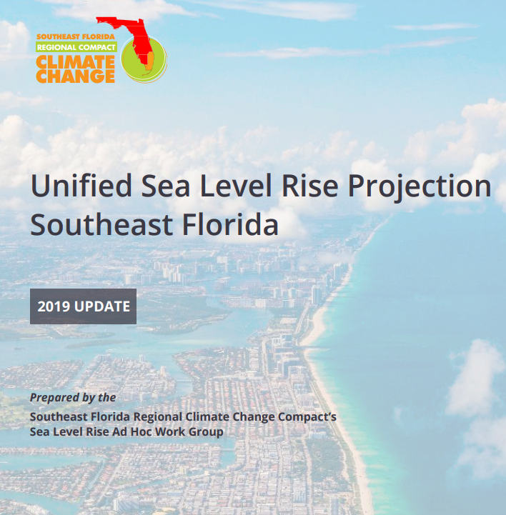

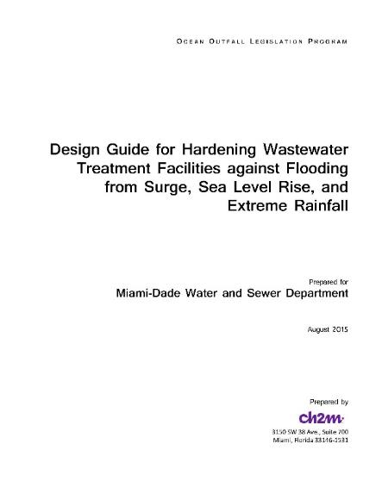


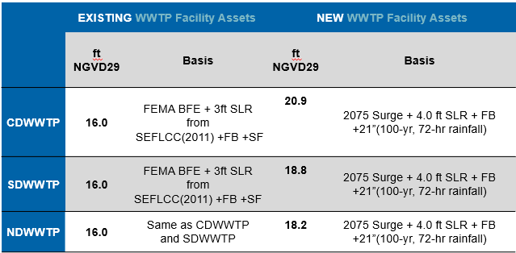



Strategic Alignment
- Regional Climate Action Plan
County resolution requiring consideration of Unified SLR Projection in all infrastructure project phases. Results in projects that already include flood mitigation measures – potential grant projects.
Vulnerability assessments of water and sewer assets including storm surge, SLR, and future precipitation (rain-derived I&I)
Established design flood elevations and hardening guidance for use in all infrastructure design projects.
County resolution requiring application of sustainability rating systems (Envision and LEED) in all infrastructure project phases – criteria requires consideration of green infrastructure and net zero strategies.
Notes:
he project addresses the vulnerability of wastewater pump stations and the collection system to flooding from high intensity rainfall events, storm surge, and seal level rise. The three pump stations addressed in this project experience flooding that impacts station operations and the ability for staff to access the station for repairs, These issues will be addressed by relocating the stations to higher elevations, converting to submersible motors, elevating electrical panels and instrumentation, and installing watertight hatches.. These resiliency measures also help to prevent sewer overflows from enhancing the continuity of service during rain events. The collection system experiences inflow and infiltration during heavy rainfall events and extreme high tide events. The project proposes to install flow meters in the collection system that conveys the wastewater to and from the pump stations, in areas impacted by rain and tidal events to provide an understanding of peak flow conditions for optimizing operations of the collection system, including pump stations, and prevent impacts that lead to sanitary sewer overflows.
lood depths for a 100-year storm event with 3.1 feet of sea level rise:
PS 407: 4.16 feet
PS 408: 1.78 feet
PS 409: 3.85 feet
Additionally, page 12 of the report indicates that PS 407 is the 12th most vulnerable “Critical Priority 2 Pump Station” at risk from sea level rise coastal and flooding alone.
Additionally, the three pump stations provide wastewater service to a total of four critical facilities including adult care service centers and educational facilities.
Pump stations 407 and 408 experience the highest severity of flooding during rain events. They have experienced flooding more than 3 times in the last three years. The Pump Station Division staff report flooding of an estimated depth greater than 1 foot in the last five years during Tropical Storms Eta (2020) and Alex (2022) and during an extended rain event in April 2023.
They also report flooding of at least 3 inches but less than a foot in the current and each of the last three calendar years, which can be seen in the photos below. Flooding lasted more than seven consecutive days following Tropical Storm Eta in 2020.
Project at 30% design when applied.
Necessary permits and easements have been identified
All permits have been applied for or at least one permit has been approved All necessary permit(s) and easement(s) have been authorized/obtained No permits or easements are required for the project
The project includes the installation of flow meters at locations along the conveyance system (collection gravity and force main pipes) to collect flow data for the purpose of detecting higher flows from stormwater inflow and infiltration into the wastewater collection system. The wastewater conveyance and pump station system are not designed to accommodate stormwater and can cause catastrophic failure of systems that lead to a sanitary sewer overflow leading to untreated sewage to spill on open ground and surface waters and may cause backup into homes and businesses. Monitoring real time conditions of flow during rain events and wet weather periods, allows for optimizing operation of the collection system to prevent these overflows. The use of these meters on the collection system is an innovative approach that can be shared with other utilities. In addition, MIami-Dade County is a member of the four-county Southeast Florida Regional Climate Change Compact. WASD can share this best practice with utilities across the four counties that are also dealing with the impacts of increased inflow and infiltration in part from rising groundwater from sea level rise.
The project addresses the vulnerability of wastewater pump stations and the collection system to flooding from high intensity rainfall events, storm surge, and seal level rise. The three pump stations addressed in this project experience flooding that impacts station operations and the ability for staff to access the station for repairs, These issues will be addressed by relocating the stations to higher elevations, converting to submersible motors, elevating electrical panels and instrumentation, and installing watertight hatches.. These resiliency measures also help to prevent sewer overflows from enhancing the continuity of service during rain events. The collection system experiences inflow and infiltration during heavy rainfall events and extreme high tide events. The project proposes to install flow meters in the collection system that conveys the wastewater to and from the pump stations, in areas impacted by rain and tidal events to provide an understanding of peak flow conditions for optimizing operations of the collection system, including pump stations, and prevent impacts that lead to sanitary sewer overflows.

Slide 9
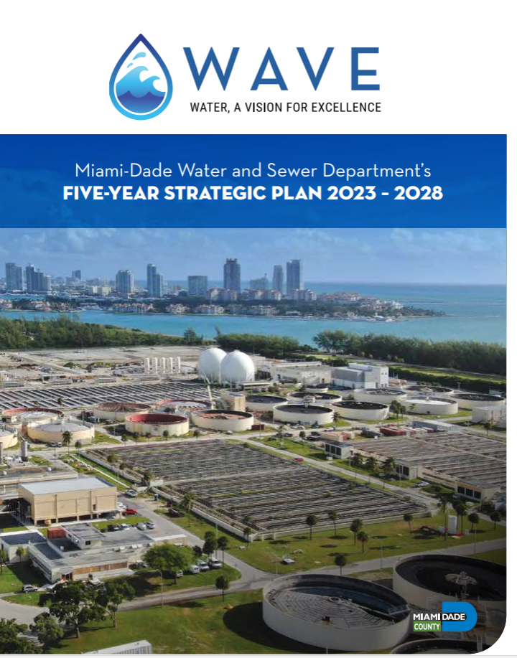
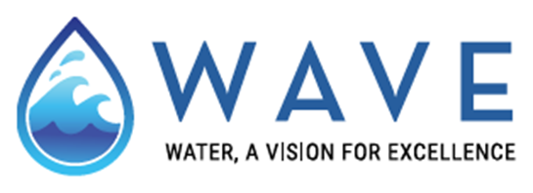
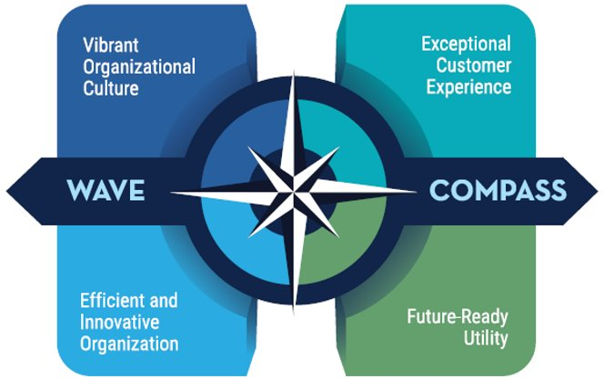
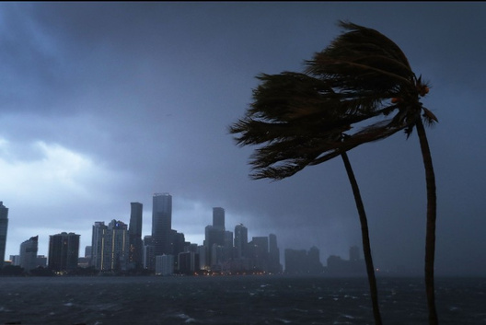

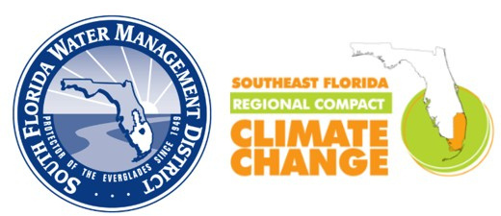

Strategic Alignment
- Resilience as a formalized strategic driver
Future-Ready Utility
We prepare for tomorrow’s challenges—today. FRU focuses on long-term resilience, from climate readiness to emergency planning. It’s about keeping our infrastructure strong and our community safe for generations to come
Each Cardinal Direction on the WAVE Compass represents a core part of WASD’s strategy. Together, they help us stay on course—even during times of change.
GOAL #1
GOAL #2
GOAL #3
Maintain essential levels of service in the face of emergencies and dynamic future conditions.
Build nimble and robust financial systems to support changing community needs and diversify revenue sources.
Utilize a “One Water” approach to sustainability, environmental stewardship, and regional partnerships and policies.

Slide 10
Lessons Learned
Ensure consensus on the project scope, schedule and budget – engage early
Leverage other efforts and data sources to identify projects (capital plans, condition assessments, risk and resilience assessments for utilities, FEMA damage reimbursements, LMS)
Prioritize based on “readiness”
Consider projects at 30-60% design and request only construction dollars
Avoid projects requiring land purchase or easements
Understand all approvals required, i.e. internal and external board approvals
Establish clear roles and develop tools, communicate regularly with PM’s and leadership
Participate in project management meetings and review scopes of work for contractors
Many projects have co-benefits that can garner broad support
The power of alignment with regional partners and strategic policy can not be overstated
Notes:
(project summary sheets, sharepoin doc management, and slides of requirements)
What type of project, where is it located, what are the total project costs and how much is your FDEP grant covering?
What did you use as a match?
How is this project increasing resilience for your community?
Is this project part of a larger planning effort or initiative (e.g. CIP, AAA, etc?)
How did your community go about gathering information for the application?
How is your jurisdiction prioritizing projects from your vulnerability assessment, and what steps were taken to progress from the VA to a shovel ready project?
How did you coordinate with other departments to develop this project?
Is there anything innovative about this project?
Describe the key challenges & takeaways/lessons learned

Slide 11

Questions
Thank You!
Contact Us
Email
Debbie.Griner@miamidade.gov
Notes:
QR code that links to WS website

