Slide 1
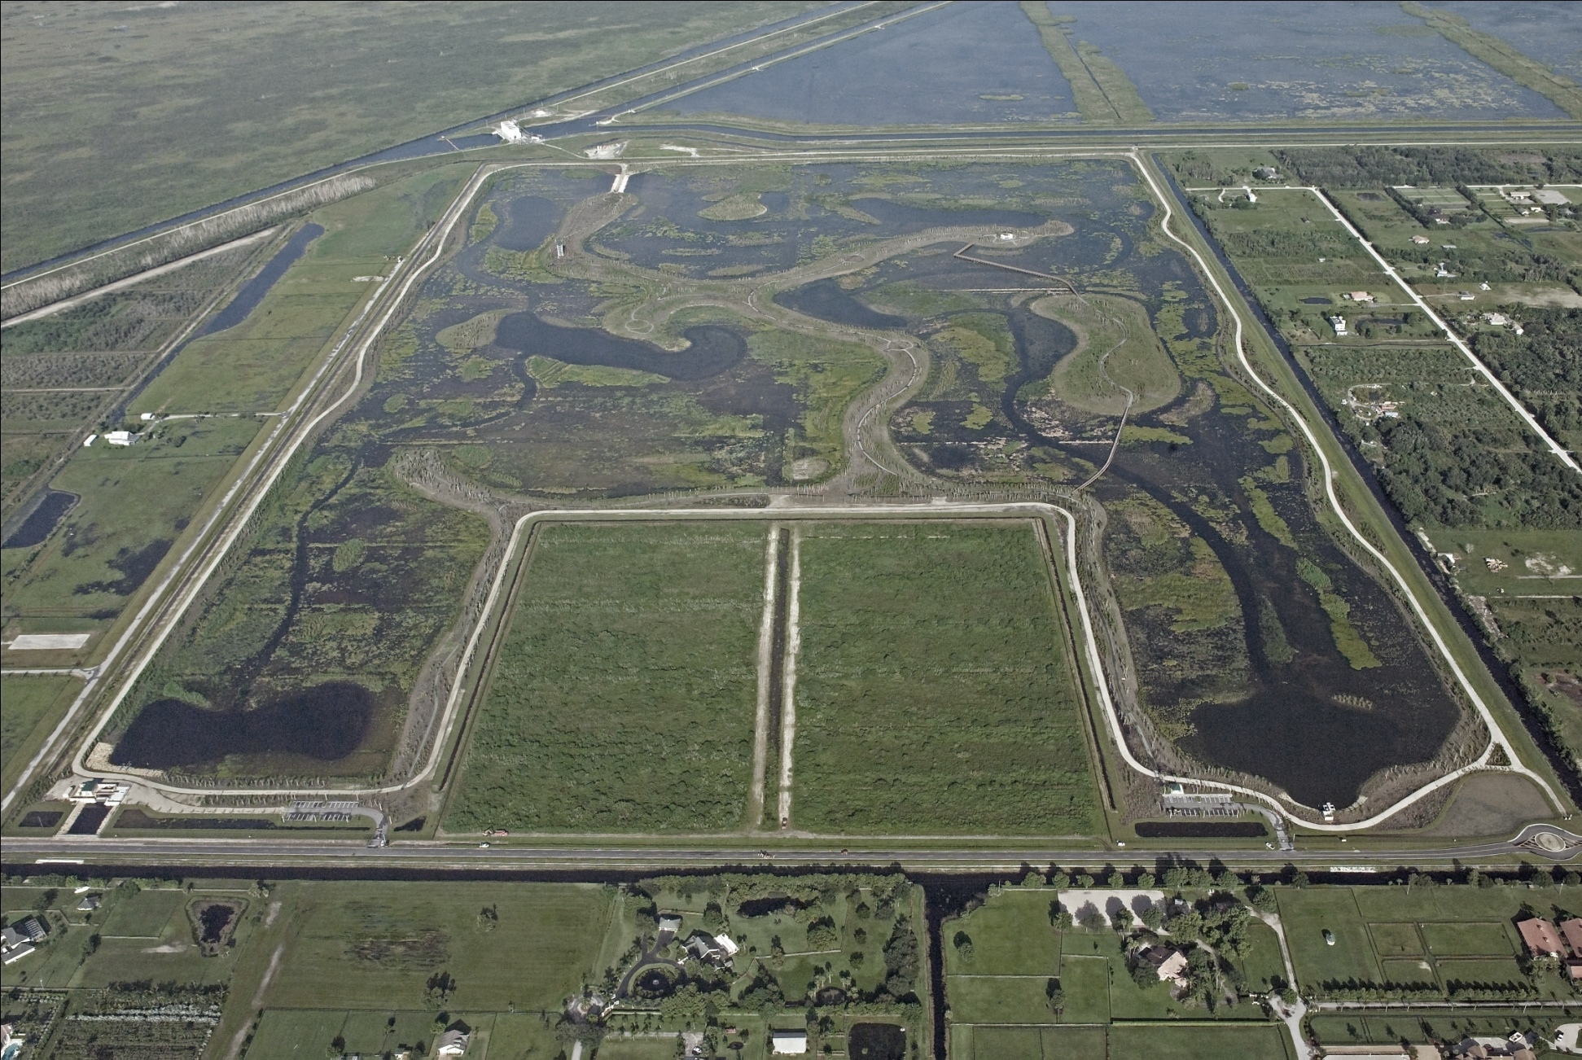

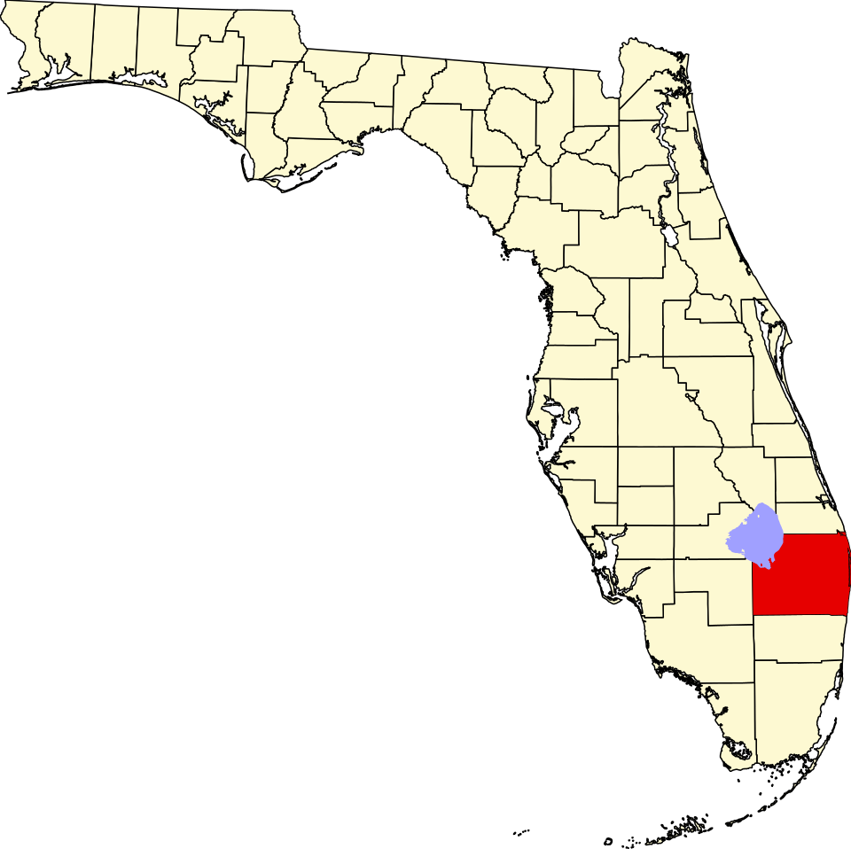

WELLINGTON ENVIRONMENTAL PRESERVE EXPANSION (An Everglades Restoration Project)
Existing
Preserve
Preserve
Expansion
Project
Flying Cow Road
N
Notes:
Introduce the project as part of Wellington’s long-term investment in stormwater resiliency.
Highlight that this is an ACME Improvement District initiative under the Village of Wellington’s Engineering Department.
Set the stage: this project combines flood protection, water quality improvement, and Everglades restoration alignment.
Mention that this ties to prior work on the Moncada property acquisition and ongoing stormwater master planning.

Slide 2

Location Map (State Level)
N

Slide 3
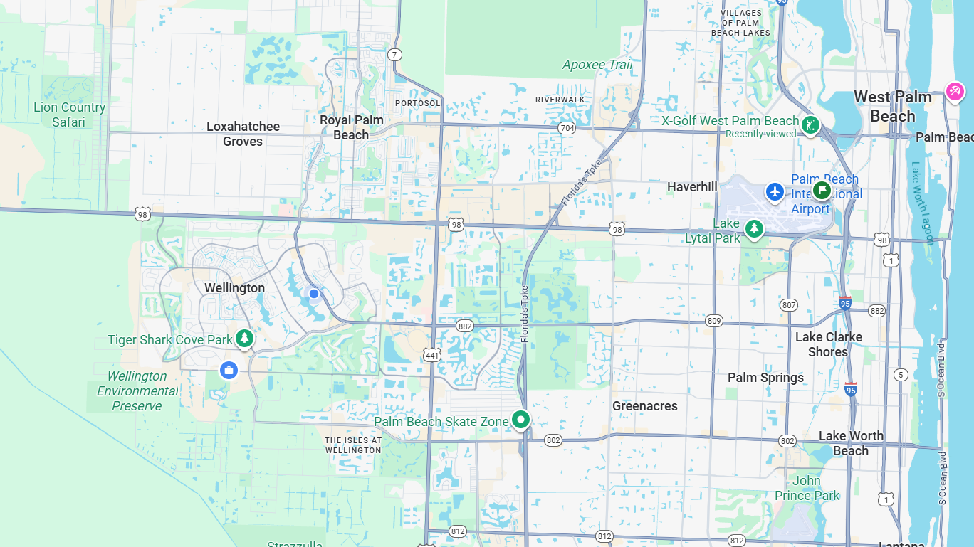
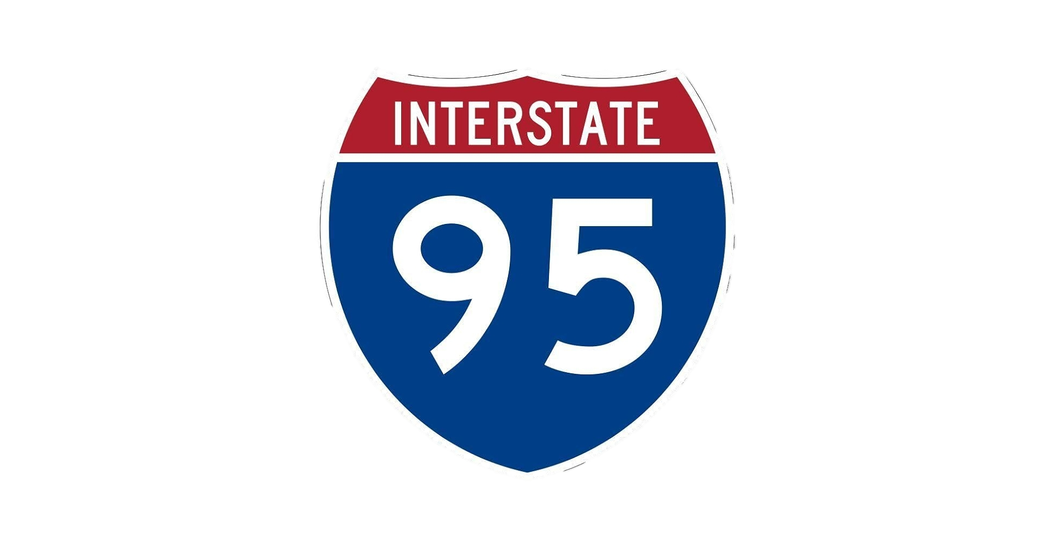




Location Map (Regional Level)
PROJECT
16.7 MILES +/-
N
Flying Cow Road

Slide 4
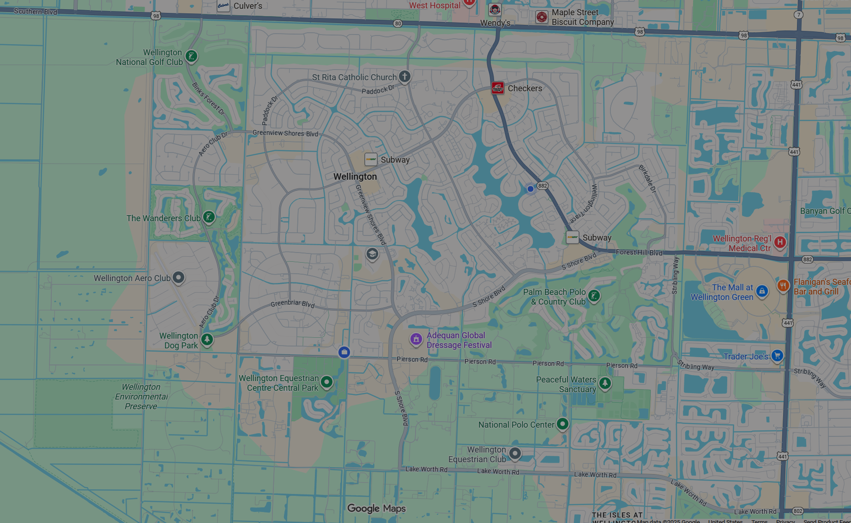



Location Map (Local Level)
CITY HALL
PROJECT
N

Slide 5







Project Budget Breakdown
8%
51%
41%
100%
Design & CEI Services
Land Acquisition
Construction
Overall Investment
$700k Village Funded
$4.5M Total
$3.8M Grant 85% Grant Funded
$3.9M Total
$1.7M Grant 44% Grant Funded
$8.75M 63% Grant Funded
Grant Total: $5.5M
Match* Total: $3.25M
*Match from Village of Wellington General Funds
Notes:
Project Budget Breakdown
Total investment: $8.75M.
63% funded by grants – highlight as a major cost savings for residents.
Land acquisition ($4.5M) – 84% grant funded → key example of leveraging outside resources.
Construction ($3.9M) – 44% grant funded.
Design & CEI ($700k) – Village funded, but critical for oversight and quality.
Key message: every $1 spent by Wellington brought back $1.70 in grant value.

Slide 6
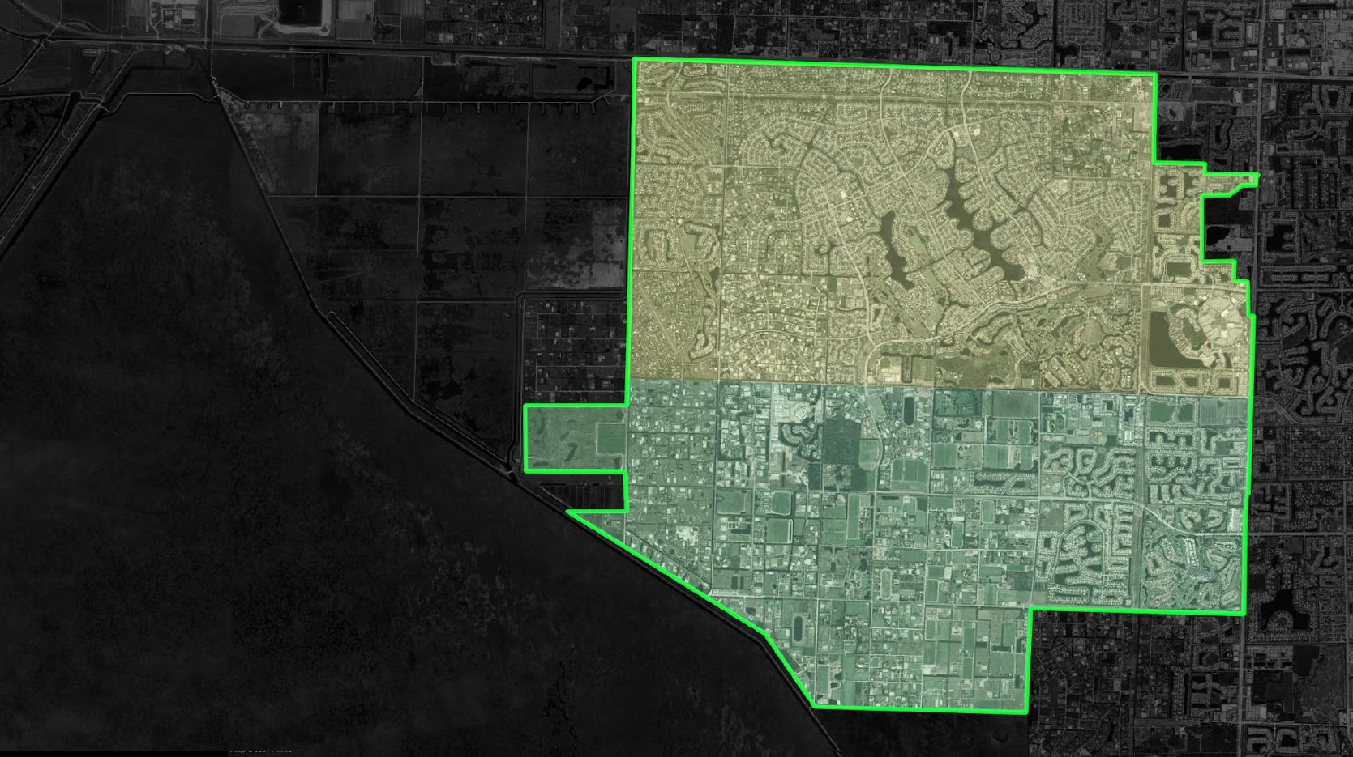
Southern Blvd
C-51 Canal
MASTER ACME STORMWATER SYSTEM
DESIGNED TO:
Maintain Efficient Stormwater Flow
Prevent Flooding
Promote Water Quality Management
Help Protect the Environment
PS#4
PS#3
PS#7
PS#6
CS#35
PROJECT
BASIN A
PS#5
CS#40
PS#8
CS#42
CS#43
CS#44
CS#45
PS#9
BASIN B
Control Structure (CS)
Loxahatchee NWR
PS#2
Pump Station (PS)
‹#›
Flow Arrow
Notes:
ACME Stormwater System Map
Overview of Basins A and B.
Pump stations (PS) and control structures (CS) interconnected.
Purpose:
Maintain stormwater flow
Prevent flooding
Improve water quality
Protect surrounding environments (Everglades, neighborhoods).
Emphasize redundancy and resilience: system is designed with multiple discharge points.
Tie back to SWMS Operations Manual: pumps activate at 12.2’ NGVD, gravity structures regulate flow at 11–12’ NGVD.

Slide 7
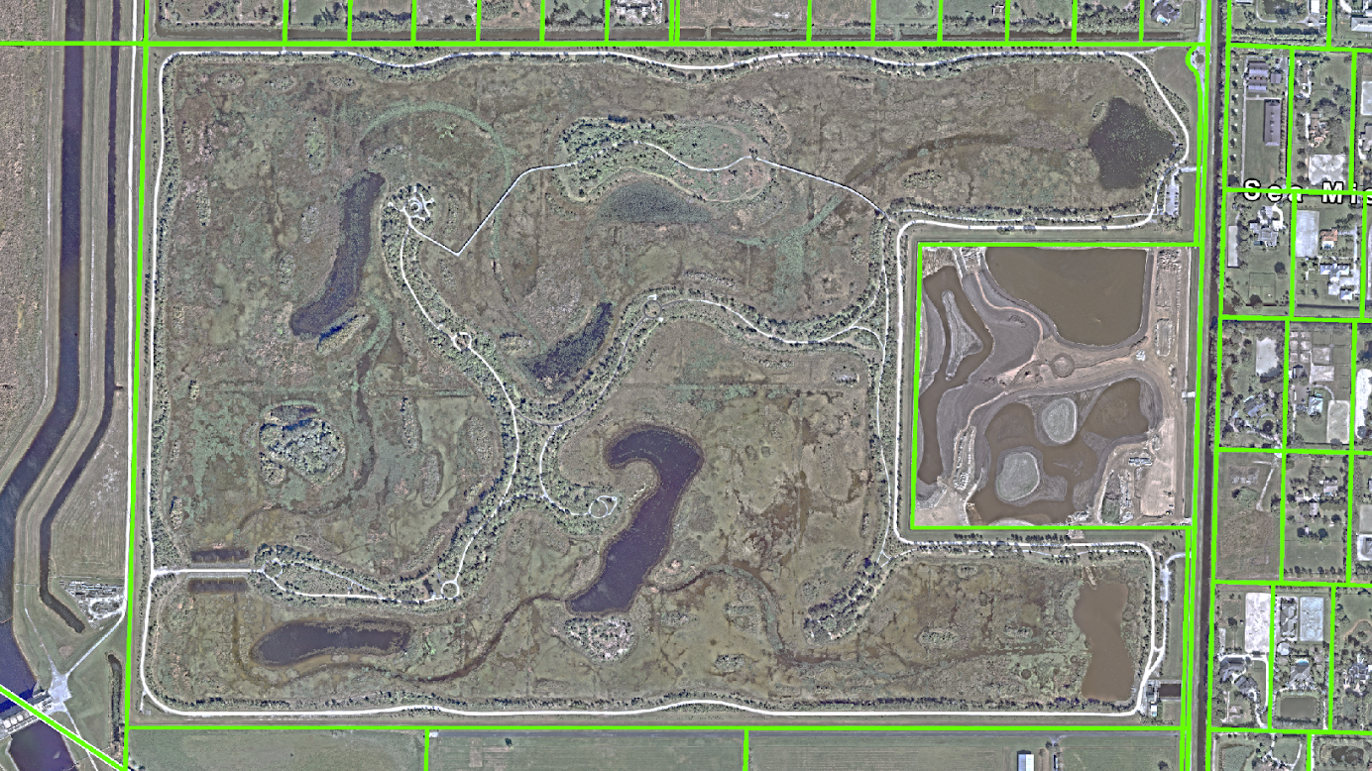
OVERALL PROJECT PLAN
DISCHARGE
NEW CULVERT
CONNECTION
PROJECT
(Completed)
CULVERT
NEW CULVERT
CONNECTION
N
PUMP
Notes:
Overall Project Plan
Master plan shows expansion area tied into existing canals and pump discharges.
New culvert connections provide greater hydraulic connectivity.
Expansion allows impoundment areas to store stormwater during heavy rains.
This is multi-benefit infrastructure:
Flood protection
Water quality treatment
Habitat restoration.

Slide 8
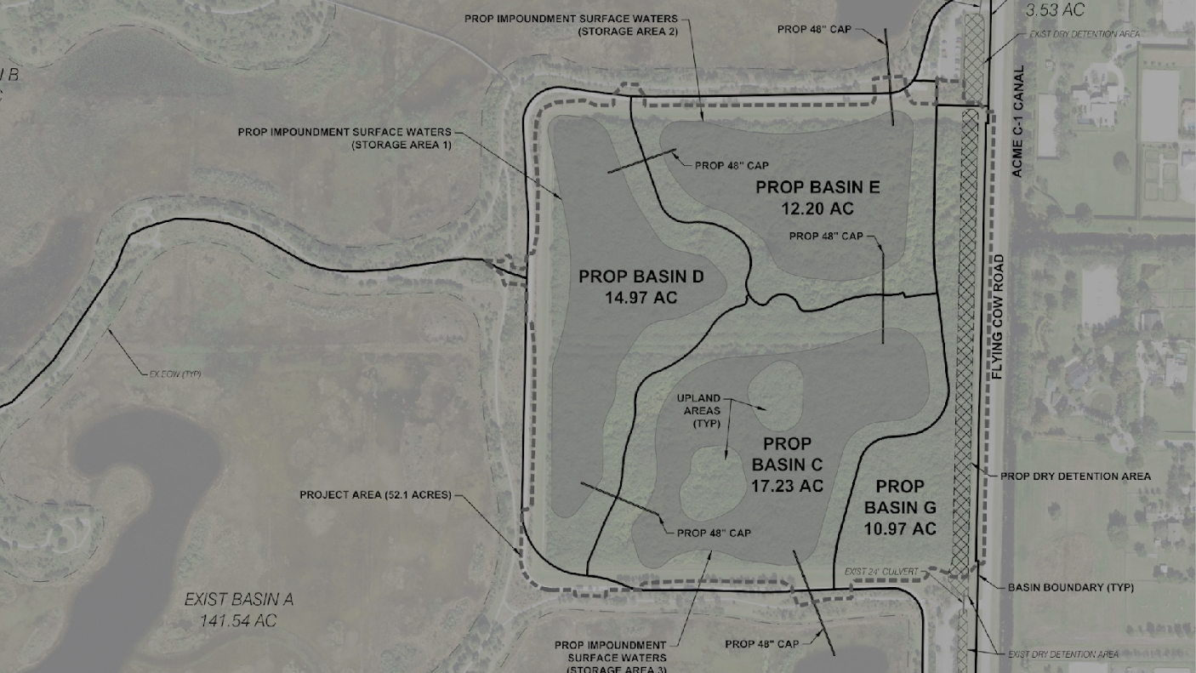
EXPANSION AREA PROJECT PLAN
Total Project Area: 52.1 Acres
Impoundment Storage: 53.1 Ac-Ft
NEW CULVERT
CONNECTION
Impoundment
Surface Water
Storage Area (Typ.)
Pathway
Expansion
N
NEW CULVERT
CONNECTION
Notes:
Expansion Area Project Plan
Focus on the Flying Cow Road / Moncada property expansion.
Integration of culverts ensures new impoundments connect to Basin B.
Design creates multi-cell surface water storage for flexibility.
Added public amenities (picnic pavilions, pathways)
Highlights Village’s commitment to multi-use infrastructure.

Slide 9
BREAK FOR VIDEO

Slide 10
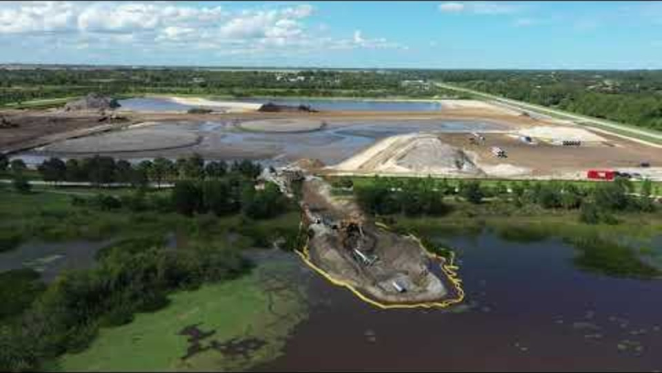


Slide 11
RESUME POWERPOINT

Slide 12
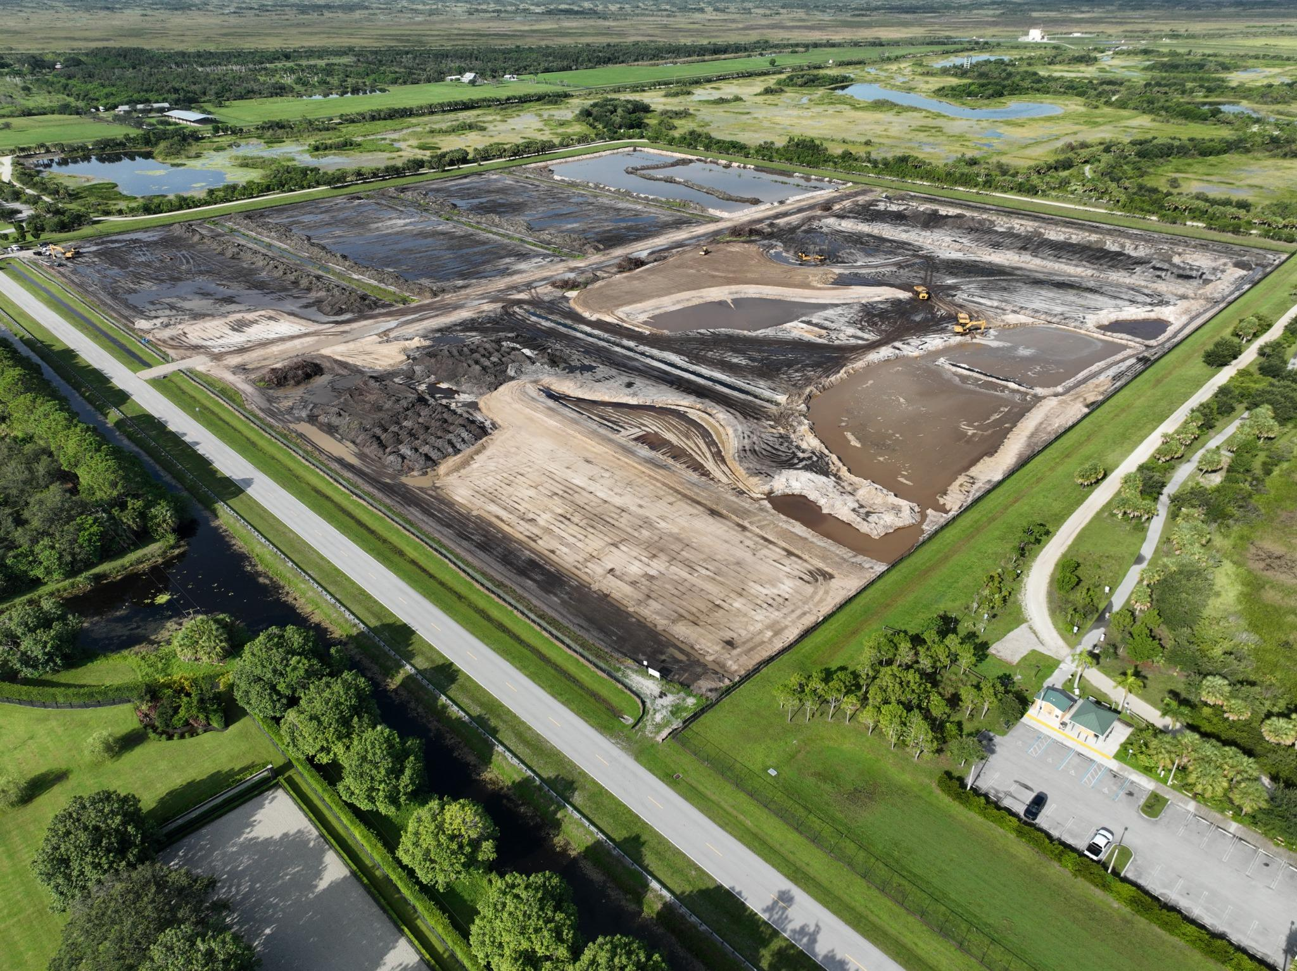
July 2024 – Initial excavation
and site preparation
Notes:
Slide 7 – Construction Timeline (July 2024 – August 2025)
Walk through the timeline:
July 2024 – initial excavation.
Fall/Winter 2024 – berm shaping, basin formation.
Jan–Mar 2025 – water storage cells, inflow structures, berm expansion.
April 2025 – major earthwork complete.
May–June 2025 – planting, sidewalks, habitat.
August 2025 – system fully operational.
Emphasize on-time delivery and phased construction approach.
Note: aligns with hurricane season planning – system ready before peak storm events.

Slide 13
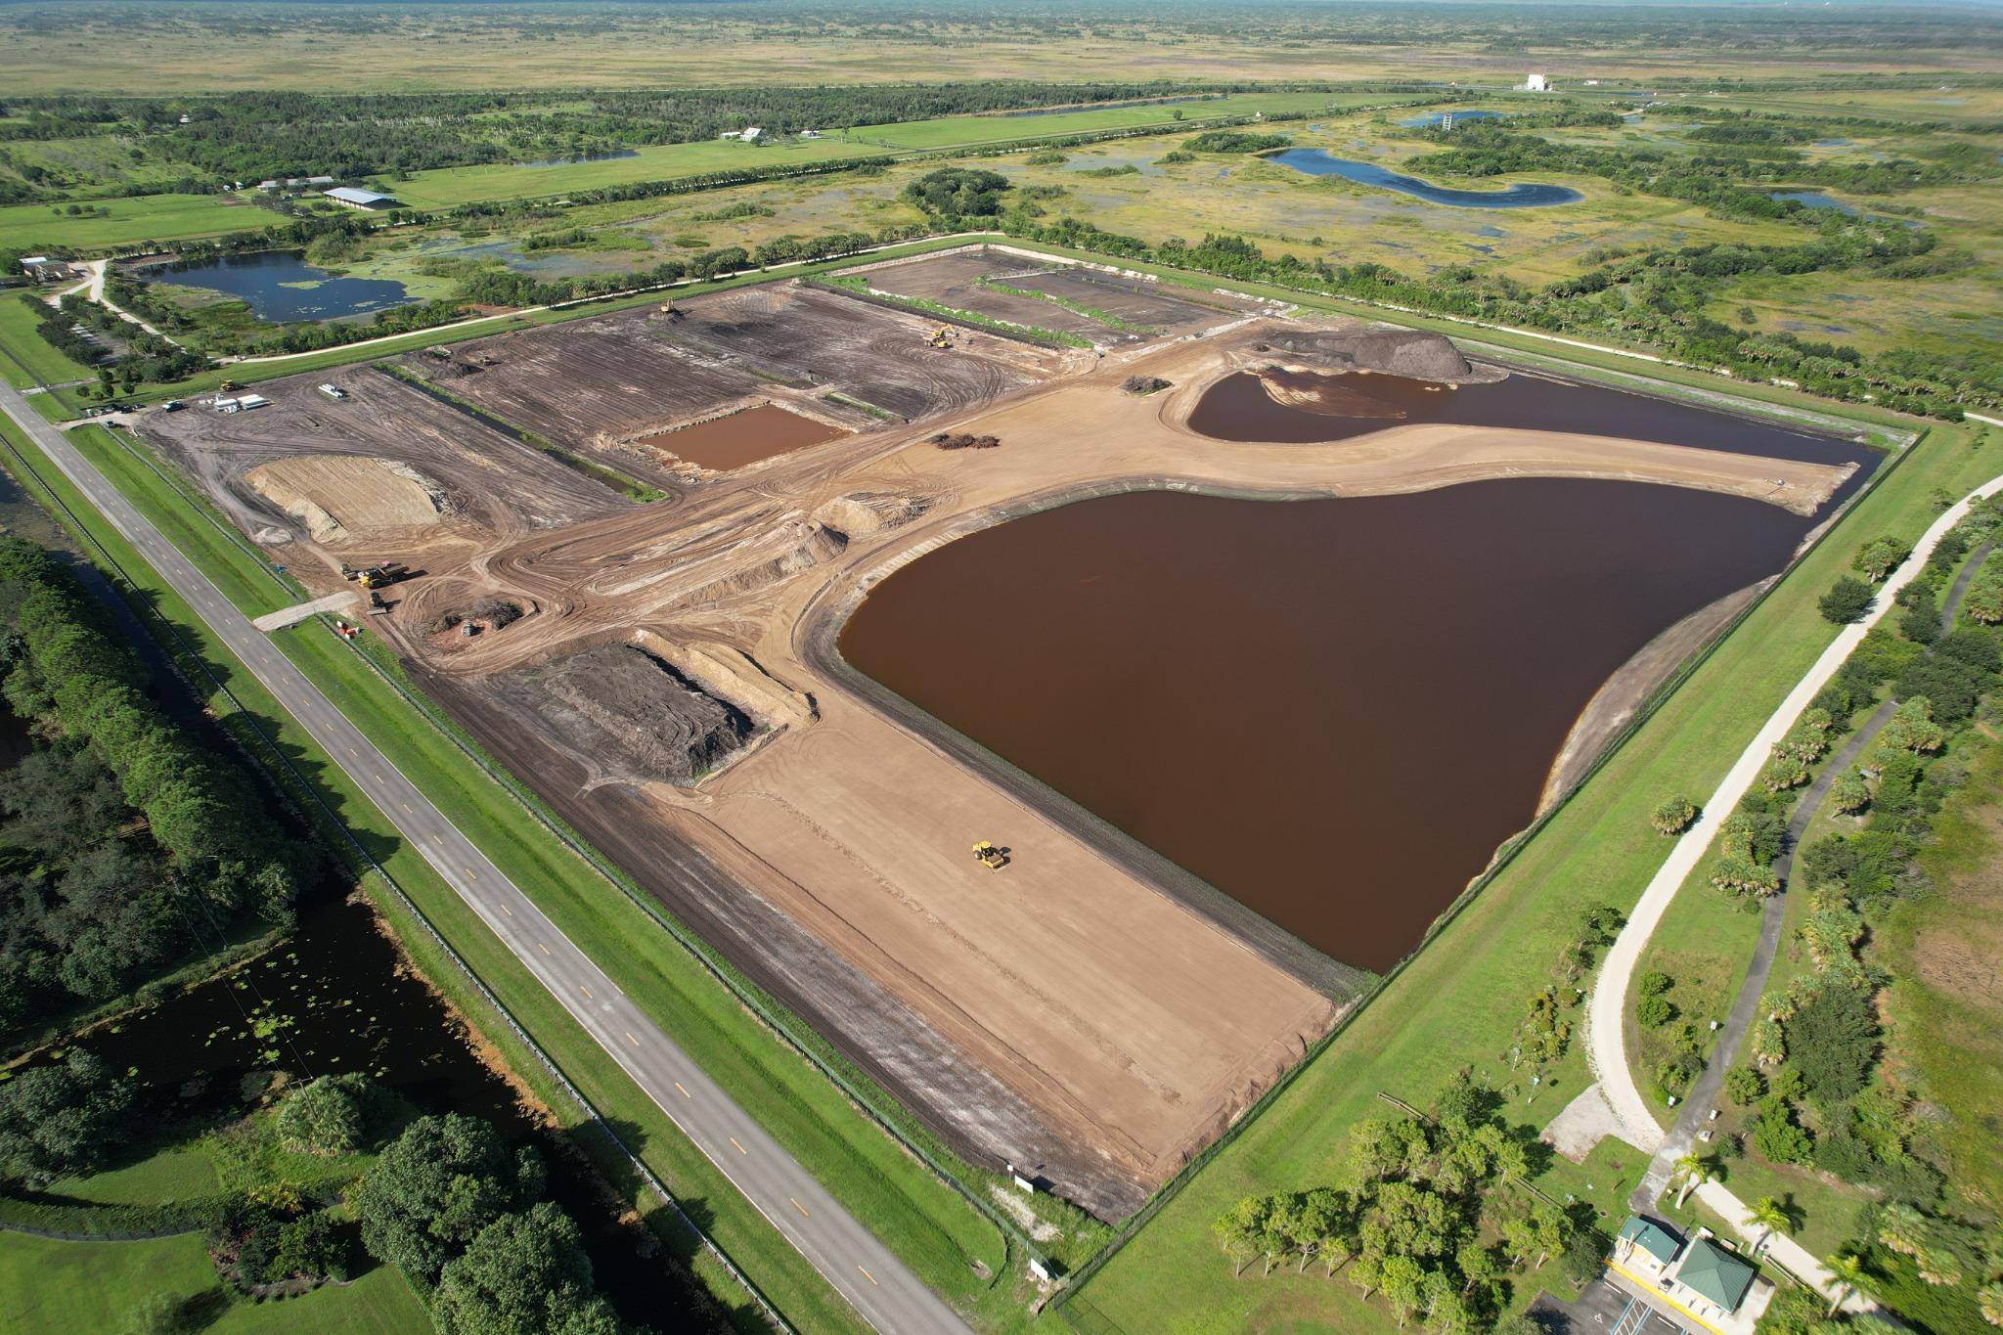
September 2024 – Early berm shaping and water control

Slide 14
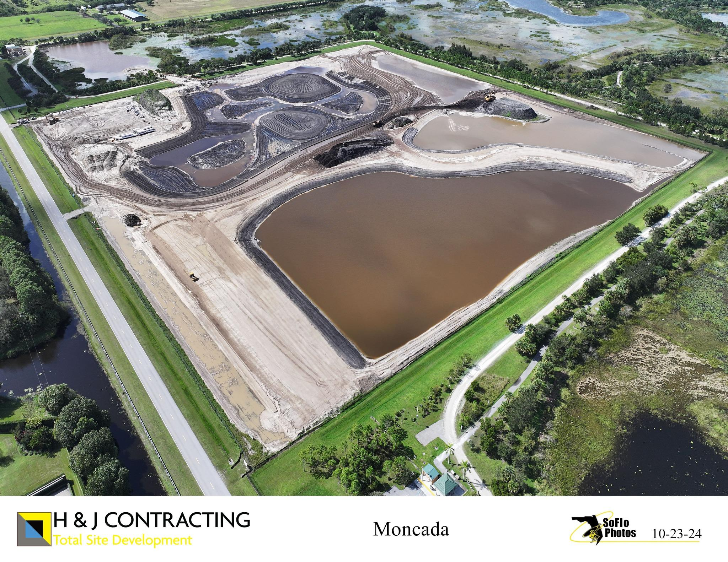
October 2024 – Basin formation begins

Slide 15
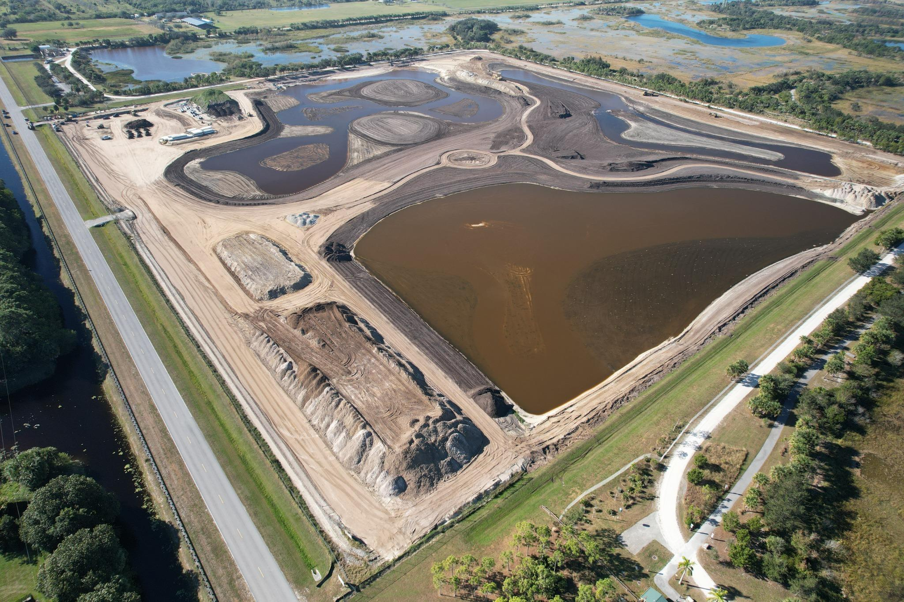
December 2024 – Major earthwork and shaping

Slide 16
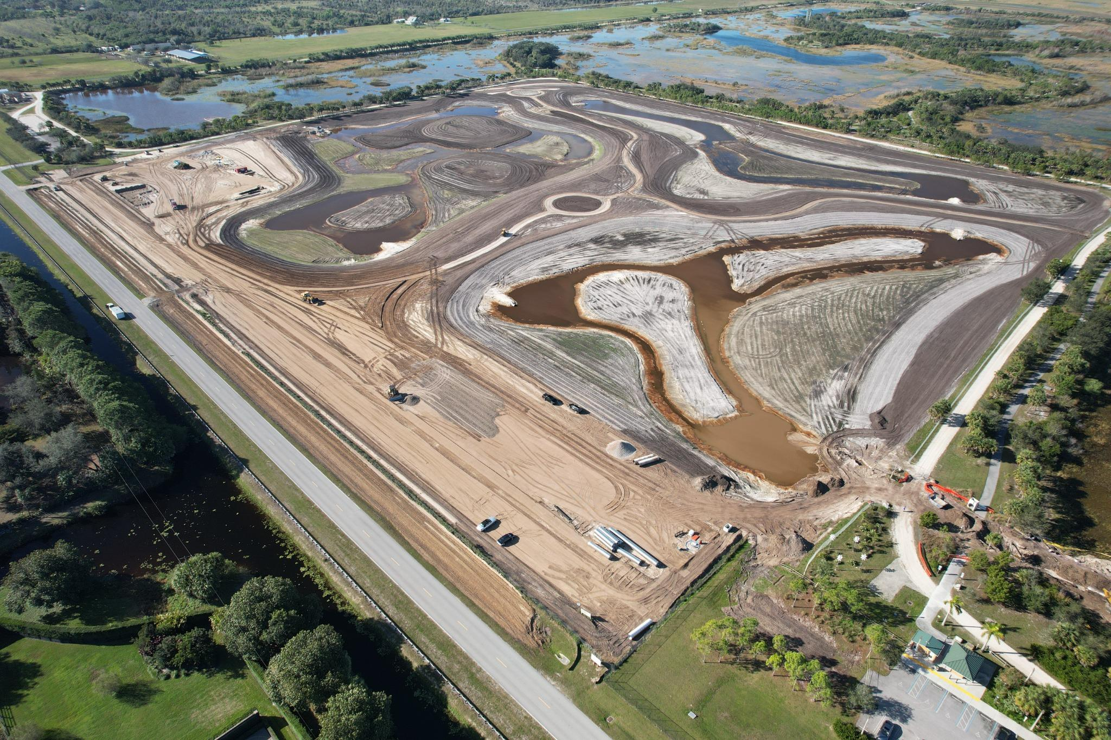
January 2025 – Water
storage taking form

Slide 17
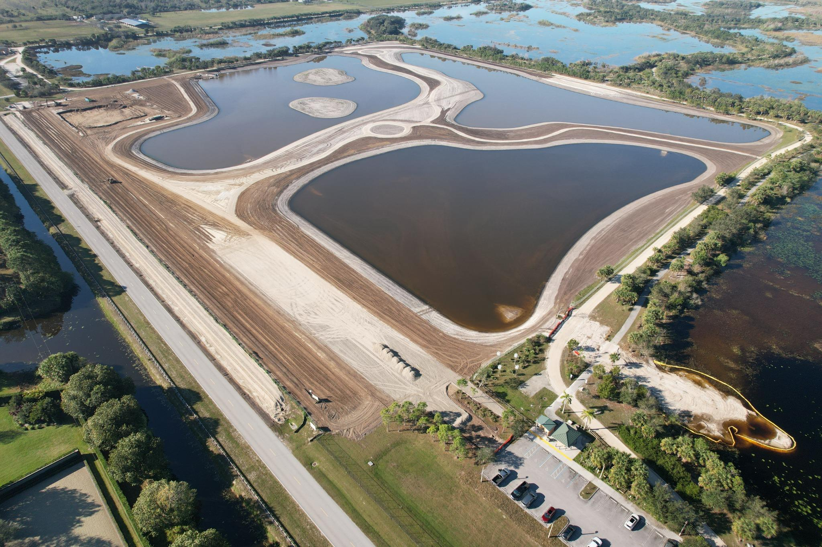
January 2025 – Continued
shaping and inflow structures

Slide 18
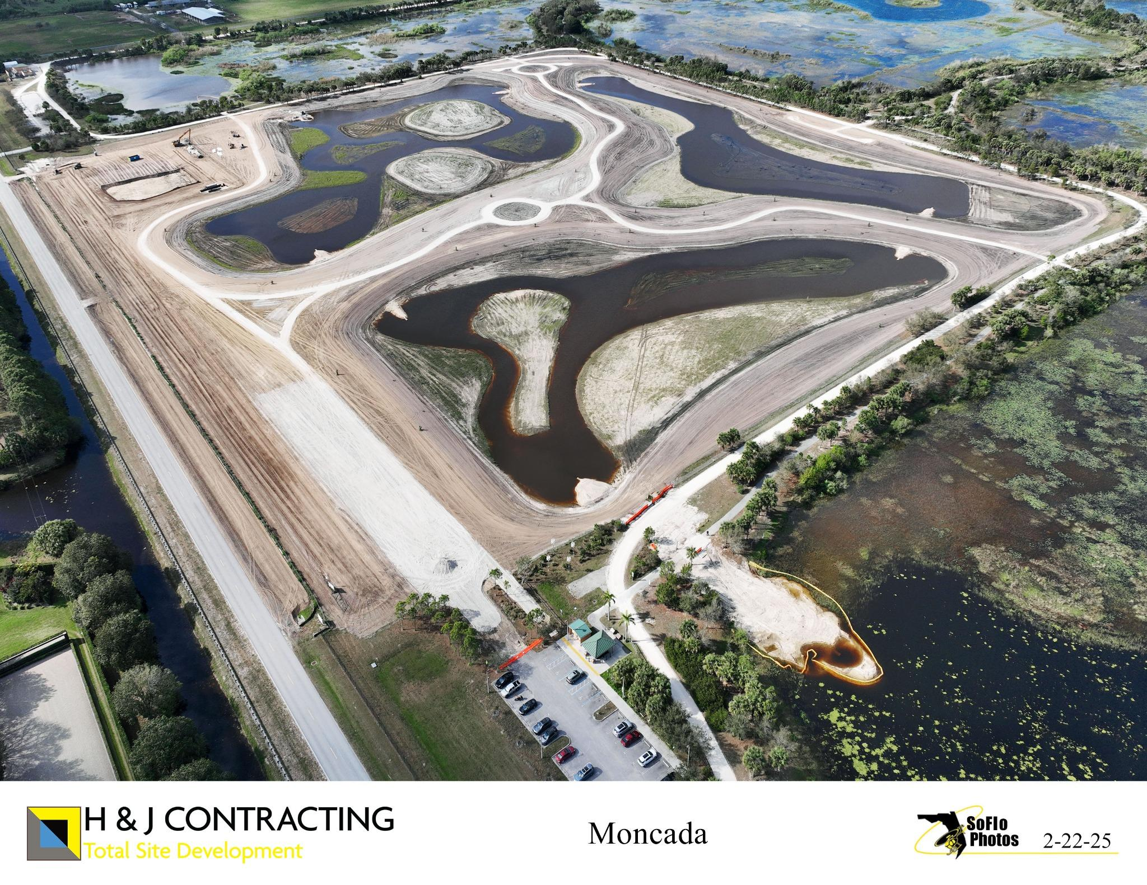
February 2025 – Expanded berms and water retention areas

Slide 19
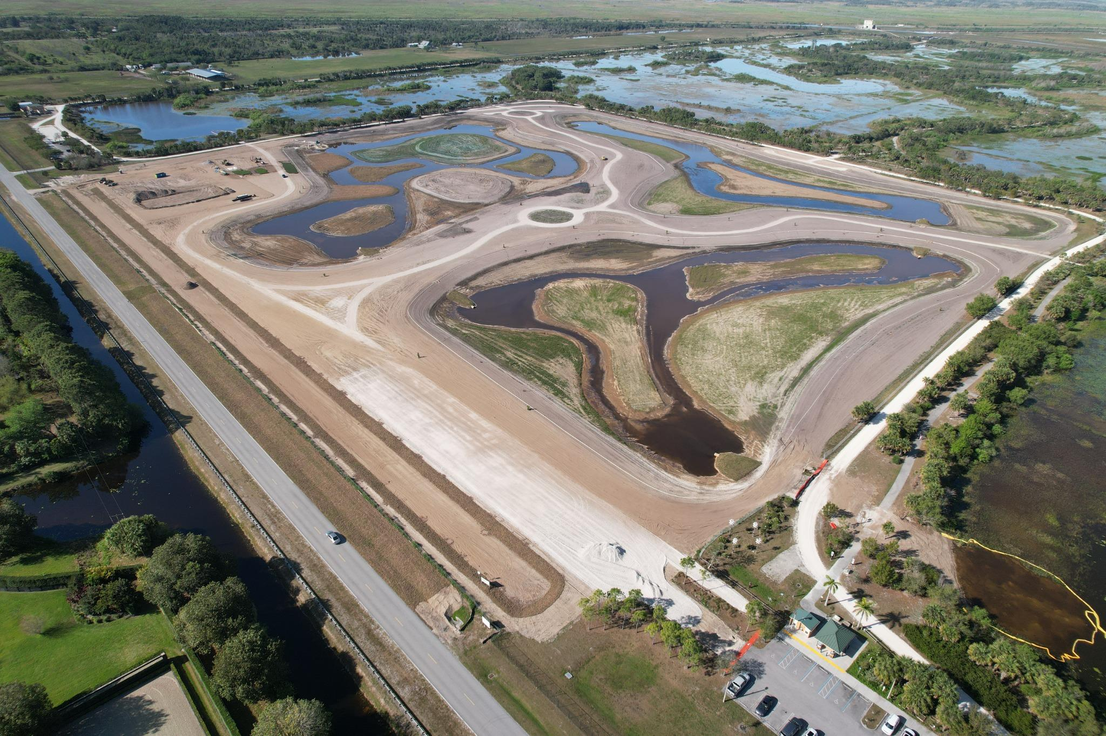
March 2025 – Multi-cell
system visible

Slide 20
April 2025 – Mass Grading
Completion

Slide 21
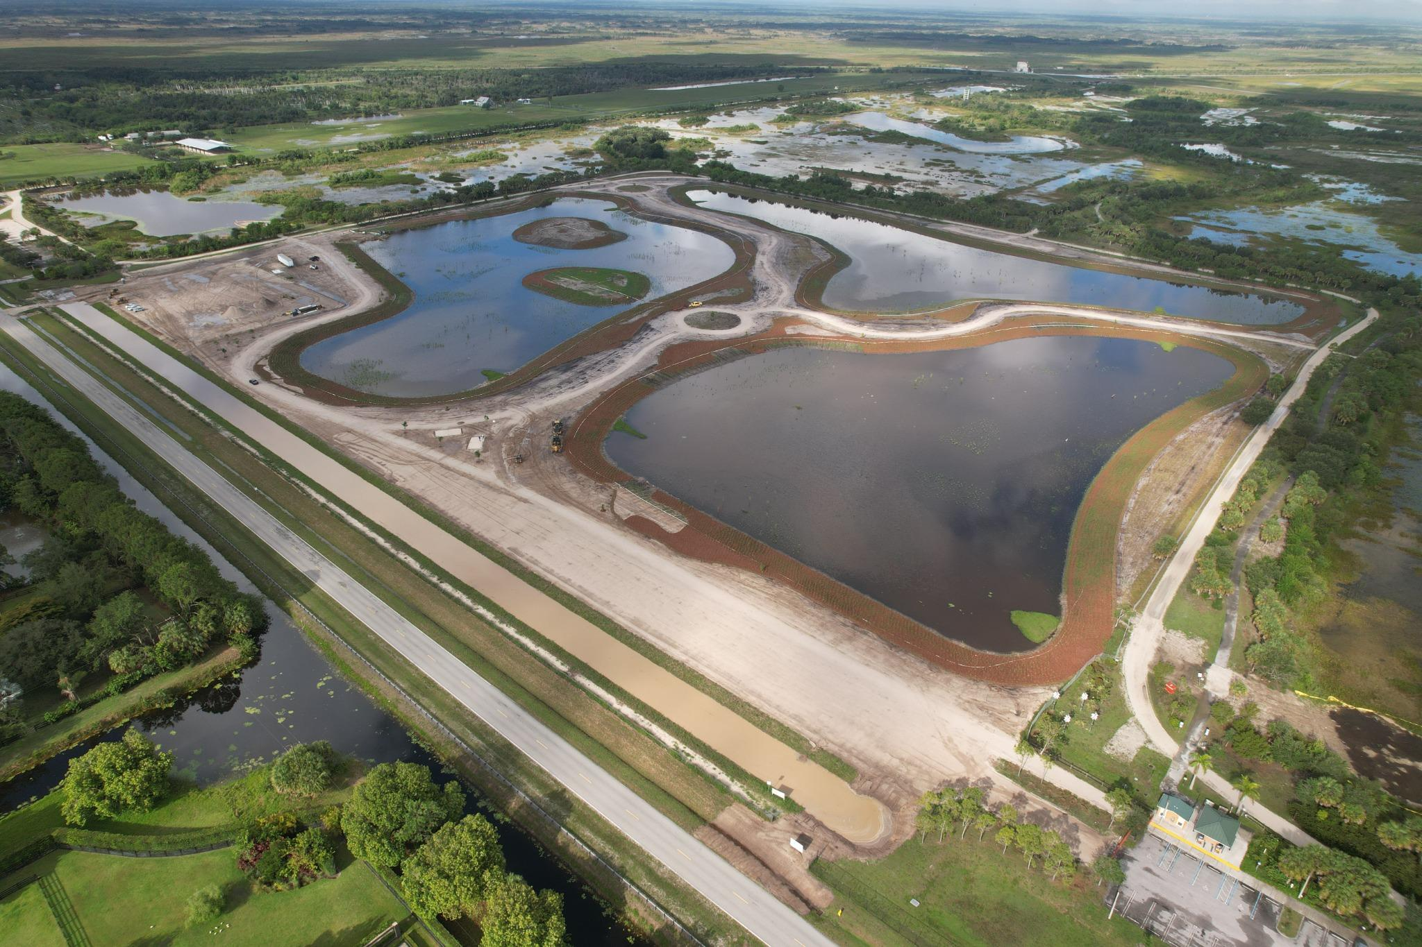
May 2025 – Plantings and Sidewalk Construction in Progress

Slide 22
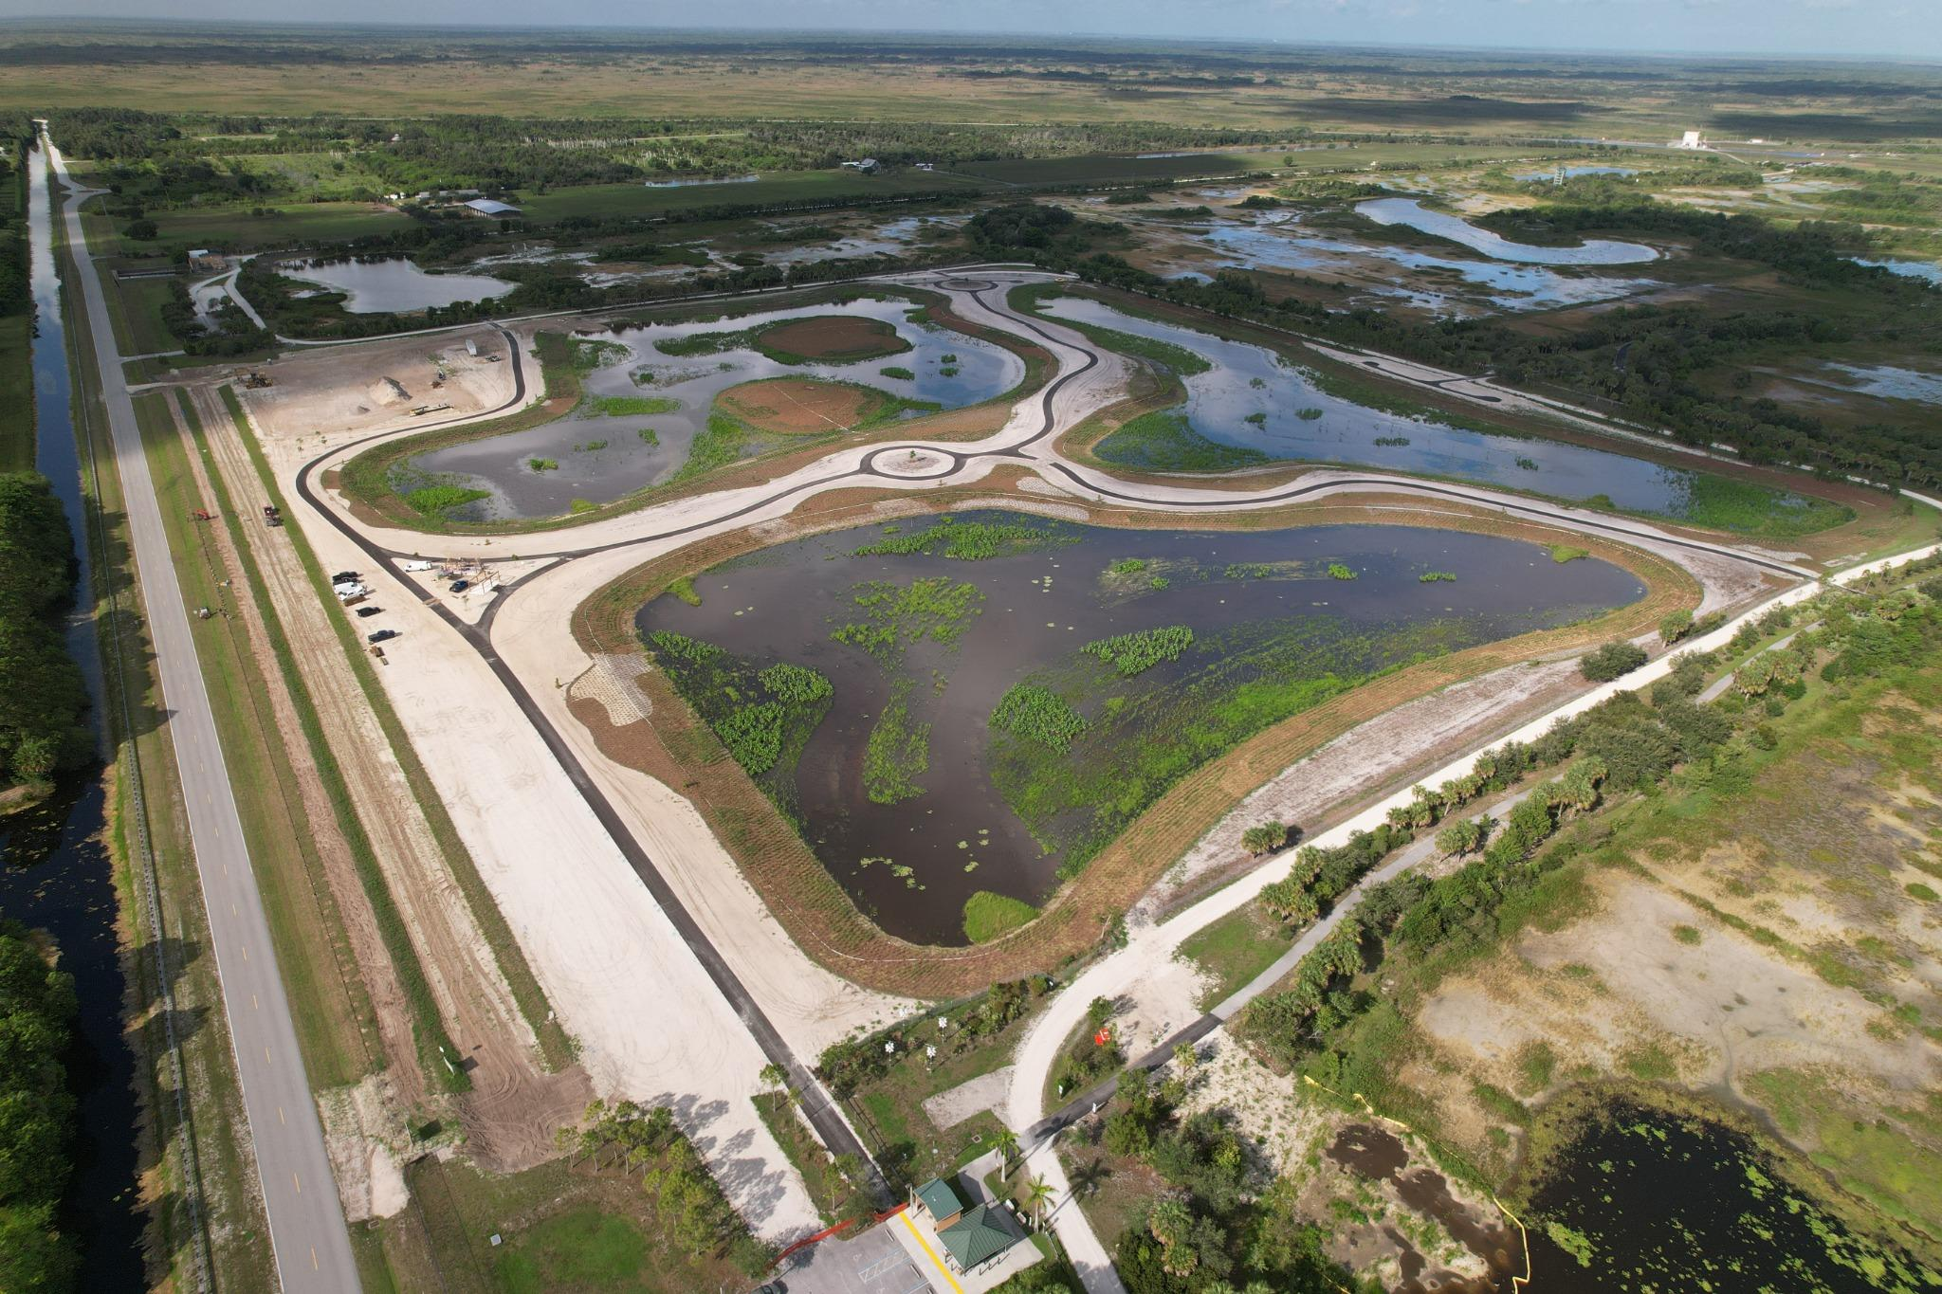
June 2025 – Water quality
and habitat established

Slide 23
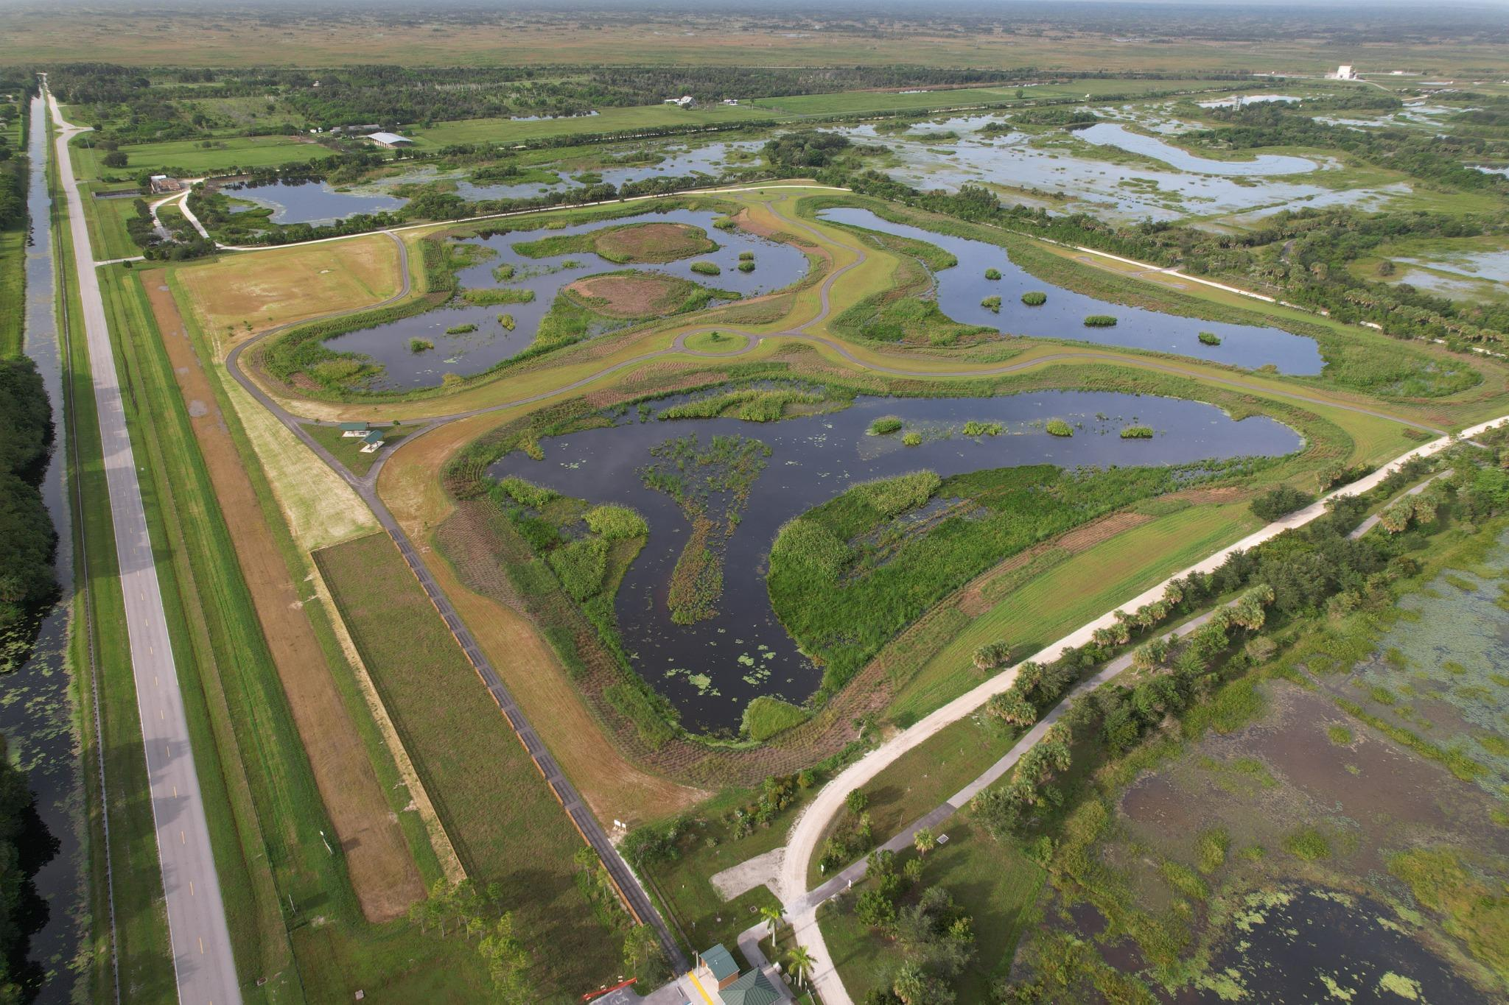
August 2025 – Final system in operation

Slide 24
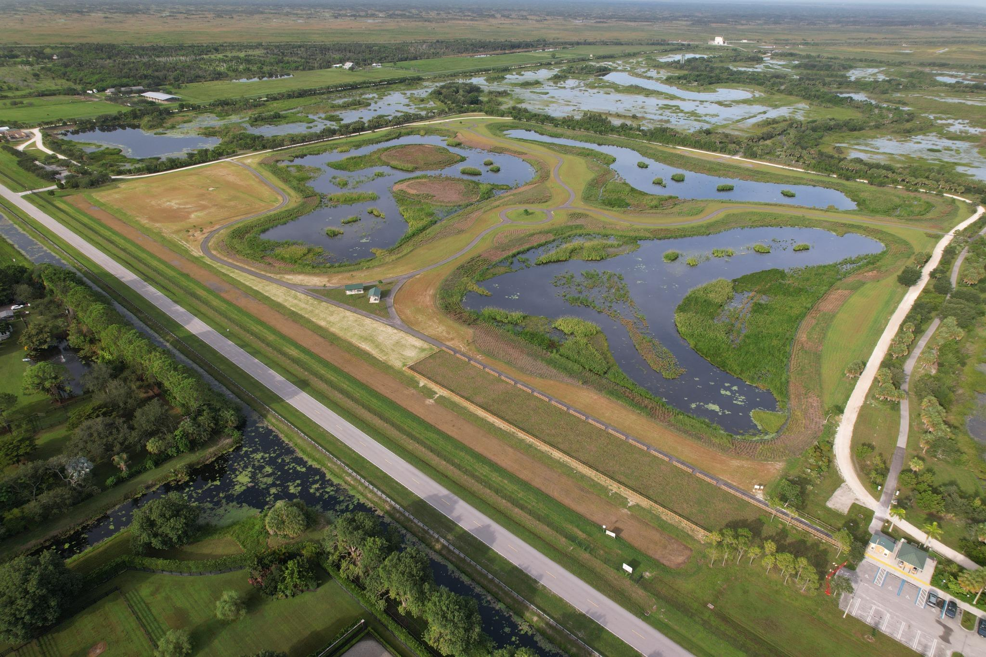
Completed Project

Slide 25
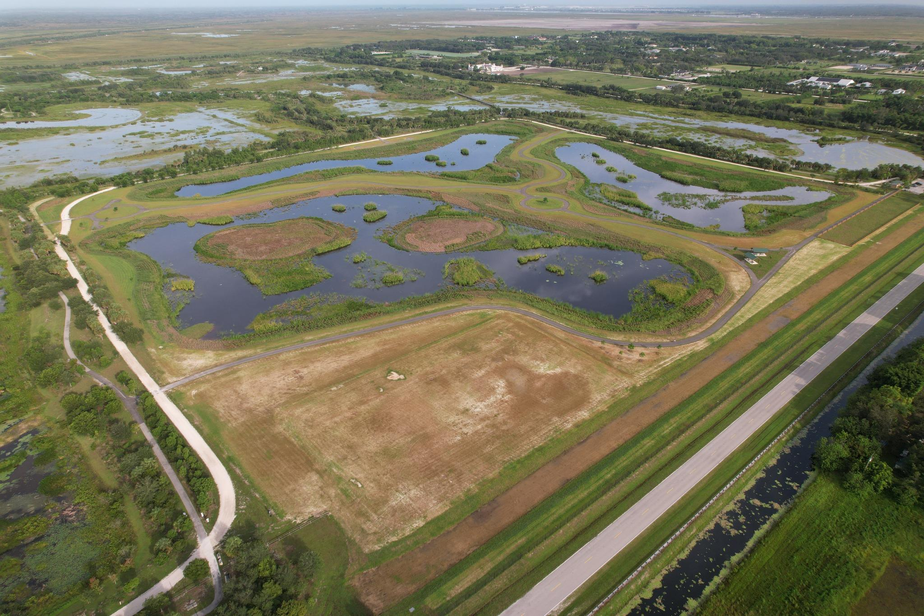
Completed Project

Slide 26
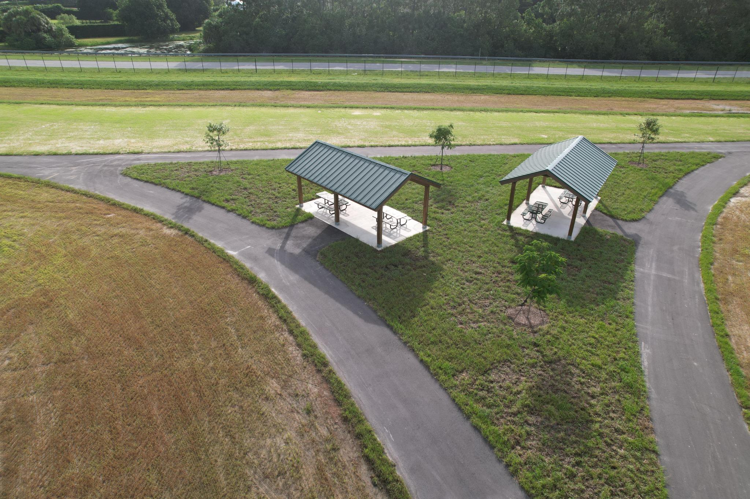
Community Amenities – Picnic Pavilions

Slide 27

QUESTIONS

