Slide 1
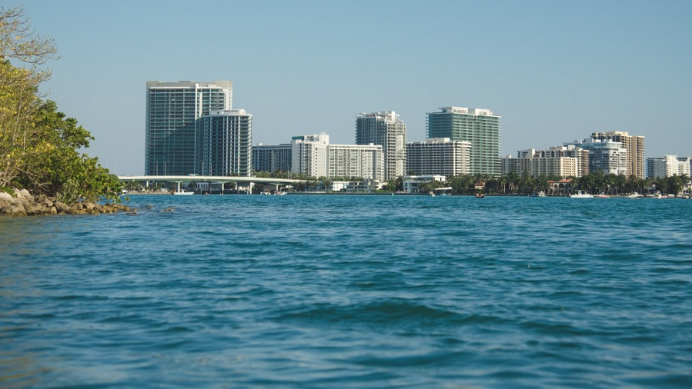

RESILIENT FLORIDA
Devin Resko, Planning & Policy Administrator
Resilient Florida Program
Office of Resilience and Coastal Protection
Florida Department of Environmental Protection
Southeast Florida Regional Climate Change Compact | Oct. 6, 2025

Slide 2
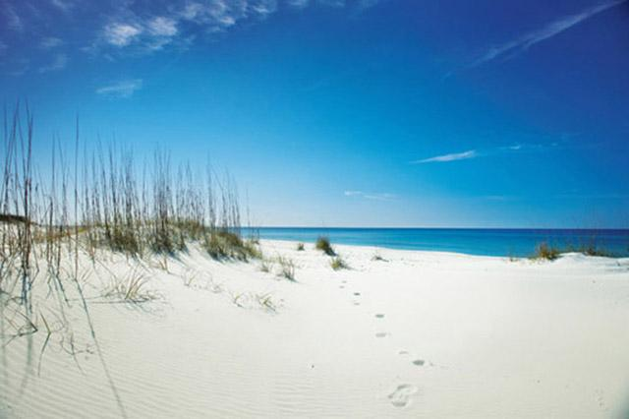
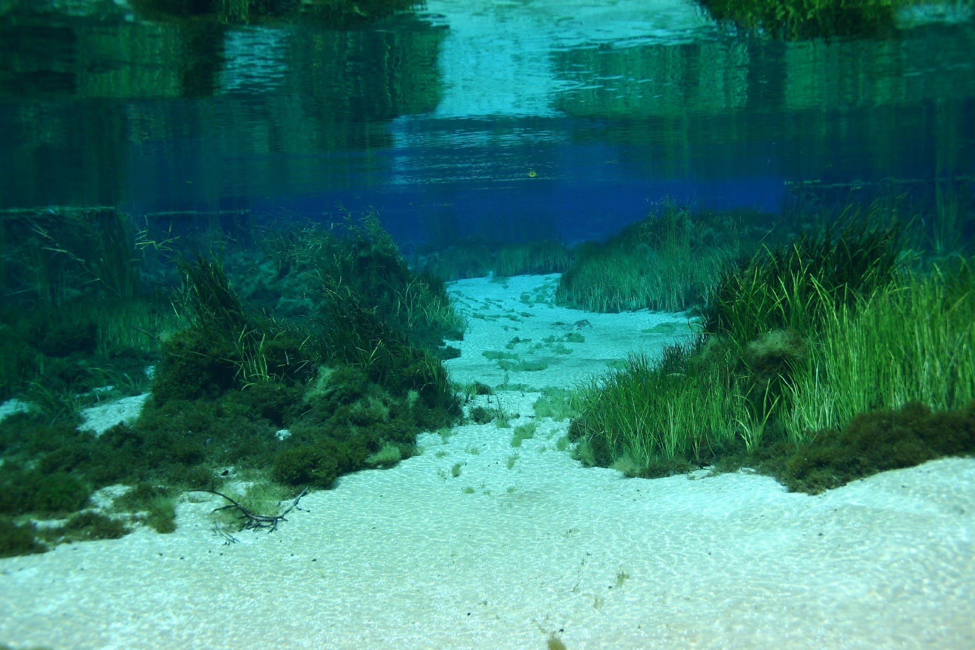
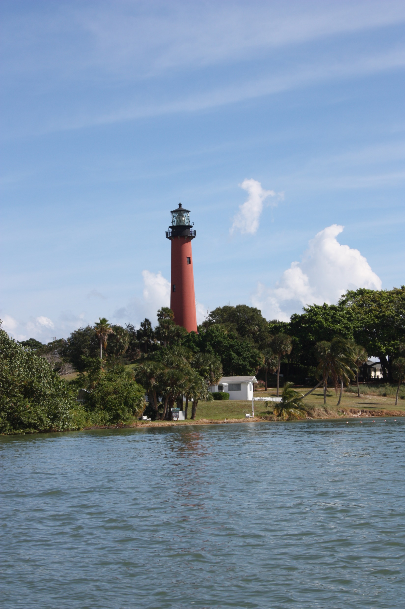
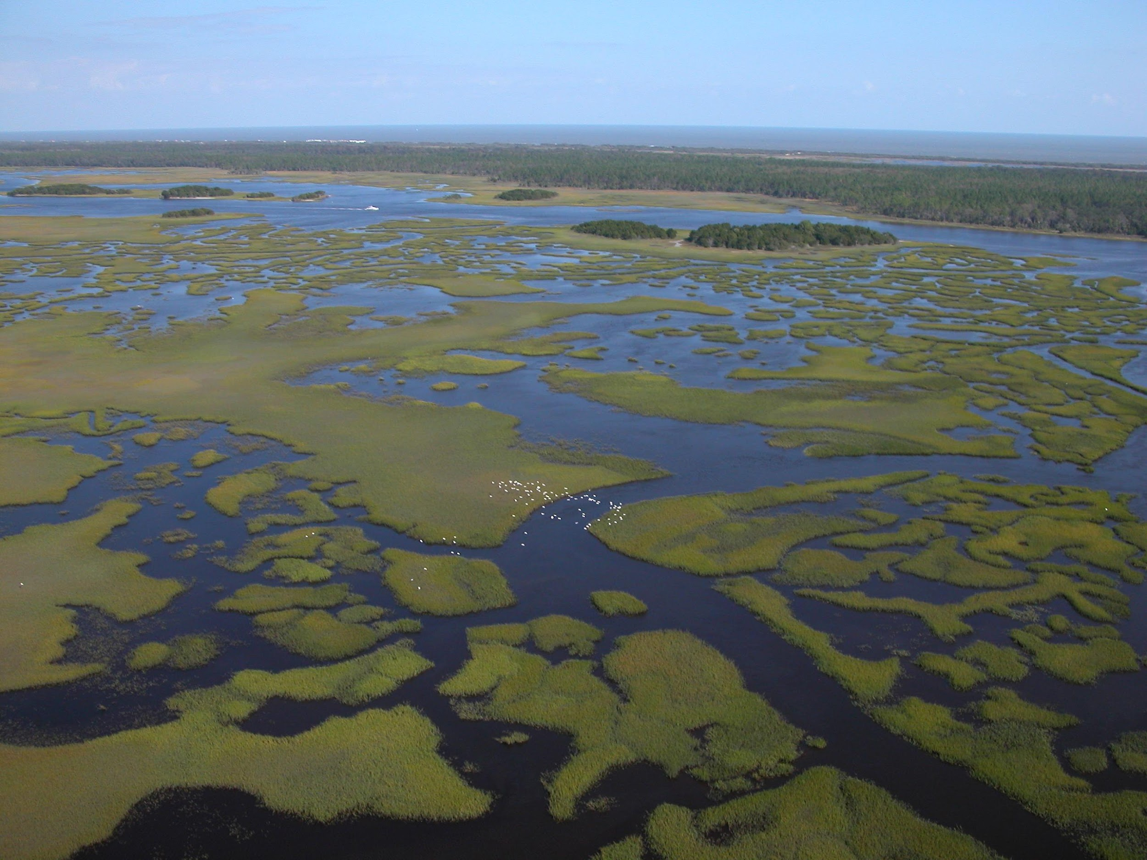
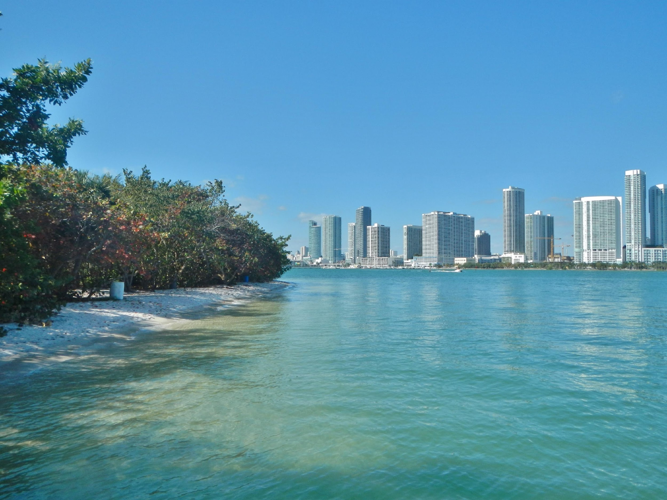
RESILIENT FLORIDA
LEGISLATIVE CHANGES OVER TIME
2021: "Always Ready Bill" Establishing the program, section 380.093, Florida Statutes (F.S.)
Changed the total proposed funding for the Statewide Resilience Plan to a minimum of $100M each year of the plan from a maximum of $100M
Added eligible entities to increase access
Further clarified definitions and program requirements
Added eligible project types
Added more match waivers for disadvantaged communities

Slide 3
RESILIENT FLORIDA
PROGRAM GROWTH
Program staffing growth
2021: 25 positions
2022: 50 positions
Funding appropriations and grant awards exceeded expectations and statute
State and federal appropriations
FY25-26 State Plan
143 eligible projects for total project cost of $2.3B
Awarded 22 projects for $150M
Fiscal Year | Anticipated Funds | Anticipated Grants | Anticipated Grant Life (Years) | Appropriated Funds | Awarded Grants | Actual Grant Life (Years)
FY21/22 | $22 million | 100 | 2 | $522 million | 245 | 3.5
FY22/23 | $122 million | 117 | 3 | $492 million | 261 | 4
FY23/24 | $122 million | 118 | 3 | $322 million | 151 | 4.5
FY24/25 | $122 million | 95 | 3 | $247 million | 129 | 4
FY25/26 | $172 million | 29 + ? PLN | 3 | $172 million | 32 + ? PLN | 4
Total | $560 million | 459+ |  | $1.75 billion | 818+

Slide 4
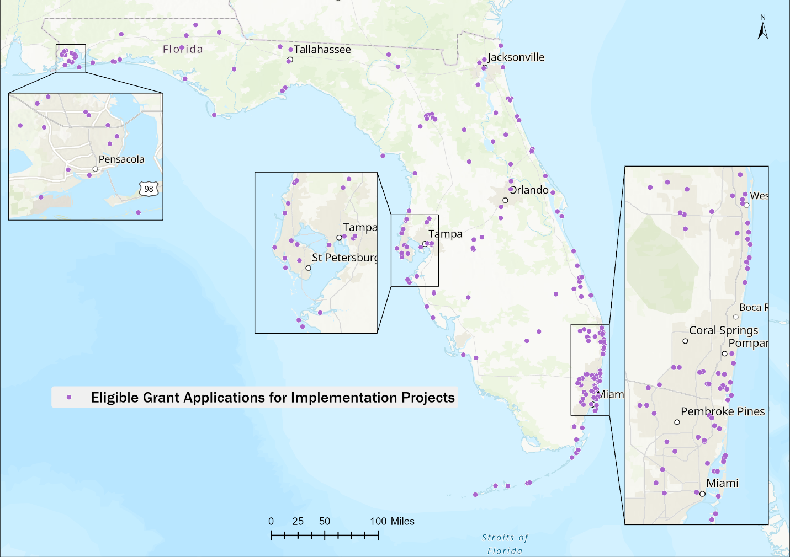
RESILIENT FLORIDA
PROGRAM GROWTH

Slide 5
PROGRAM ELEMENTS
RF Grant Program (Planning Grants)
Statewide Flooding and Sea Level Rise Resilience Plan
Regional Resilience Entities
Comprehensive Statewide Data Set and Assessment
Florida Flood Hub for Applied Science

Slide 6
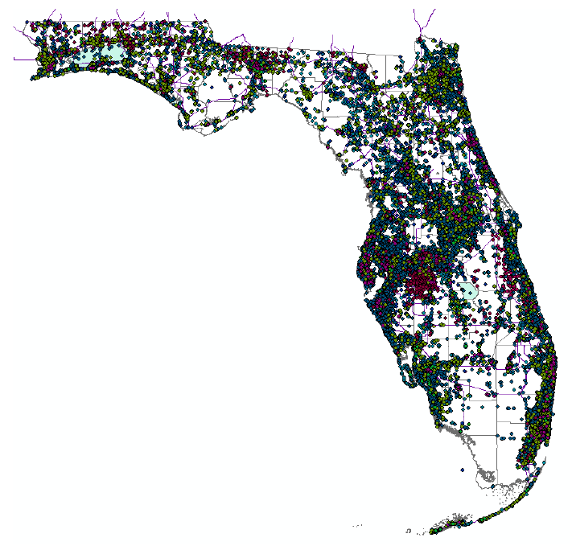
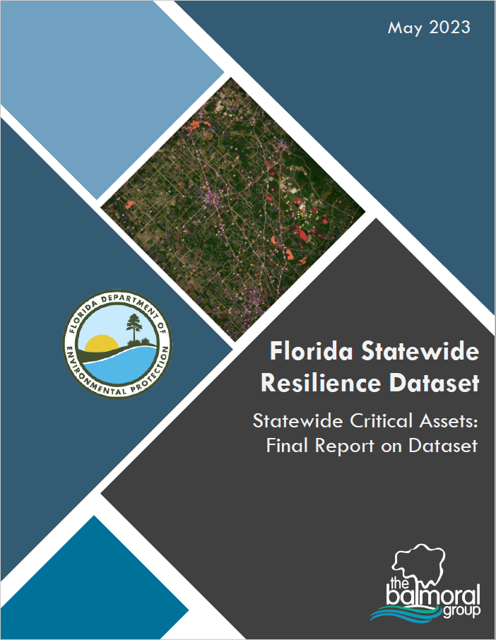
COMPREHENSIVE STATEWIDE DATA SET
Initially compiled 155 datasets, later refined to 63 datasets from local, state and federal sources
3.3 million points, polygons and lines representing critical assets
Coordinate with FFH for review and hosting
Data used to develop statewide VA

Slide 7
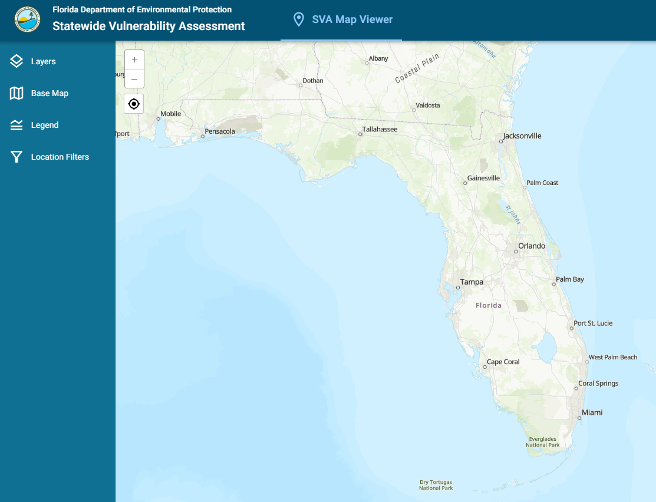
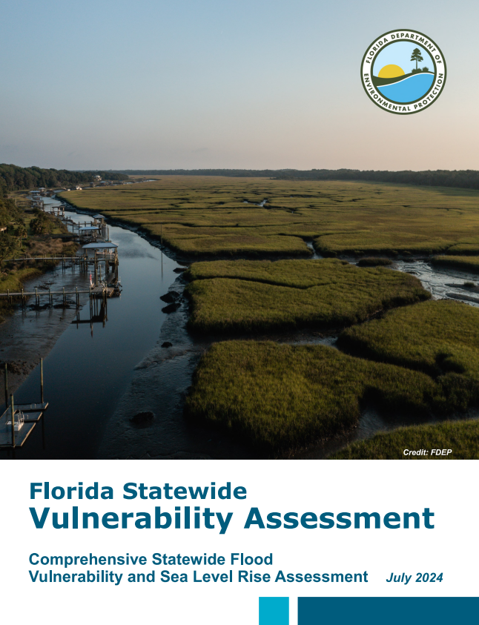
FLORIDA STATEWIDE VULNERABILITY ASSESSMENT
The Florida Statewide VA was completed in July 2024
Utilized Comprehensive Statewide Data Set
Exposure and Sensitivity Analysis for 67 counties
Will be updated every five years
User-friendly webtool launched Feb. 2025

Slide 8
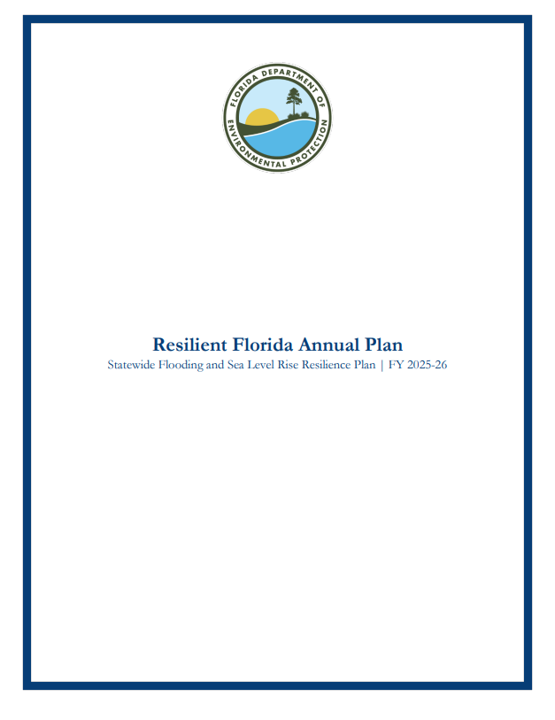
STATEWIDE RESILIENCE PLAN
IMPLEMENTATION PROJECTS
Prioritized based on criteria in statute and implemented via rule 62S-8, Florida Administrative Code (F.A.C.)
Three-year rolling plan of projects:
Fully-fund projects to completion
50% match funding required unless community is a community eligible for reduced cost share
Must include at least $100 million of projects each year

Slide 9
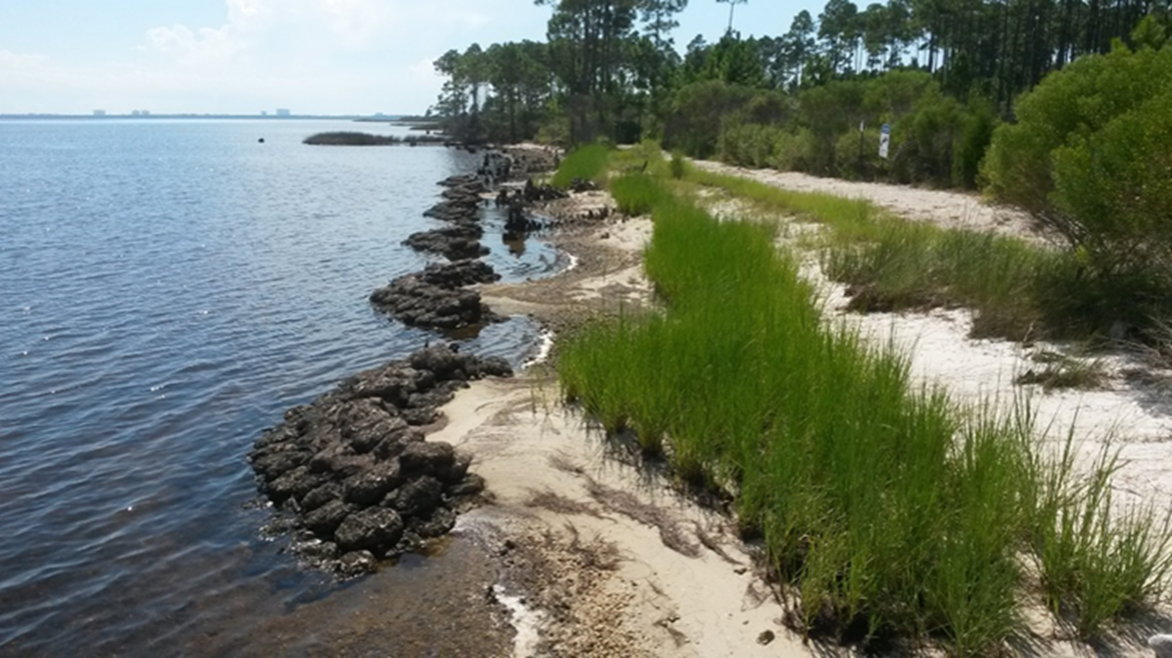
STATEWIDE RESILIENCE PLAN
ELIGIBLE ENTITES
Counties
Municipalities
Special districts as defined in s. 189.012, F.S.
Water Management Districts
Drainage districts
Erosion control districts
Flood control districts
Regional water supply authorities
Regional resilience entities acting on behalf of one or more member counties or municipalities

Slide 10
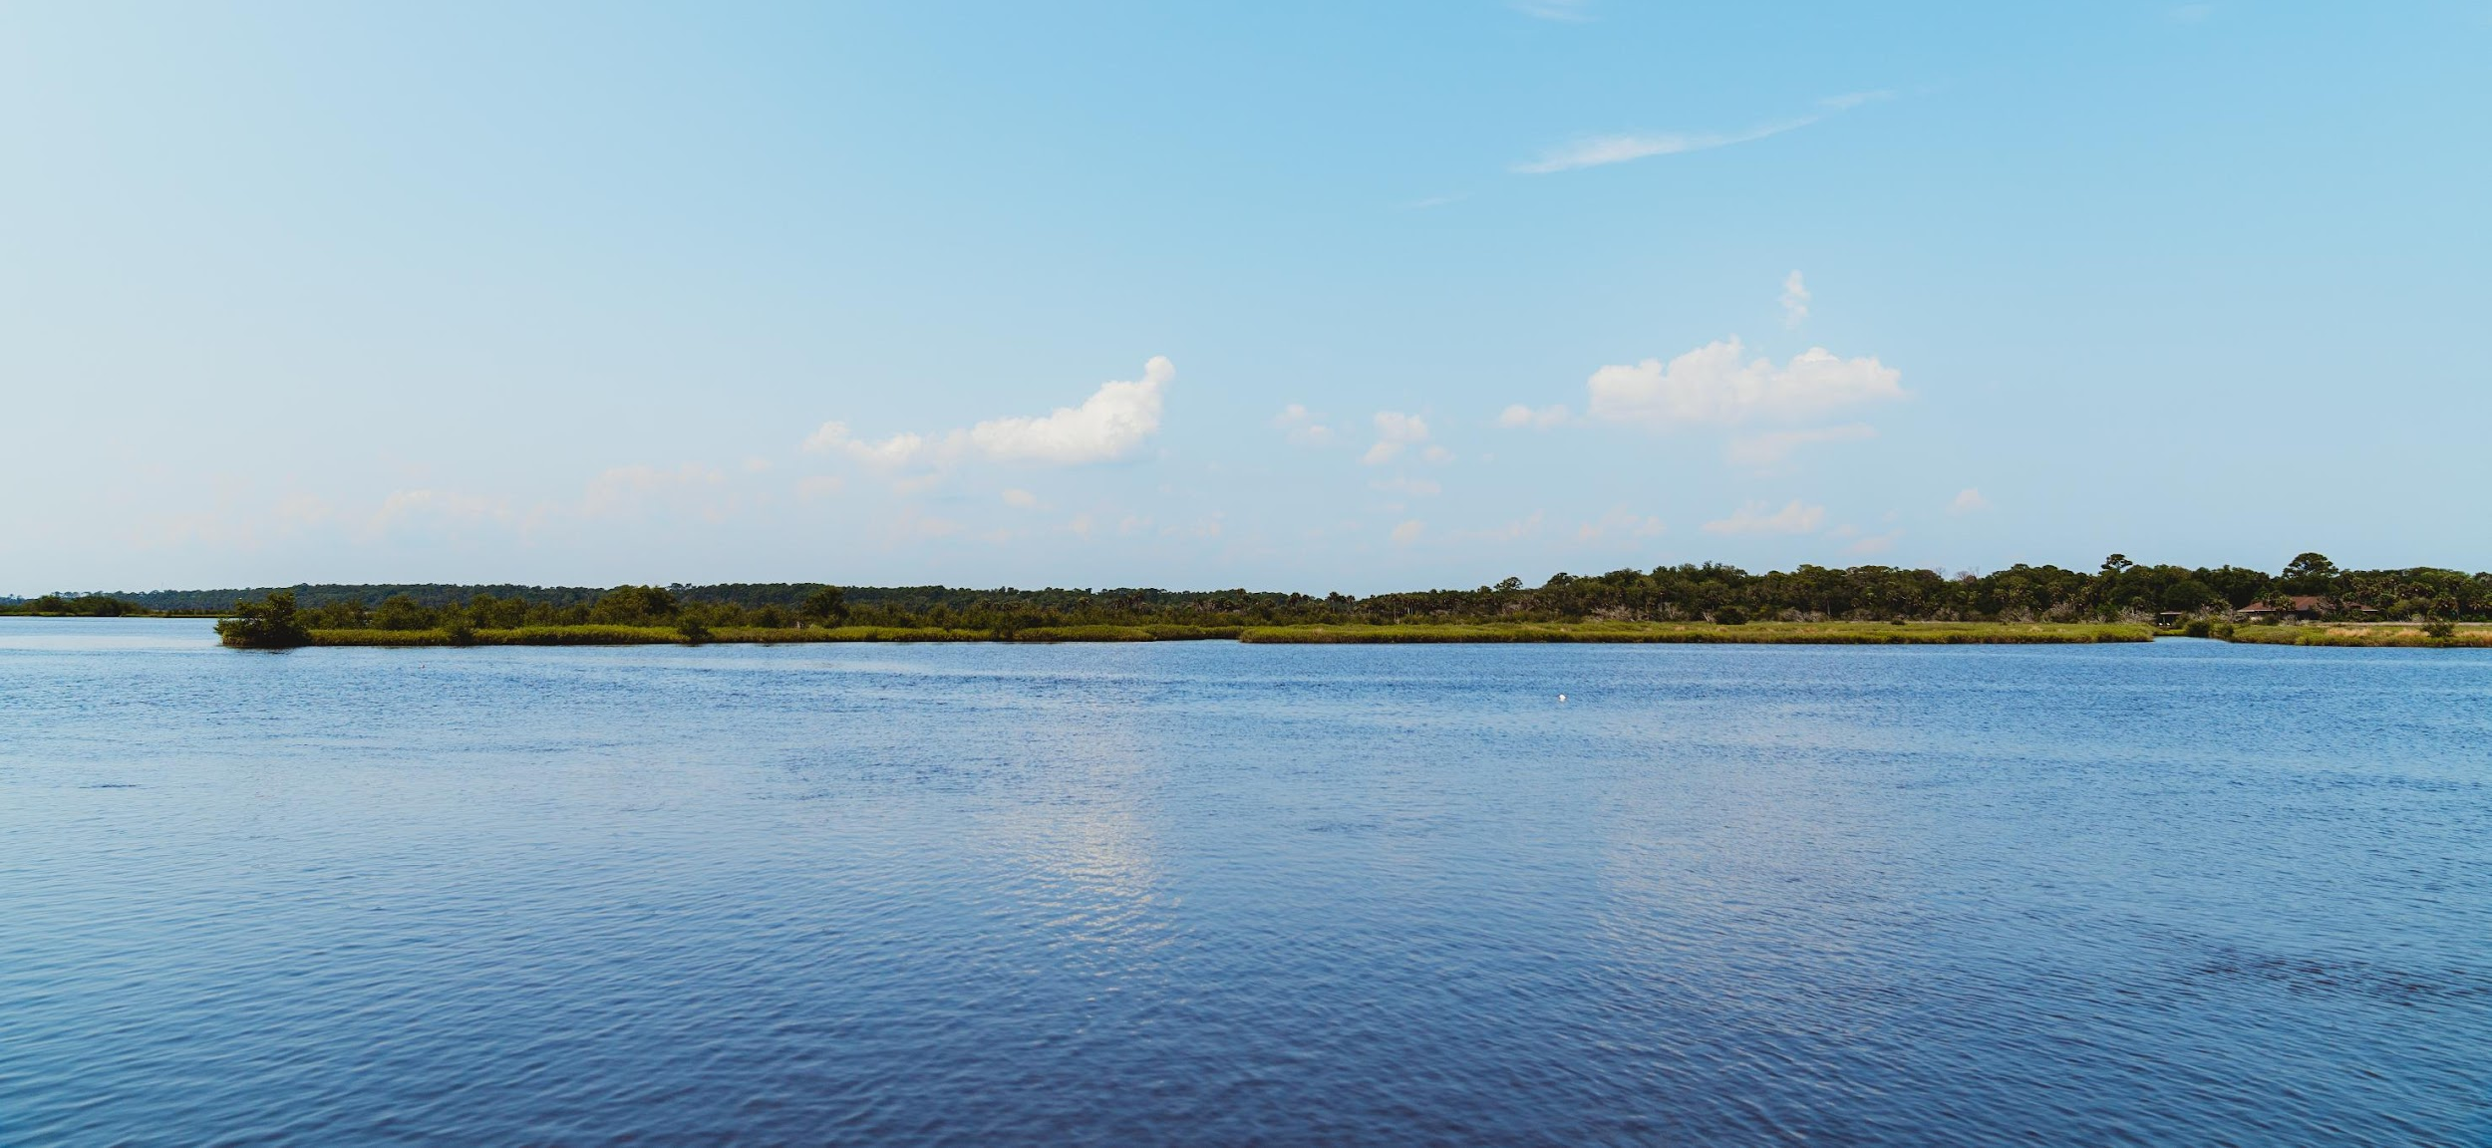
IMPLEMENTATION GRANT CYCLE
TIMELINE FOR PORTAL APPLICATIONS
April – Sept.
Office Hours are held to assist applicants
Pre-application portal is open to draft proposals
JULY 1
Resilient Florida project portal opens to accept applications
SEPT. 1
Deadline to submit proposed projects through portal
DEC. 1
Statewide Flooding and Sea Level Rise Resilience Plan due

Slide 11




IMPLEMENTATION PROJECTS
SCORING CRITERIA AT A GLANCE
A tiered review process for the plan was created in Senate Bill 1954 and codified in section 380.093, F.S., and incorporated in DEP Rule 62S-8, F.A.C.
TIER 3 (20%)
Availability of matching funds, previous state commitment, and exceeding minimum construction requirements
TIER 4 (10%)
Innovative technologies to reduce costs and provide regional collaboration, and assistance for financially disadvantaged communities
TIER 1 (40%)
Addressing risks to critical assets and regionally significant assets, existing efforts to reduce upland costs, and increases credits awarded to community in NFIP CRS
TIER 2 (30%)
Existing flooding conditions, readiness to proceed, environmental options and exceeding minimum requirements

Slide 12
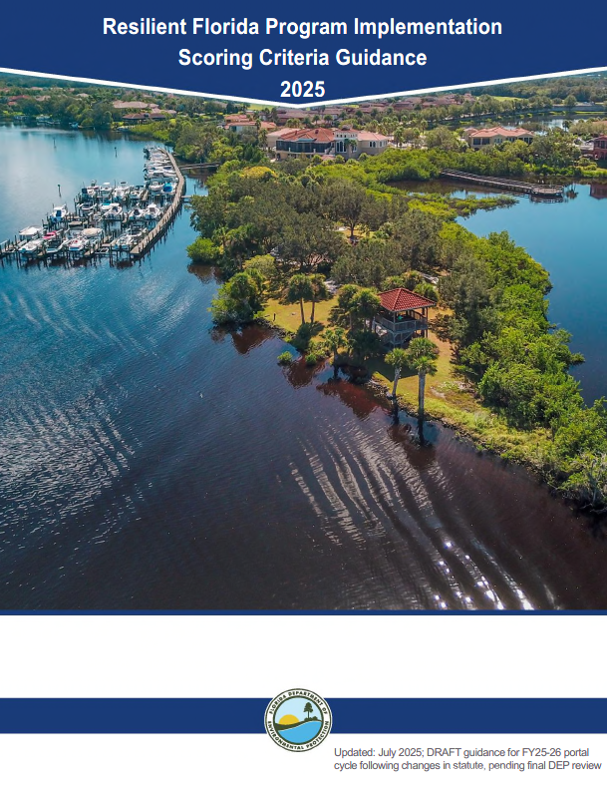
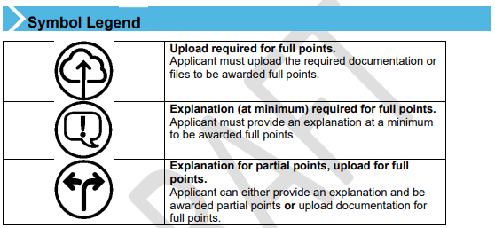
IMPLEMENTATION PROJECT SCORING
APPLICANT GUIDANCE DOCUMENT
Provides discussion, example response and specific guidance for each scoring criteria
Clearly identifies the criteria that require additional supporting documentation and/or explanation for the partial or full award of points

Slide 13
IMPLEMENTATION PROJECT SCORING
TIER 1 – 2025 UPDATE
Tier 1 must account for 40% of the total score and consist of all of the following criteria:
Criteria |  | Achievable Points
Addresses risk in a vulnerability assessment or comprehensive statewide flood vulnerability and SLR assessment. | Risk of flooding and sea level rise to critical assets and | 4
 | Risk of compound flooding to critical assets | 4
Reduces risk to regionally significant asset. | Reduces or avoid risk to regionally significant asset | 8
Reduces risk in areas with a higher percentage of vulnerable critical assets. | Percentage of total critical assets within the project impact area that are vulnerable critical assets | 8
Contributes to existing flooding mitigation projects that reduce upland damage by incorporating new or enhanced structures or restoration and revegetation projects. | Contributes by incorporating new or enhanced structure or | 4
 | Contributes by incorporating natural system restoration and revegetation or | 4
 | Contributes by incorporating new or enhanced structure and incorporating natural system restoration and revegetation | 8
Degree to which the project reduces the flood risk, and thereby increases the credits awarded to a community participating in the NFIP Community Rating System. |  | 8
Tier 1 Maximum Points |  | 40

Slide 14
IMPLEMENTATION PROJECT SCORING
KEY TAKEAWAYS
TIER 4 (10%)
Innovative technologies to reduce costs and provide regional collaboration, and assistance for financially disadvantaged communities
TIER 3 (20%)
Availability of matching funds, previous state commitment, and exceeding minimum construction requirements
TIER 2 (30%)
Existing flooding conditions (severity and frequency), readiness to proceed (status of design & permitting), environmental options and exceeding minimum requirements, and cost effectiveness
TIER 1 (40%)
Addressing risks to critical assets and reduces risks to regionally significant assets, existing efforts to reduce upland costs, and increases credits awarded to community in NFIP CRS

Slide 15
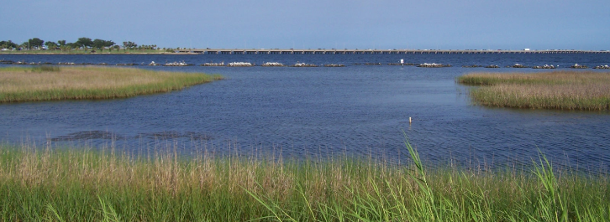
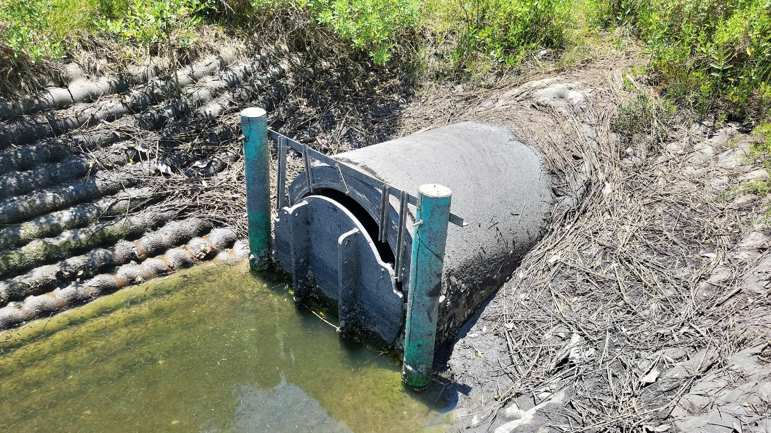
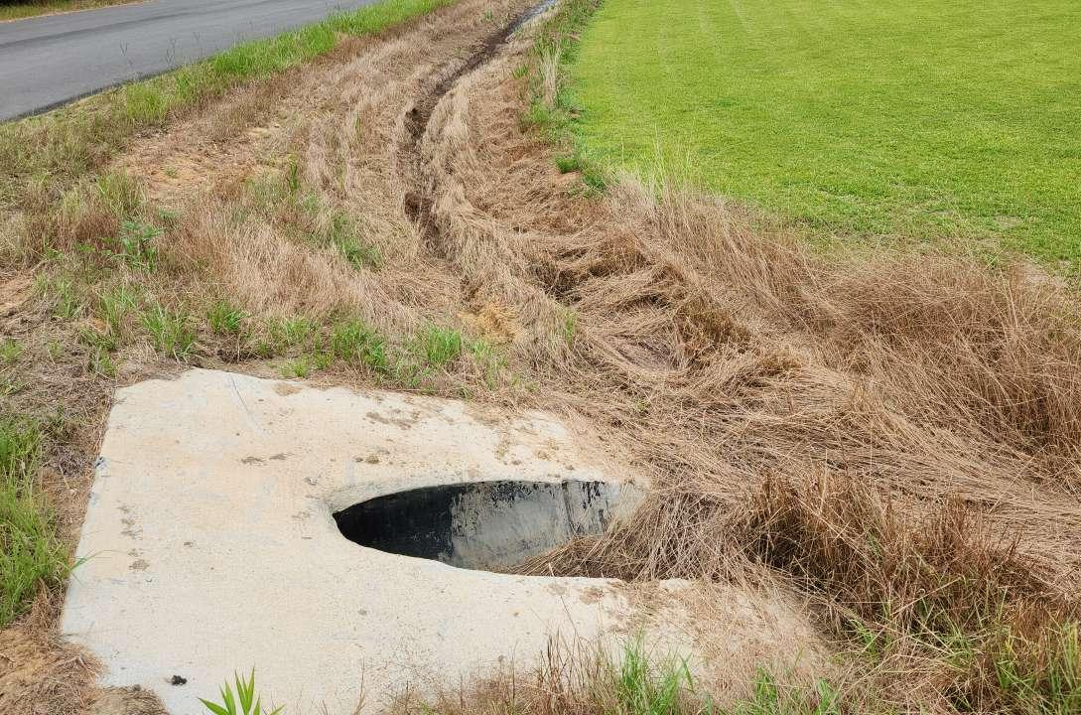
IMPLEMENTATION GRANTS
PROJECT TYPES

Slide 16
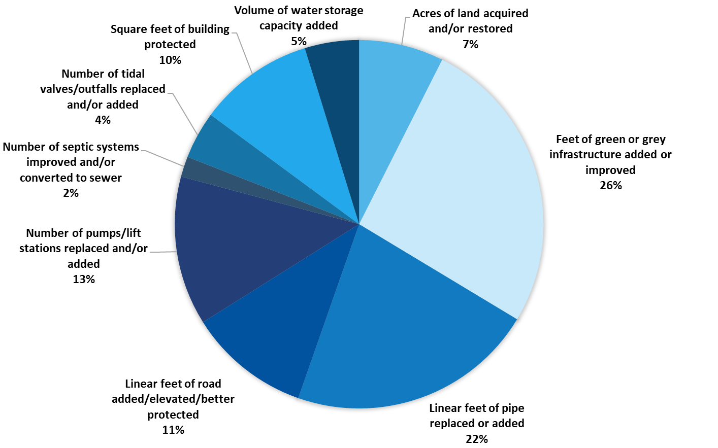
PROJECT METRICS
EVALUATING SUCCESS
Metrics assigned based on project type
Tracked with grant deliverables and during site visits by DEP regional field agents

Slide 17
IMPLEMENTATION GRANTS
CONSTRUCTION START TIMELINE
Estimated or actual construction start year for each implementation grant
74 projects estimated to start construction in Oct. – Dec. 2025

Slide 18
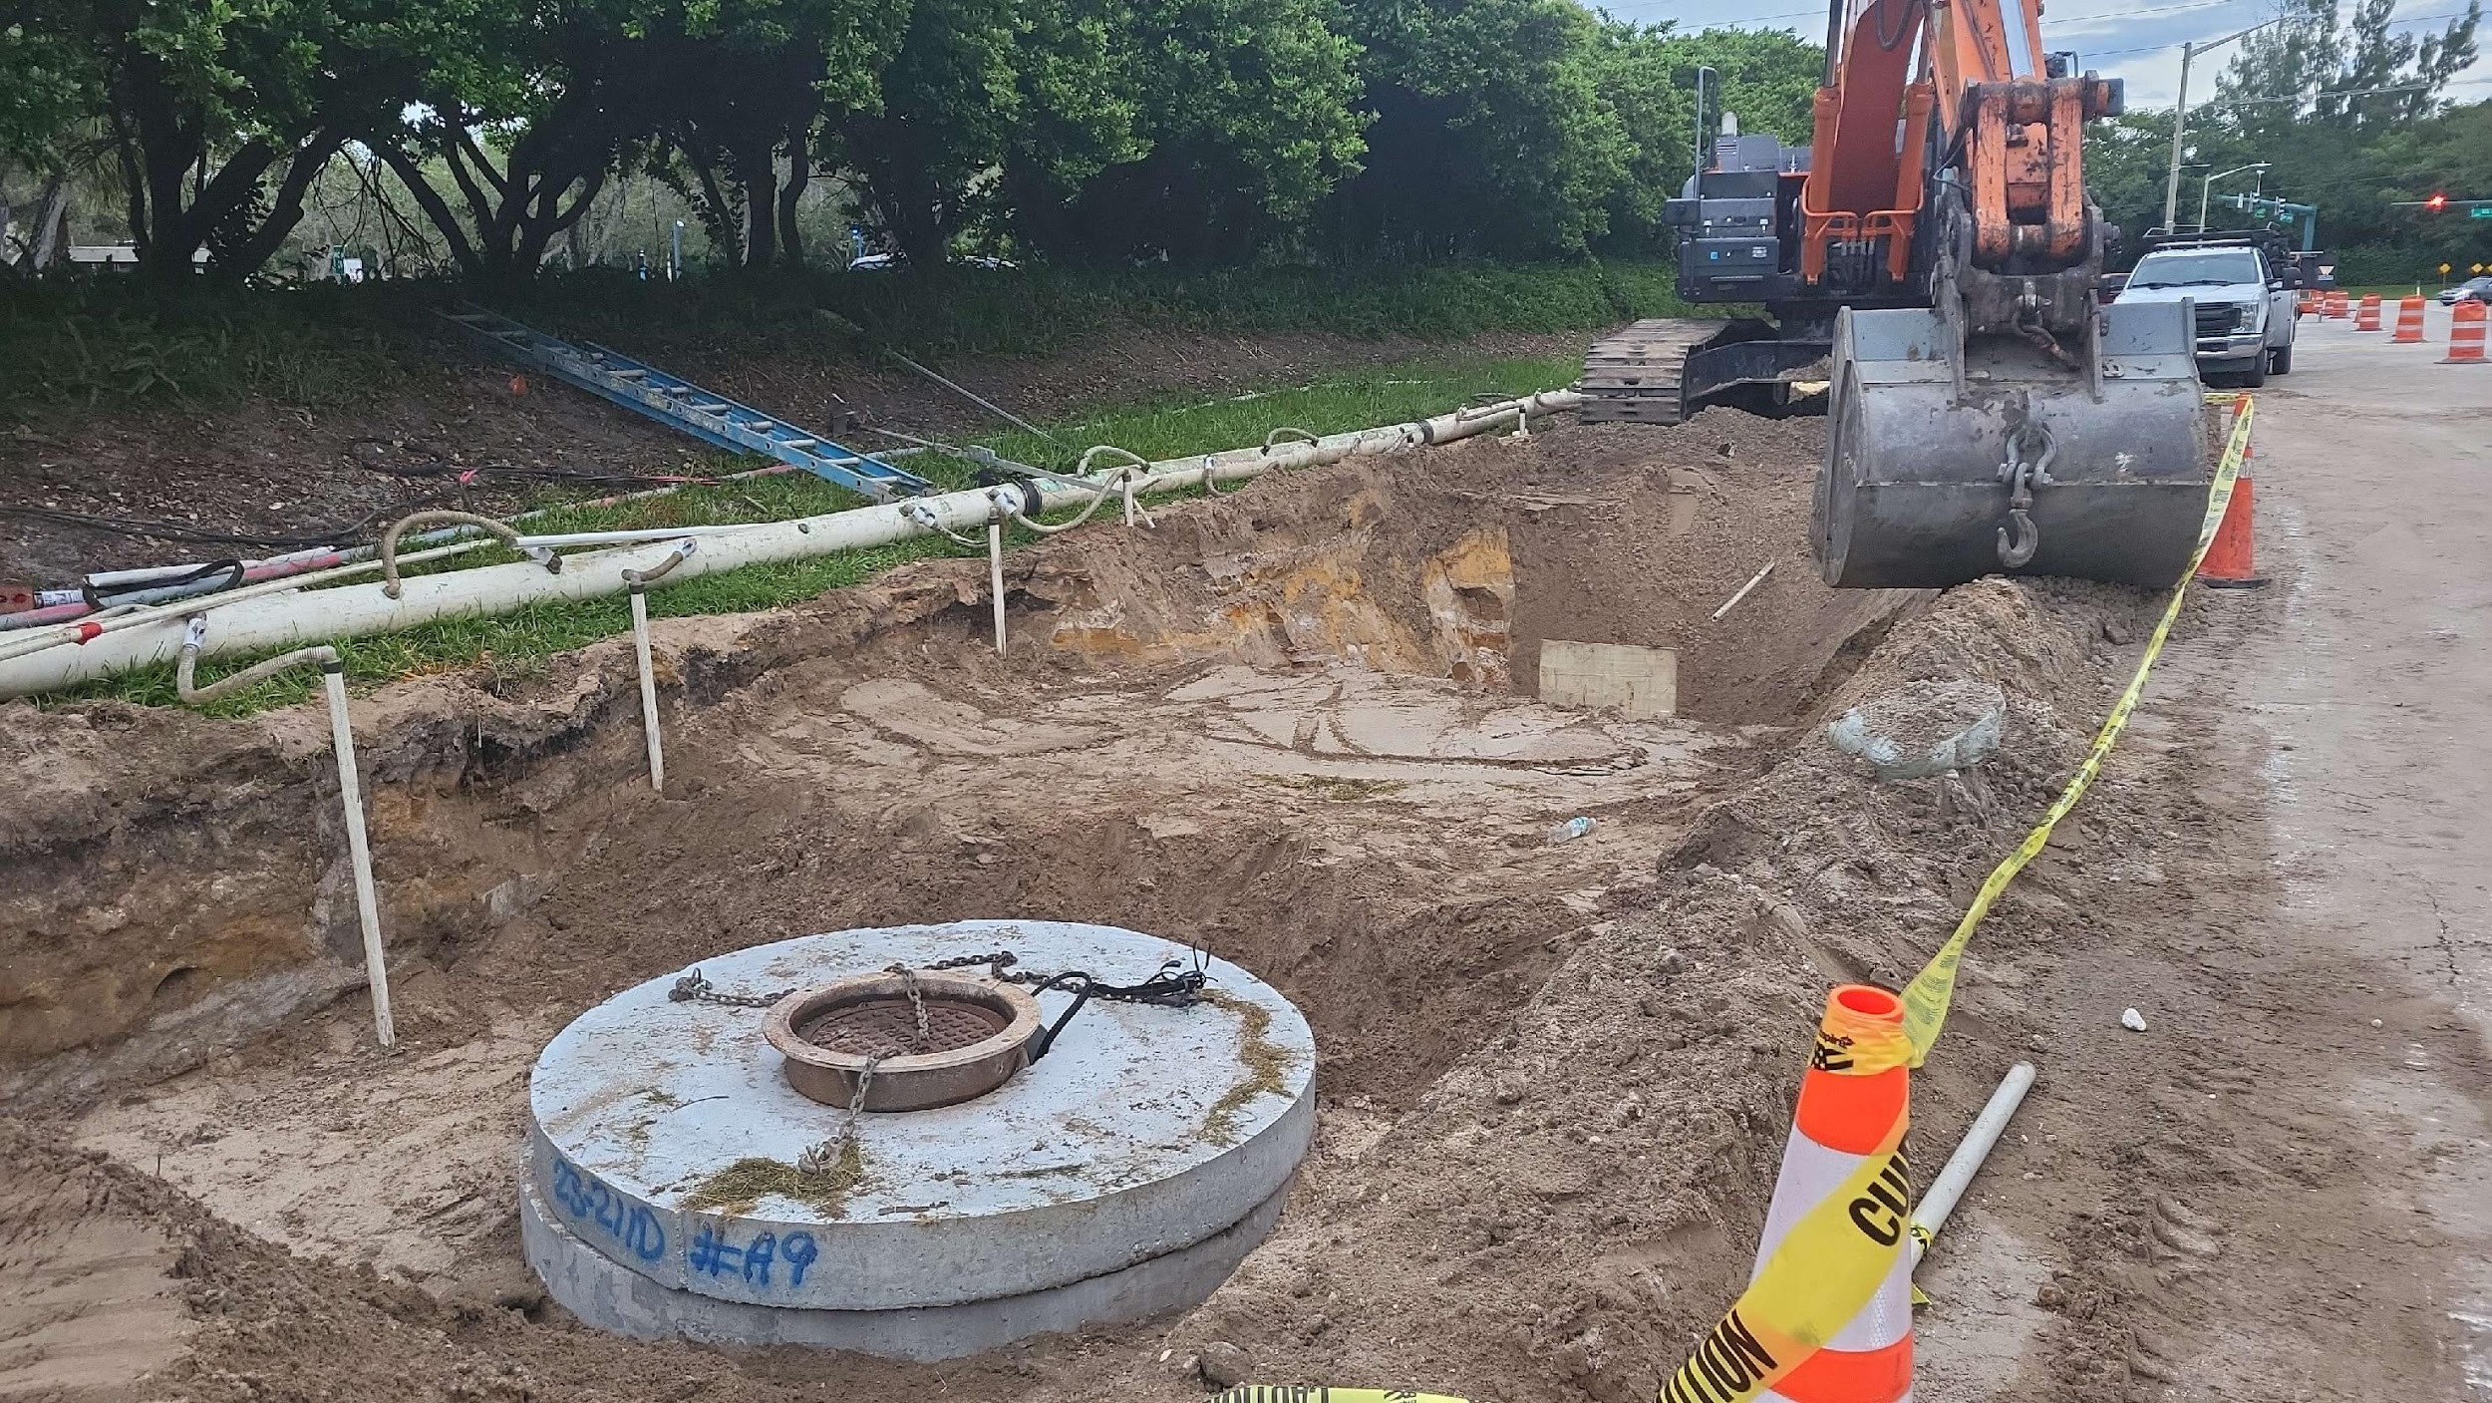
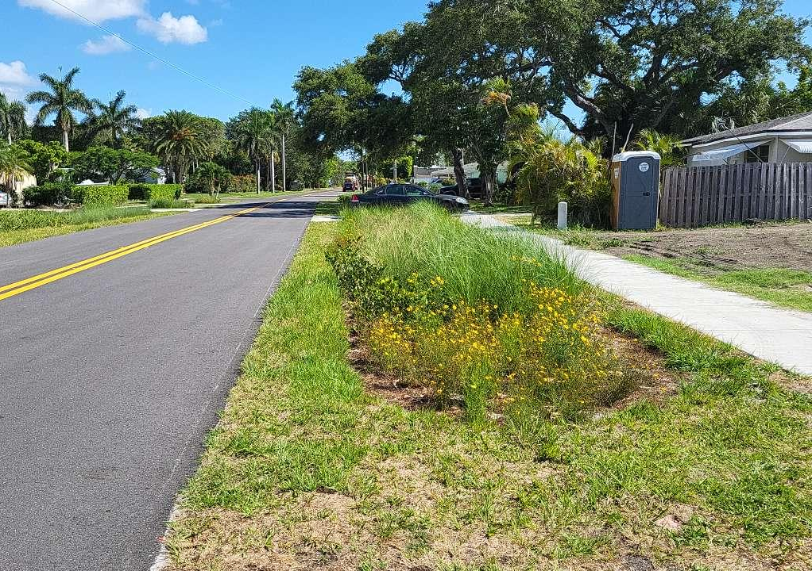
RESILIENT FLORIDA PROGRAM
LESSONS LEARNED
Planning effort challenges:
Statute requirement changes
Extended timelines for completion
Inconsistent approaches
Cost overruns
Implementation project challenges:
Timing of grant and match fund awards
Match fund eligibility
Design and permitting delays
Implementation of complex projects in existing environment
Scope of work adjustments
During design and/or unexpected changes required during construction
Cost of materials and cost overruns

Slide 19

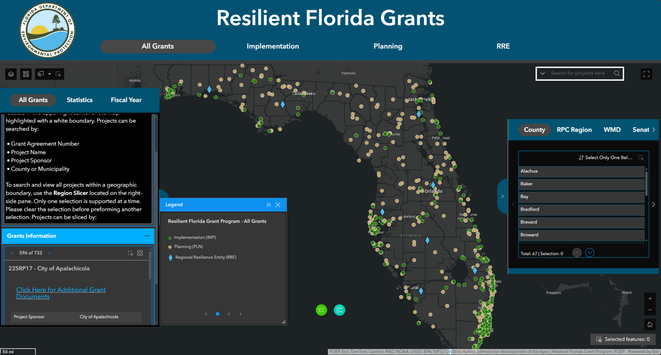
RF PROGRAM AWARDS
Access the Dashboard by scanning the QR Code.
Public GIS Dashboard
All grants in system for the program
View, sort, filter and export general project information

Slide 20

THE FLORIDA DEPARTMENT OF ENVIRONMENTAL PROTECTION
THANK YOU
Resilient Florida Program
Office of Resilience and Coastal Protection
Florida Department of Environmental Protection
Contact Information:
Resilience@FloridaDEP.gov
Eddy.Bouza@FloridaDEP.gov
Devin.Resko@FloridaDEP.gov
Hanna.Tillotson@FloridaDEP.gov

