Slide 1
Climate Mayors
Electric Vehicle Purchasing Collaborative
Jared Walker
Technical Lead – Fleet Transition
RCAP Resilient Procurement
May 10th 2019

Slide 2
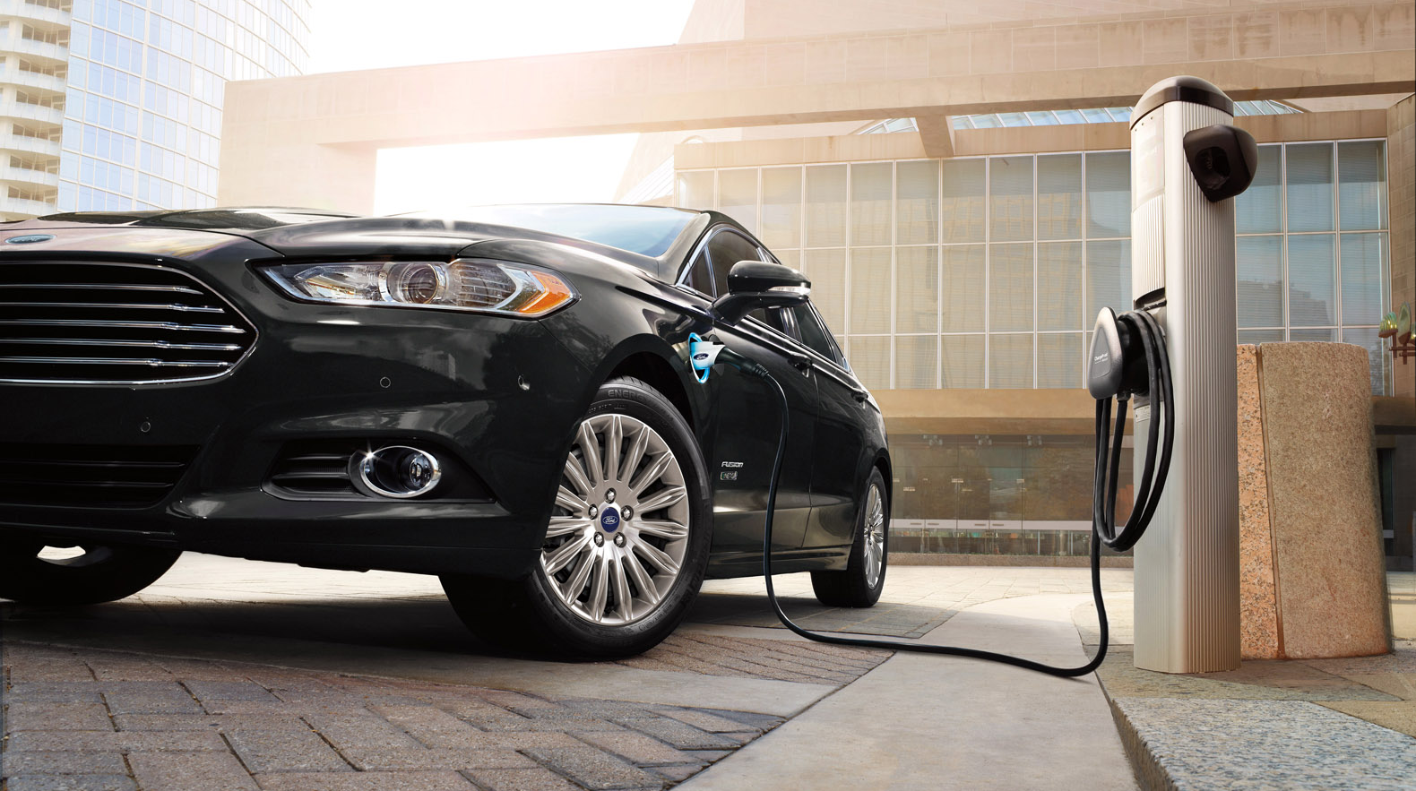
The Electrification Coalition
About Us
The Electrification Coalition is a nonpartisan, not-for-profit group of business leaders committed to promoting policies and actions that facilitate the deployment of electric vehicles on a mass scale.

Slide 3
How to Maximize Fleet Electrification Benefits
Total Cost of Ownership Approach
Fleet managers rank TCO as the most significant factor in acquisition decisions
Route Predictability
Lower infrastructure investment; known impact of transition to new technology
High Utilization Rates
High VMT/vehicle increases ROI and lowers cost per mile
Use of Central Parking Facilities
Lower infrastructure investment; economies of scale in installation
Maintenance Costs
Lower maintenance costs of new technology = substantial cost savings
Lower Fuel Prices
Electricity is domestic, diverse, and cleaner
Return on Investment
In the right applications, EVs will generate an ROI during their useful life
Sustainability Initiatives
EVs contribute to sustainability initiatives around reduced GHG emissions and/or petroleum use

Slide 4
Driving EV Fleet Transition
Driving EV Fleet Transition
Reducing barriers to transition for ALL public fleets (not just cities that are part of Climate Mayors)
Increasing procurement choice – including innovating leasing options
Reducing administrative time
Aggregating national demand to lower costs
Helping with pre/post-deployment planning and training
Offering cooperative purchasing/bundling purchasing

Slide 5
Driving EV Fleet Transition
Cities with commitments to EV fleets
MI | Ann Arbor | AR | Fayetteville | NY | Rochester
CO | Aspen | MD | Greenbelt | CA | San Diego
TX | Austin | NY | Highland Park | CA | Sacramento
CA | Berkeley | NJ | Hoboken | CA | Santa Monica
CA | Beverly Hills | TX | Houston | FL | Satellite Beach
NY | Binghamton | NJ | Jersey City | WA | Seattle
VT | Burlington | CA | Long Beach | MA | Somerville
FL | Cape Canaveral | CA | Los Angeles | NJ | Verona
NJ | Cape May Point | KY | Louisville | DC | Washington
CA | Chula Vista | WI | Madison | FL | West Palm Beach
OH | Cincinnati | WA | Olympia | NY | Yonkers
NC | Charlotte | FL | Orlando | CA | Alameda County
OH | Cleveland | AZ | Phoenix | OH | Cuyahoga County
OH | Columbus | PA | Pittsburgh | MN | Hennepin County
CO | Denver | NJ | Plainsboro | CA | Los Angeles County
IA | Des Moines | OR | Portland | AZ | Pima County
 |  | CA | Redwood City

