Slide 1
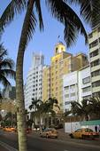
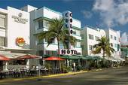
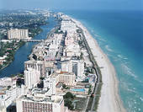
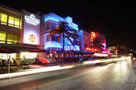
SEA LEVEL RISE IN MIAMI BEACH
MIAMIBEACH

Slide 2
Seawall Construction

Slide 3
Seawall installed

Slide 4
Setting stormwater manhole

Slide 5
Stormwater Vortex Structure

Slide 6
Stormwater Structure

Slide 7
Finishing installing vortex structure

Slide 8
Pump station wet well with lid

Slide 9
Pump station discharge pipes

Slide 10
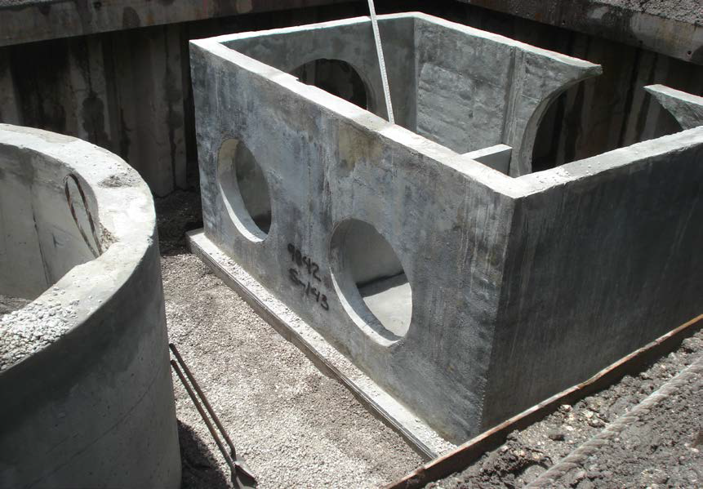
Diversion Boxes for High Flow

Slide 11
Pump station gravity bypass

Slide 12
Pump station discharge pipes

Slide 13
Finishing the bottom of the pump station

Slide 14
Completed structure

Slide 15
Pump Station outfall pipe

Slide 16
Stormwater Outfall

Slide 17
6th Street and West Ave

Slide 18
14th Street and West Ave.

Slide 19
New Elevation Criteria

Slide 20
New Elevated Streets

Slide 21
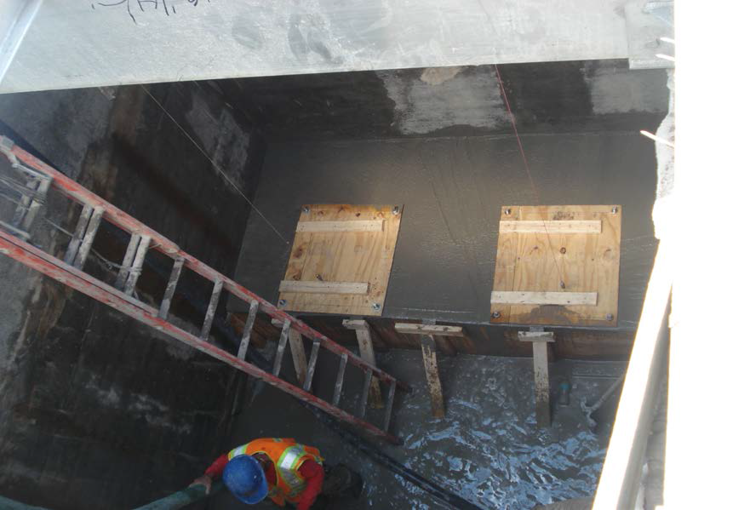
New Elevated Streets

