Slide 1
think globally, act regionally:
the southeast florida regional climate change compact
Jason Liechty
AAA workshop
august 28, 2014

Slide 2
the southeast florida regional climate change compact

Slide 3
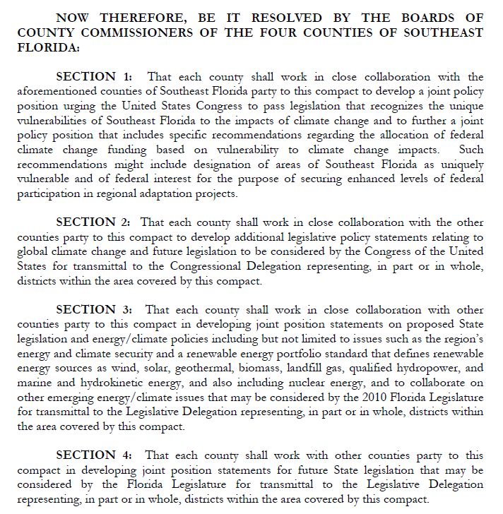
dual identity
strictly speaking: an agreement by Palm Beach, Broward, Miami-Dade, and Monroe counties to work collaboratively on climate issues

Slide 4
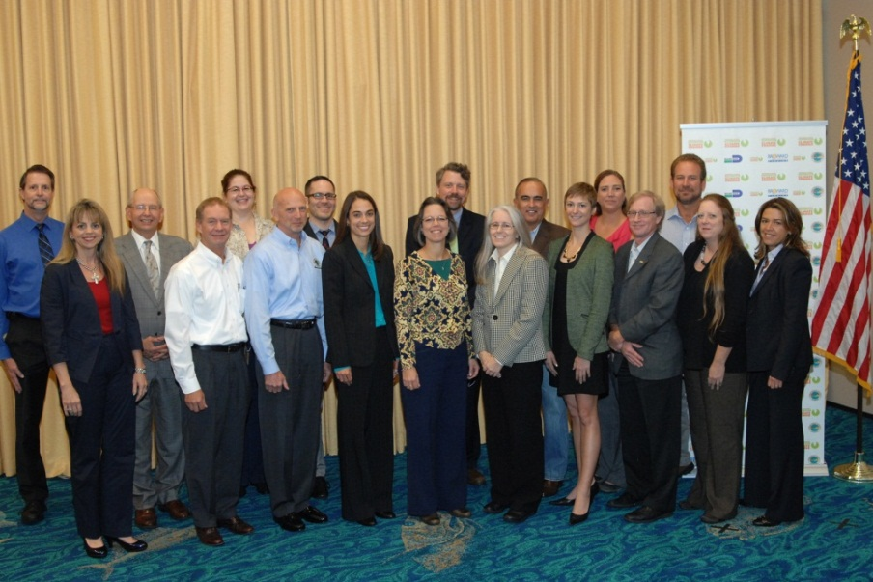
dual identity
more broadly: a way of describing the working relationships and collaborative efforts among the partners

Slide 5
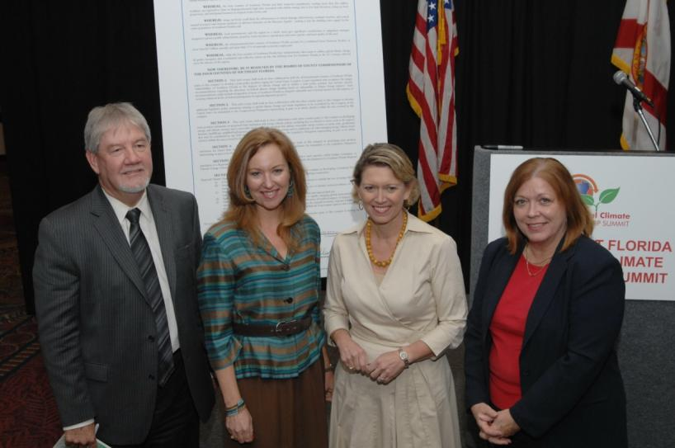
genesis
arose out of shared recognition of regional vulnerabilities and challenges
october 2009: leaders from the four counties convene first summit
january 2010: ratification by all four counties complete

Slide 6
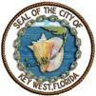
governance
staff steering committee
2 members from each county
1 municipal member from each county
non-voting representatives
usually operates by consensus

Slide 7
governance
teams
policy
technical
summit
institute for sustainable communities (isc) support

Slide 8
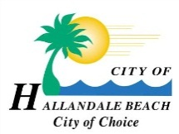
collaborating partners

Slide 9
four commitments
annual climate leadership summits
regional tools
policy and resource coordination
regional climate action plan (RCAP)

Slide 10
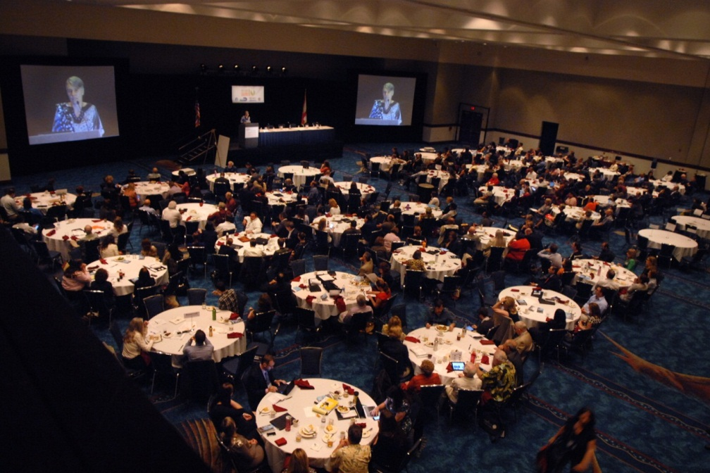
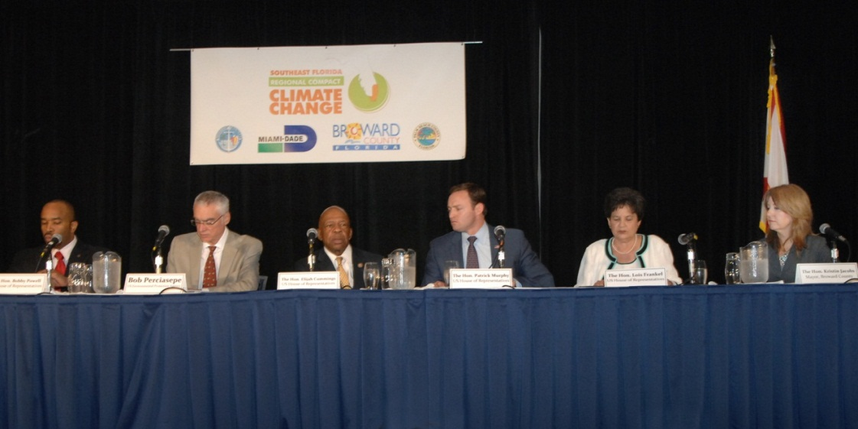
annual climate leadership summits

Slide 11
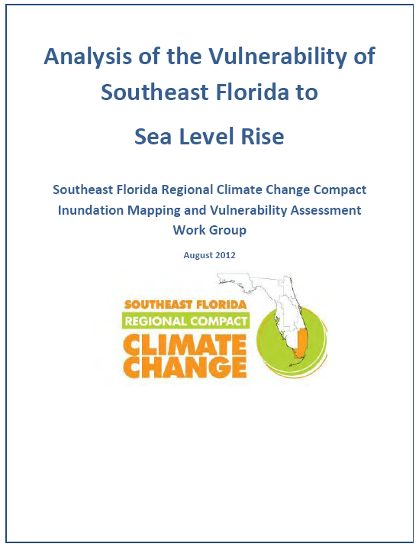
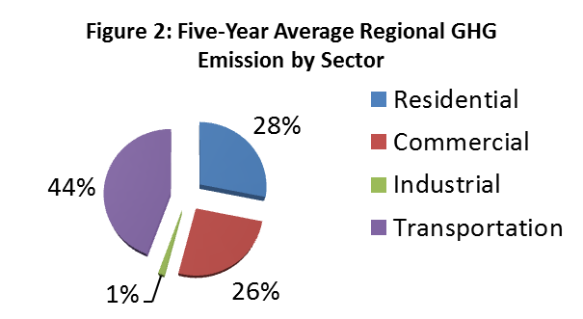
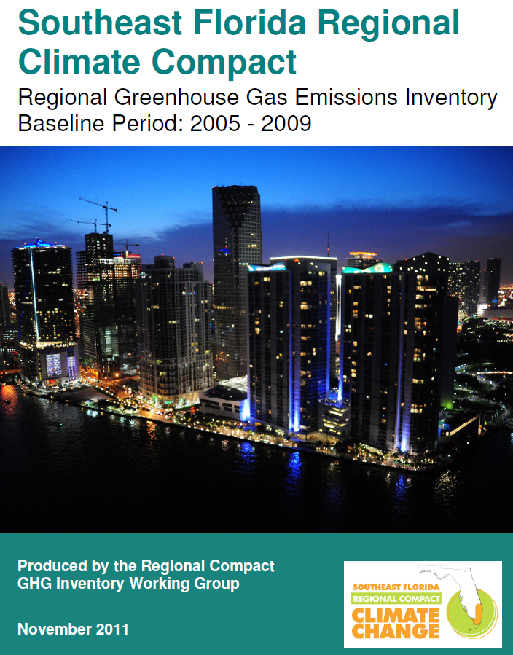
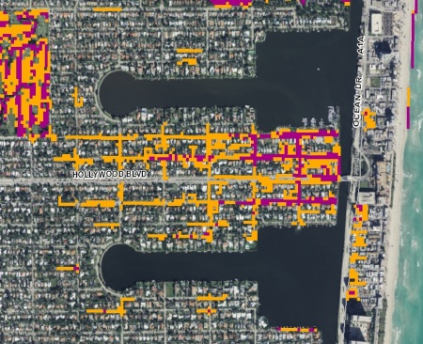
regional tools
Taxable Value of Property Impacted
 | Monroe | Broward | Palm Beach
1 foot | $ 2,763,294,786 | $ 403,069,831 | $ 396,618,089
2 foot | 8,388,138,219 | 1,751,104,870 | 1,251,877,561
3 foot | 15,087,755,147 | 6,900,509,868 | 3,559,471,158

Slide 12
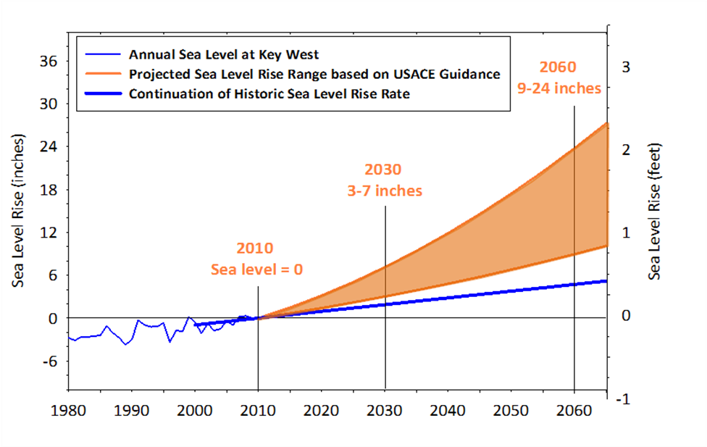
regional tools
unified sea level rise projection

Slide 13
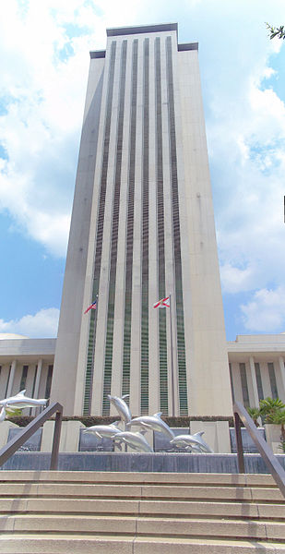
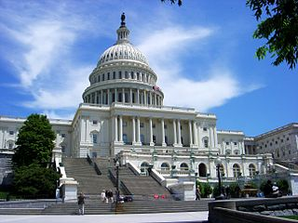
policy and resource coordination
at the core of the compact
federal and state legislative advocacy
annual legislative programs
strong support for clean energy, energy efficiency, smart growth, greenhouse gas emissions reductions
collaborative efforts
information sharing and replication of initiatives

Slide 14
policy and resource coordination Adaptation Action Areas
added to Florida Community Planning Act in 2011 session
Florida Statutes 163.3177(6)(g)10
optional comprehensive plan designation for areas that:
experience coastal flooding
are vulnerable to the related impacts of rising sea levels
purpose: prioritizing funding for infrastructure and adaptation planning

Slide 15
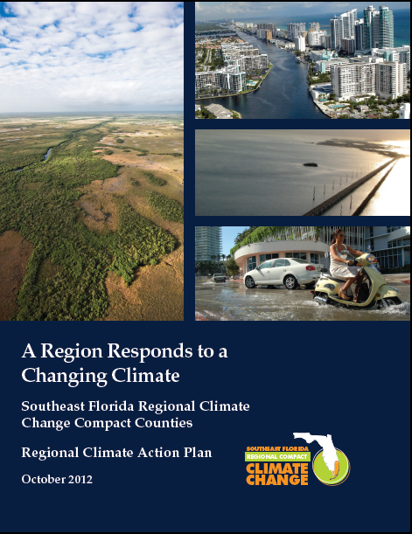
regional climate action plan
completed october 2012
fully adopted by four counties as of april 2014
product of 3-year planning and public process
reflects contributions of 135+ work group members
includes companion implementation guide
Download at www.southeastfloridaclimatecompact.org

Slide 16
regional climate action plan
details 110 recommendations across 7 planning areas:
sustainable communities and transportation planning
water supply, management, and infrastructure
natural systems
agriculture
energy and fuel
risk reduction and emergency management
outreach and public policy

Slide 17
regional climate action plan
climate action plan
stormwater master planning
Miami-d
CDMP
..
local mitigation strategy
aligns with other plans
2 regional
planning
councils
7 livability principles
4 counties
regional climate action plan
7 goal areas
137 initiatives

Slide 18
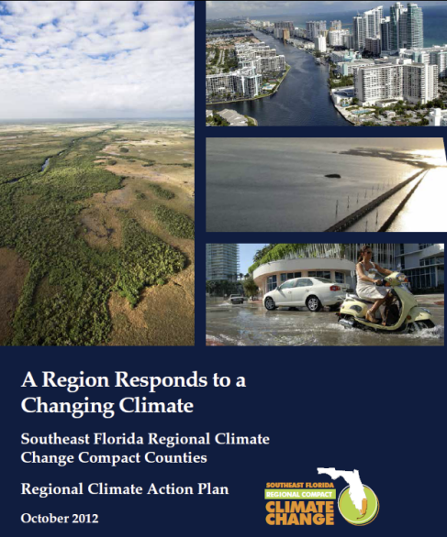
regional climate action plan
implementation underway
RCAP workshops
supported by three-year, $975K grant from Kresge Foundation to Institute for Sustainable Communities
9 to 12 workshops over three years

Slide 19
AAAs in the RCAP
SP-3 | Incorporate “Adaptation Action Area” definition (as provided for in Florida law) into municipal and/or county Comprehensive Plans, to provide a means to identify those areas deemed most vulnerable to sea level rise and other climate change impacts including but not limited to extreme high tides, heavy local rain events, and storm surge for the purpose of prioritized funding and adaptation planning.
SP-4 | Develop criteria in collaboration with municipal and county planning authorities for the purpose of defining Adaptation Action Areas as well as other areas requiring adaptation improvements related to coastal flooding and sea level rise that may include, but not be limited to:
 | · Areas below, at, or near mean higher high water;
 | · Areas which have a hydrological connection to coastal waters;
 | · Areas designated as evacuation zones for storm surge; and/or
 | · Other areas impacted by climate related drainage/flood control issues.
SP-5 | Conduct new or utilize existing vulnerability analyses and other technical tools as they are developed as a means for identifying Adaptation Action Areas as well as other areas requiring adaptation improvements related to coastal flooding and sea level rise, to provide guidance for adaptation planning efforts in areas especially at risk to sea level rise, tidal flooding and other related impacts of climate change.
SP-6 | Develop policies, as provided for in Florida law and in collaboration with the appropriate municipal and county planning authorities, related to areas designated as Adaptation Action Areas or similarly vulnerable areas to improve resilience to coastal flooding, sea level rise and other climate related vulnerabilities and provide guidance for other adaptation planning efforts.
SP-8 | Identify locations within Adaptation Action Areas or similarly vulnerable areas where targeted infrastructure improvements, new infrastructure, or modified land use and/or development practices could reduce vulnerability and/or improve community resilience.
SP-9 | Coordinate regionally across municipalities and county planning authorities on the development of projects and funding proposals to seek prioritized funding for identified infrastructure needs and specific adaptation improvements required within Adaptation Action Area or other related adaptation planning areas.

Slide 20
AAA resources
on compact website:
http://southeastfloridaclimatecompact.org/ aaa-resource-page/

Slide 21
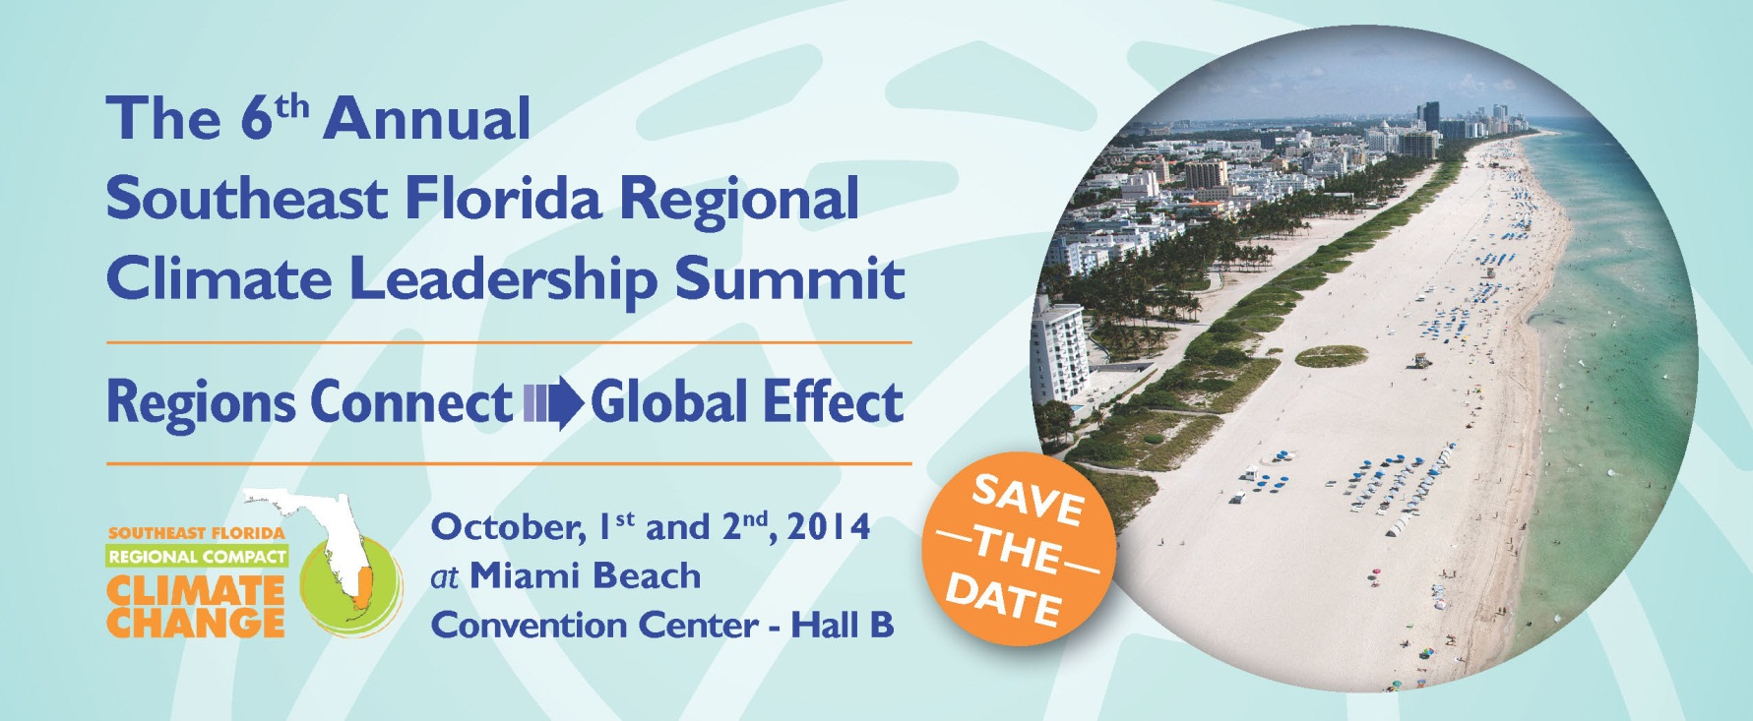
reminder: summit registration
discounted registration ends August 31!

Slide 22
http://www.broward.org
http://southeastfloridaclimatecompact.org
Jason Liechty
Environmental Projects Coordinator
Broward County Environmental Planning and Community Resilience Division
954-519-0310
jliechty@broward.org

