Slide 1
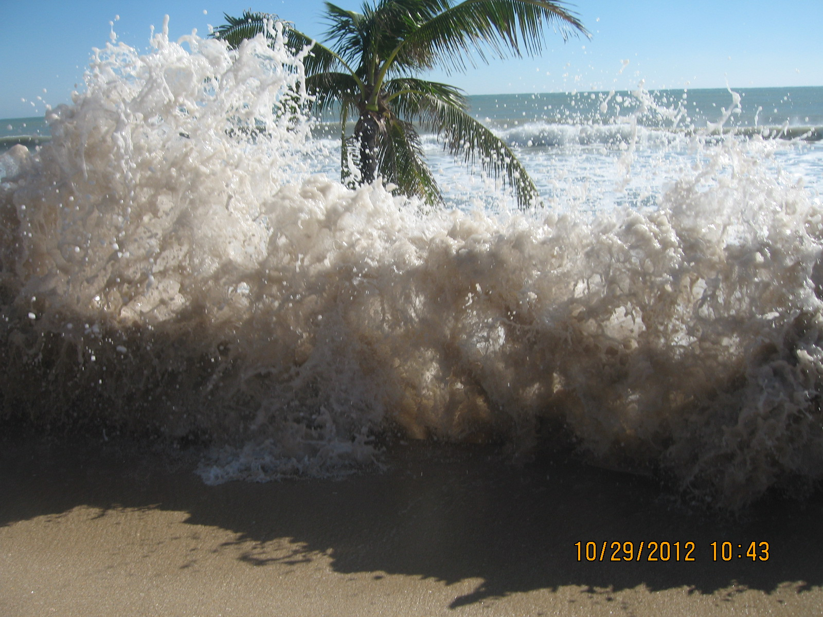
Regional Climate Resilience: Policy and Planning in Broward County
Adaptation Action Area Workshop
August 28, 2014
Notes:
Florida is home to natural resources of national and international significance including the Florida Everglades, the prized coral reefs, FL Keys Sanctuaries and many national parks.

Slide 2
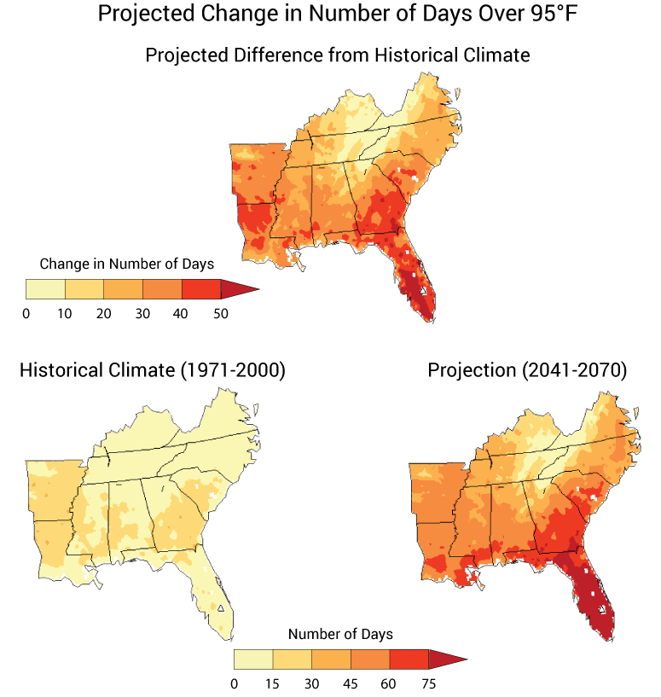
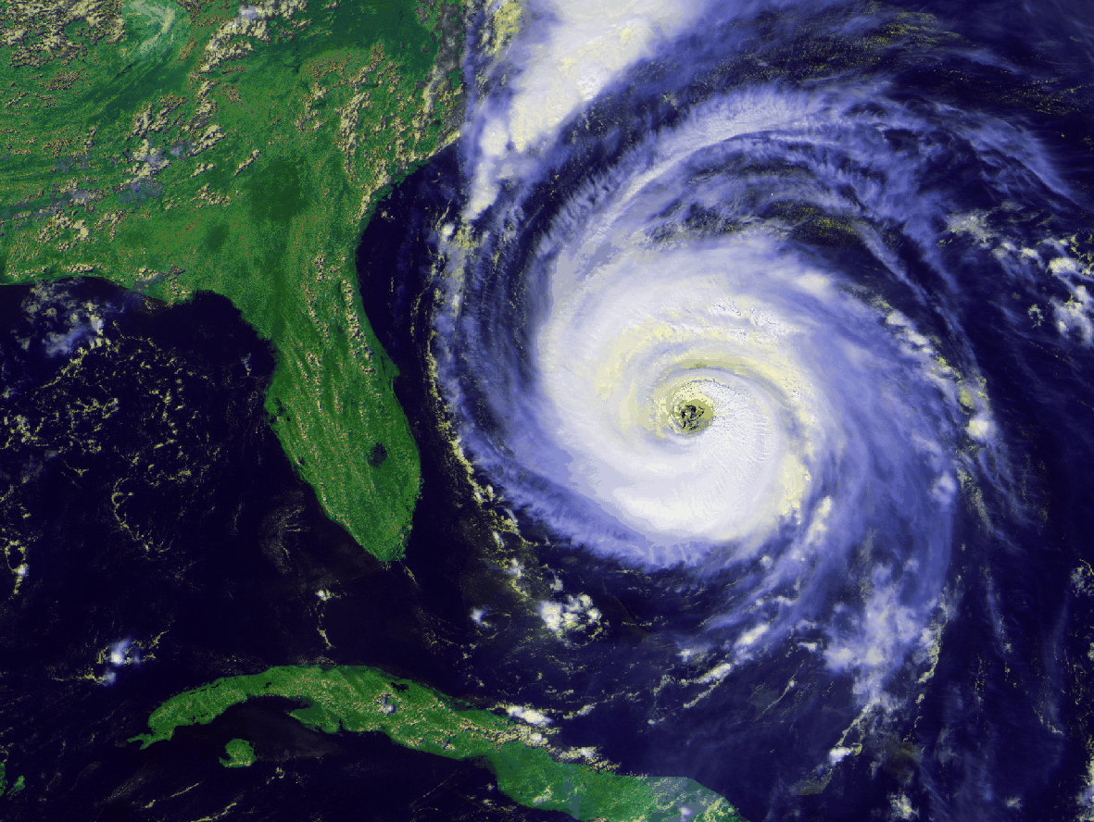
Climate Trends and Predictions for South Florida
Sea level rise
Extreme rainfall and drought
Coastal and inland flooding
Increased storm intensity
Beach erosion
Saltwater intrusion
Rising Temperatures
Ocean acidification

Slide 3
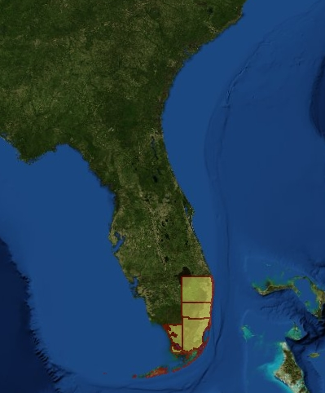
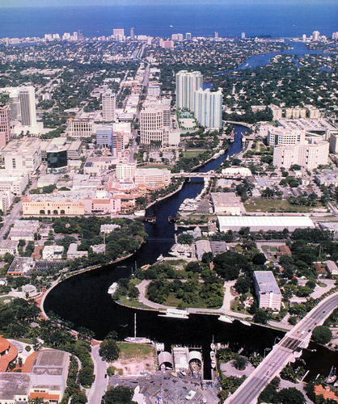
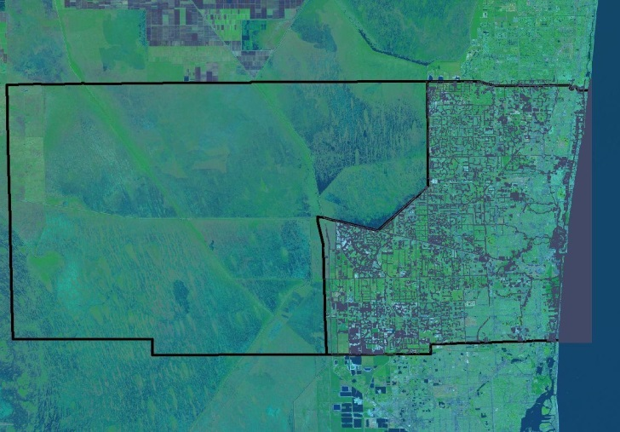
Sawgrass to Seagrass: Connected

Slide 4
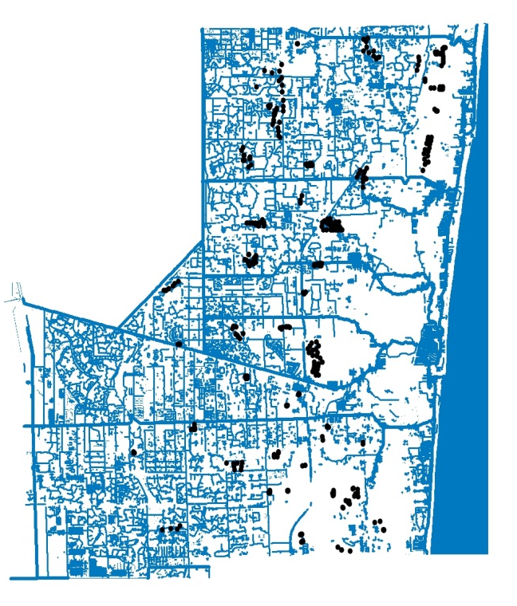
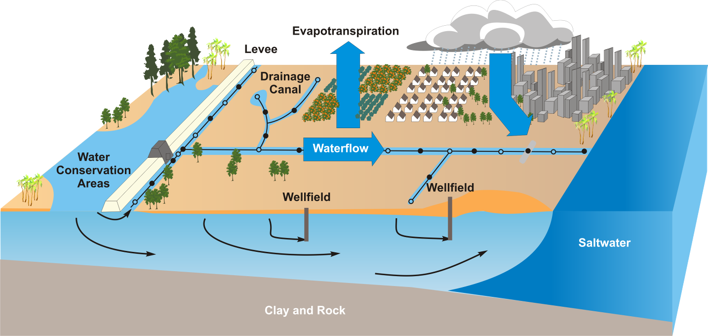
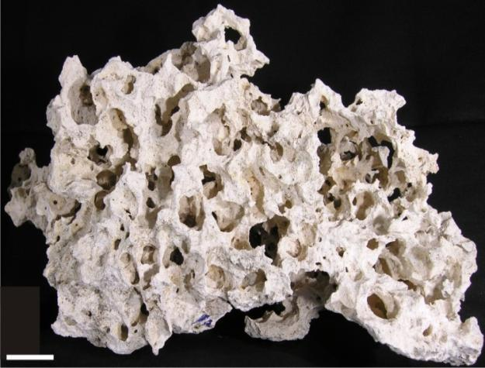
Elevation and Hydrology Matter!
5cm
Broward Today
23% of land surface and 30% total area is
less than 4 feet above mean sea level
1800 miles of canals provide flood control

Slide 5
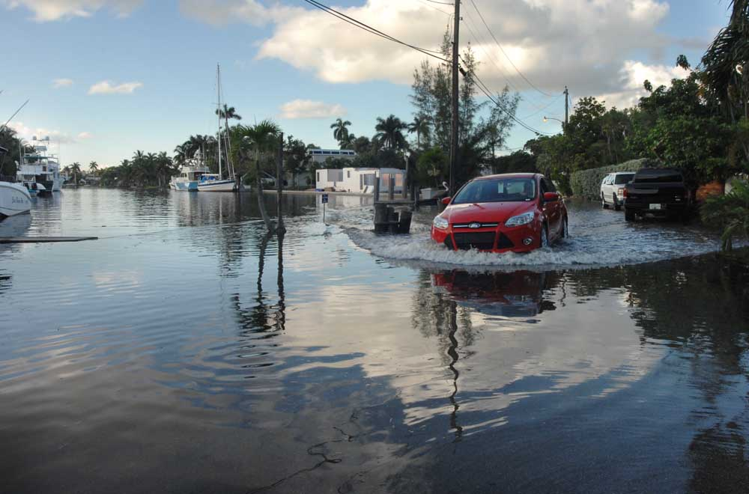
Coastal Extreme High Tide Flood Impacts

Slide 6
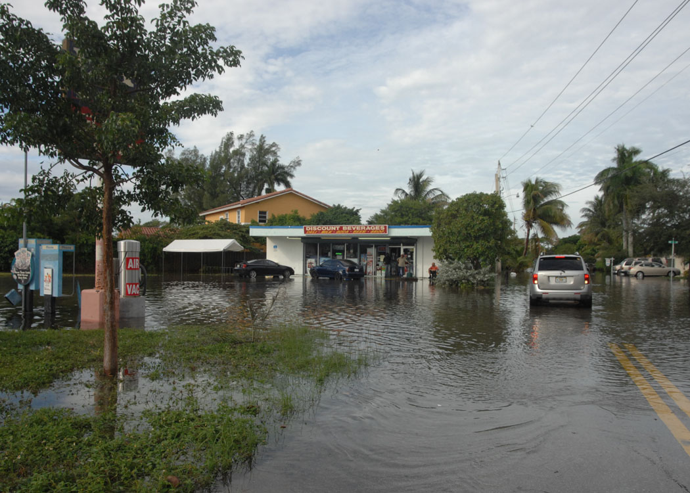
Impacts Further Inland
Compounded Storm Flooding due to High Tide

Slide 7
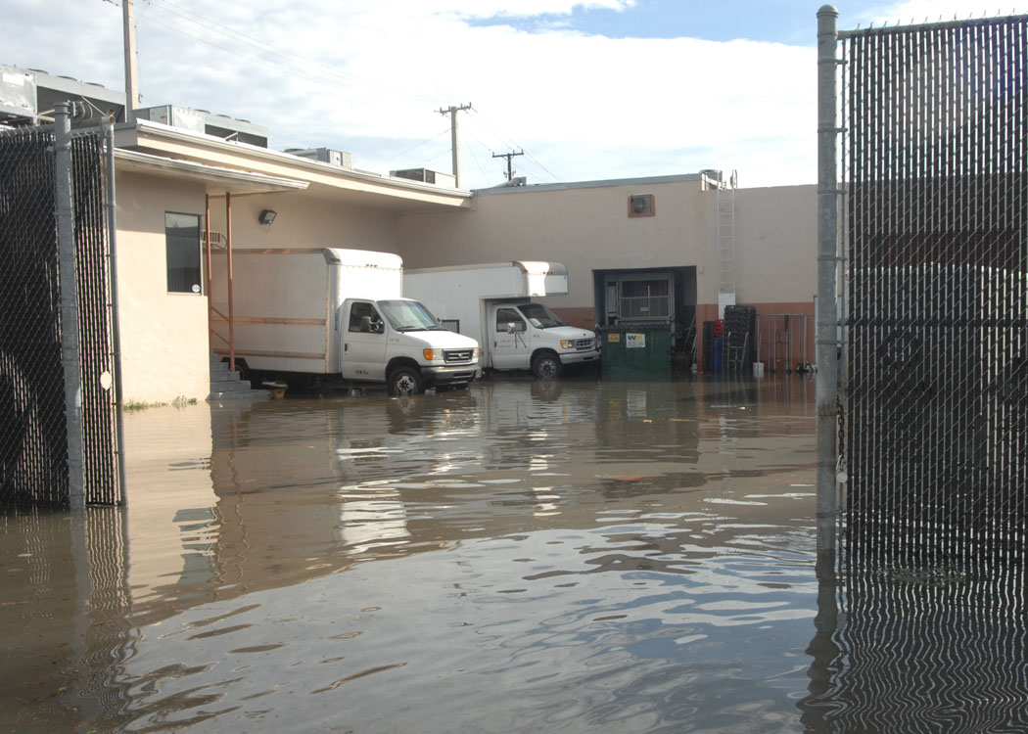
Impacts to Commercial Operations

Slide 8
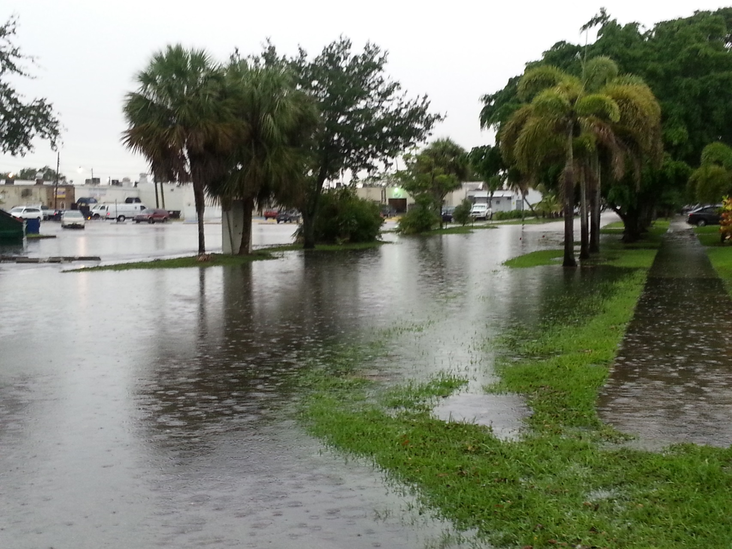
Older Residential –
Taxed Drainage Systems

Slide 9
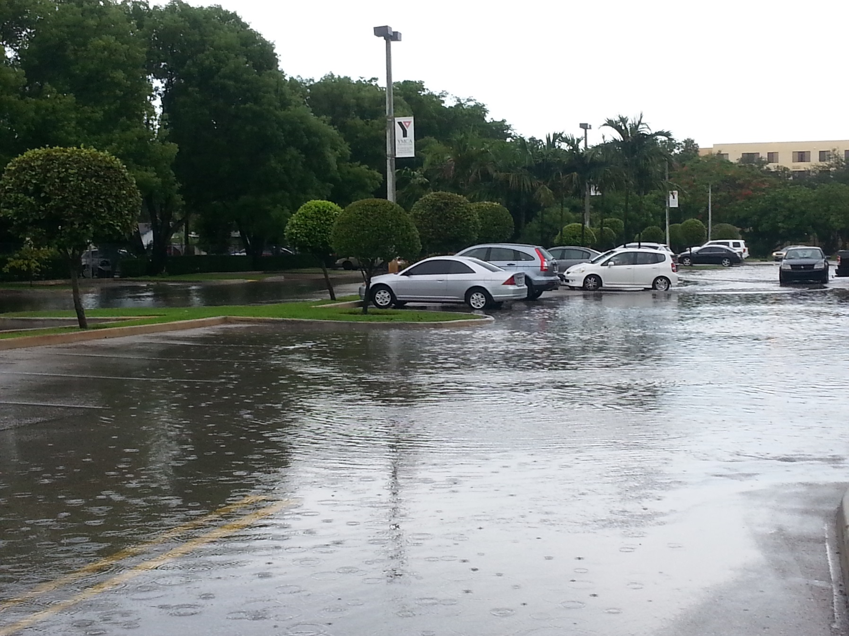
Inaccessible Activity Center

Slide 10
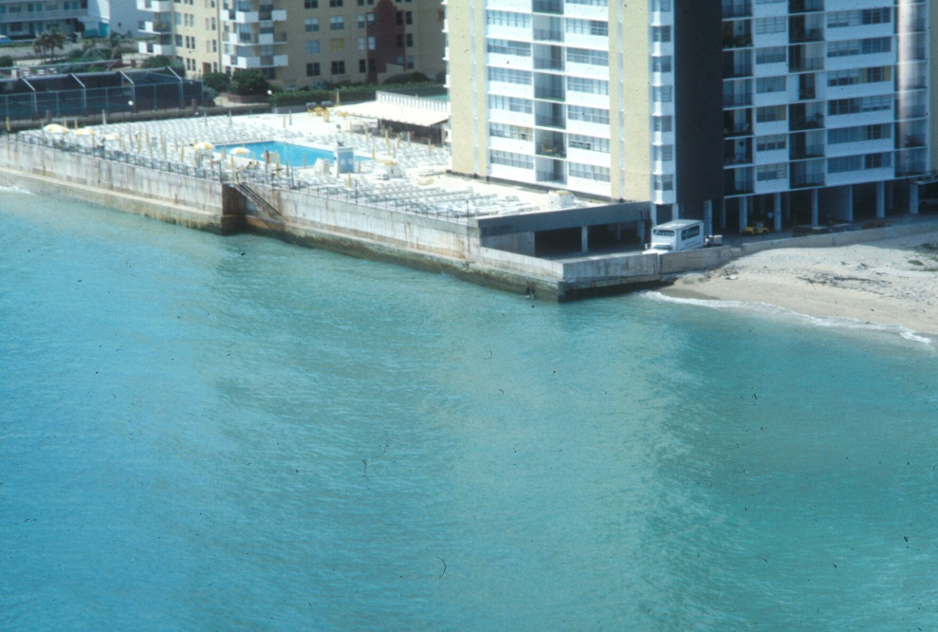
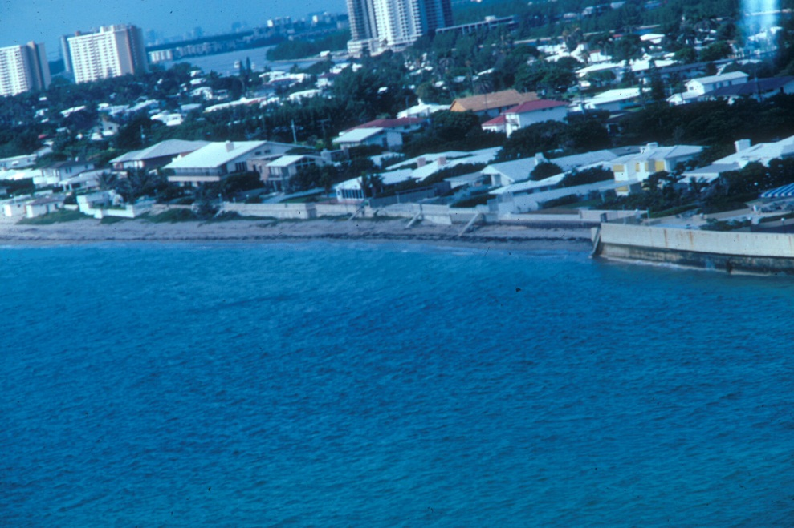
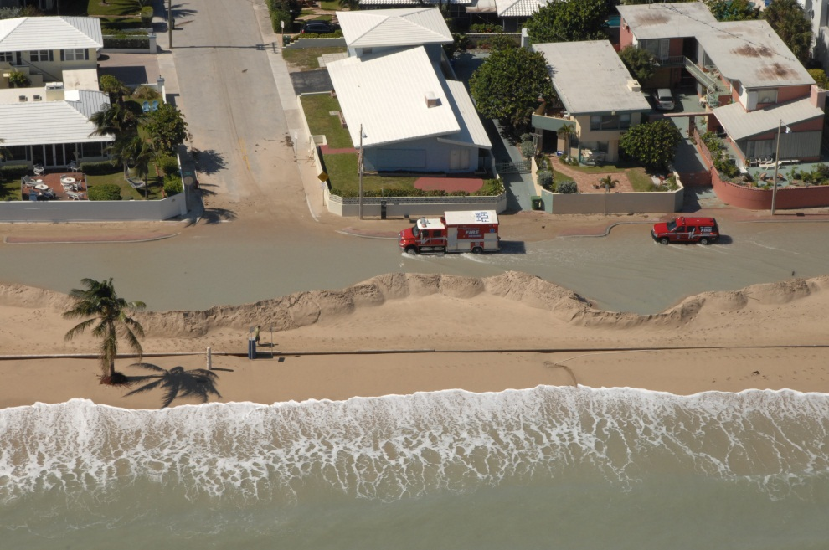
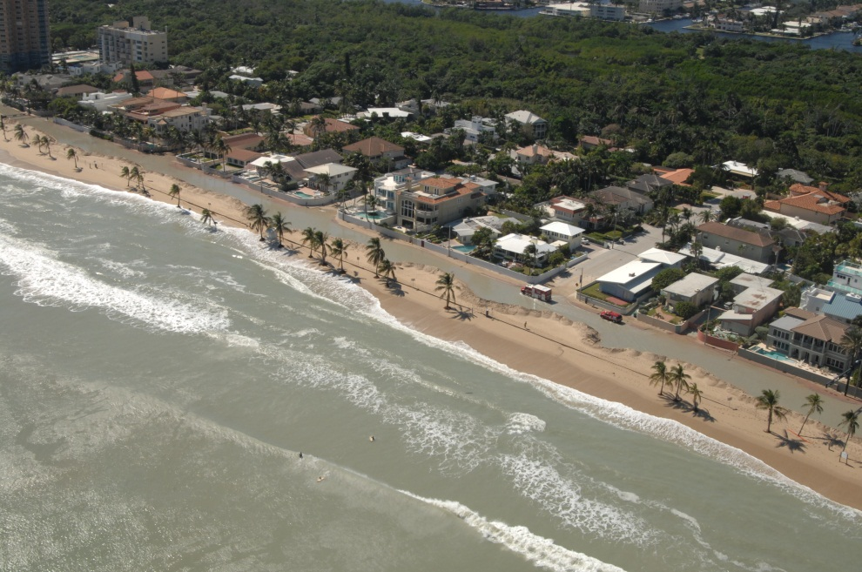
Vulnerable Infrastructure

Slide 11
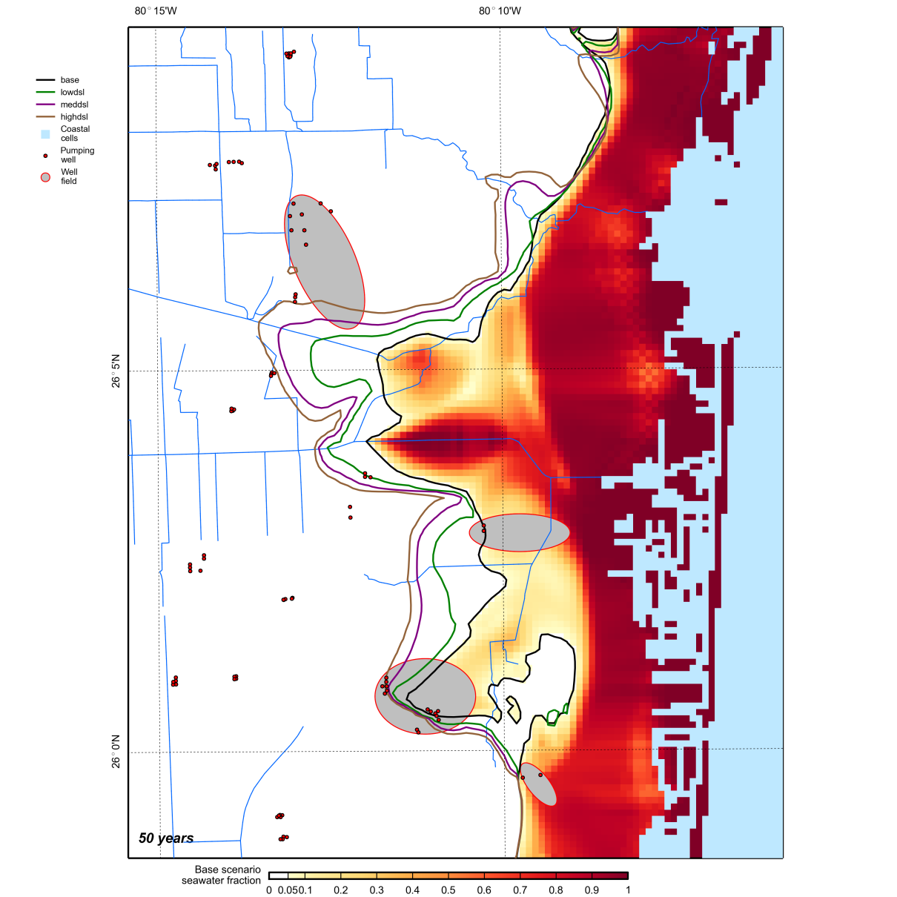
Loss of Wellfield Capacity
PROVISIONAL RESULTS DO NOT CITE
Preliminary Findings:
Sea level rise will drive additional saltwater intrusion, threatening major potable wellfields under low, medium, and high scenarios.

Slide 12
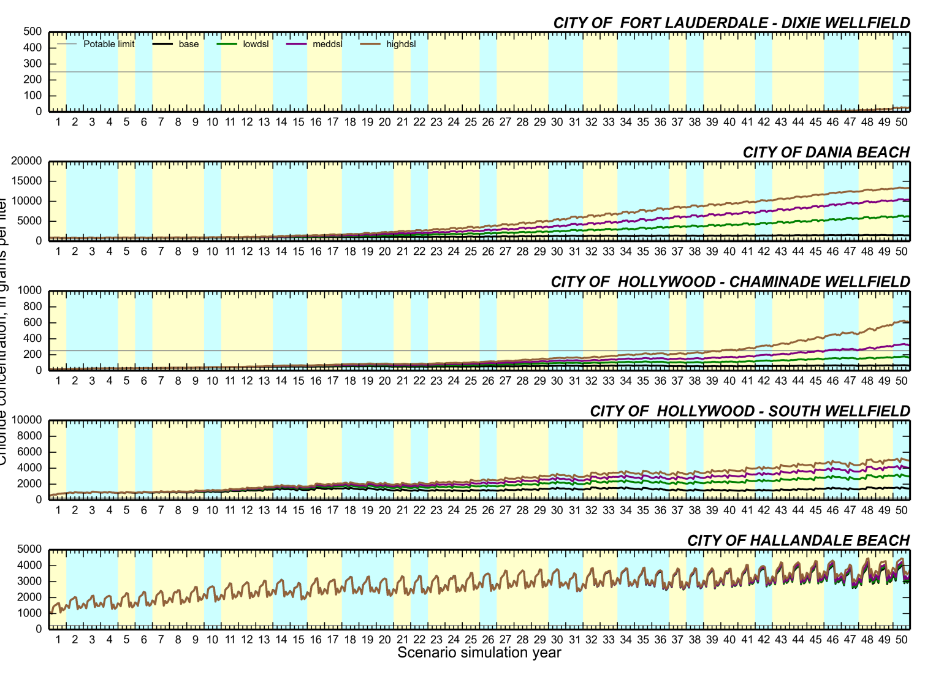
Sea Level Rise – Changes in Wellfield Chlorides
PROVISIONAL RESULTS
DO NOT CITE

Slide 13
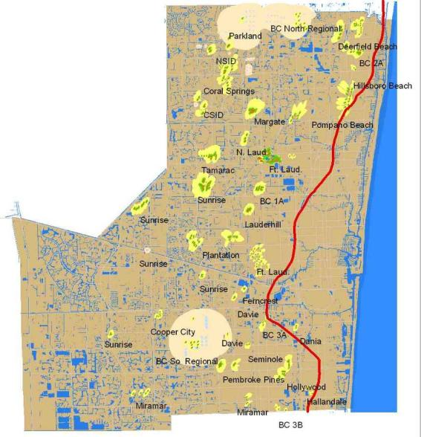
Cultivating Regional Climate Resilience
County-wide Climate Change Task Force
Adoption of Compact Unified Sea Level Rise Projection
Monitoring, Mapping and Modeling
Comprehensive Planning
Wellfields
Saltwater Front

Slide 14
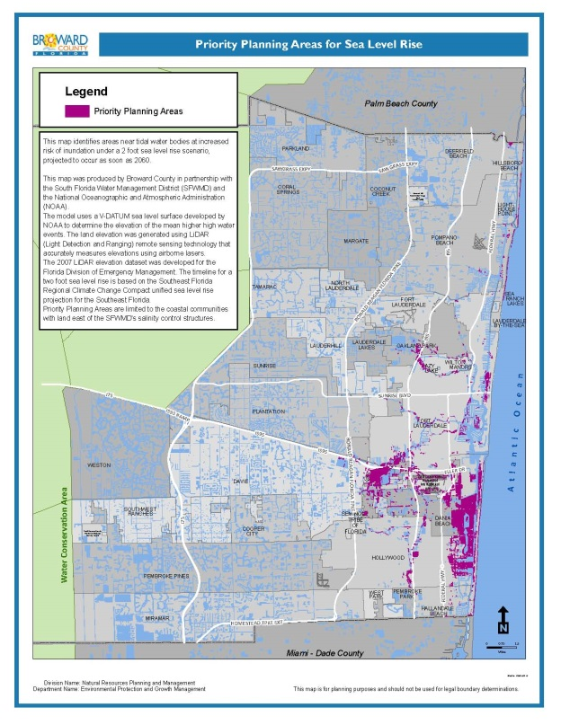
Regional Climate Policy and Planning
Comprehensive Planning (2013)
  Climate Change Element - AAA
  Priority Planning Areas
Enhanced Local Mitigation Strategy (2013)
Water Supply Planning (2014-2015)
  10-year Water Supply Work Plan
  Updates to water element
  Coastal Element – AAA
Modified Land Use Plan – 8/27/14 Kickoff

Slide 15
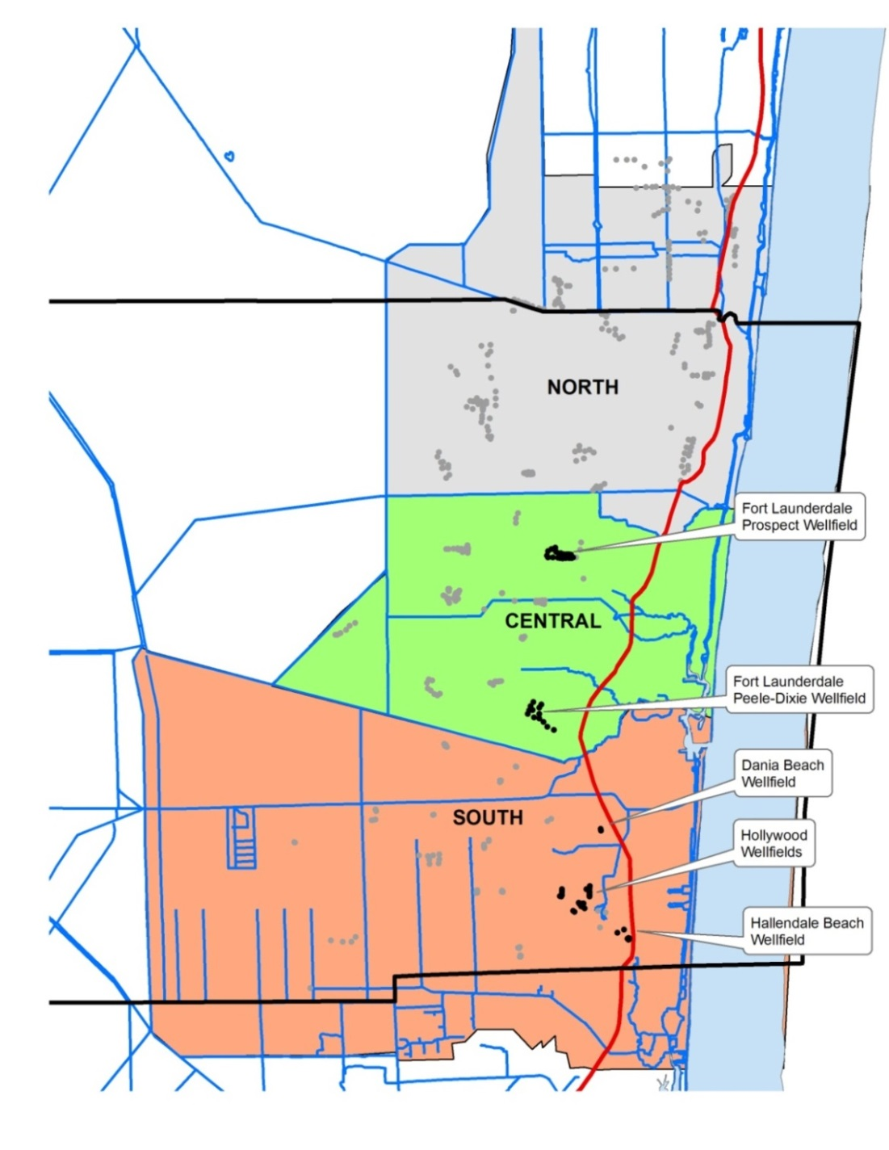
Regional Models
Variable Density
Surface/Groundwater
Climate/Stormwater

Slide 16
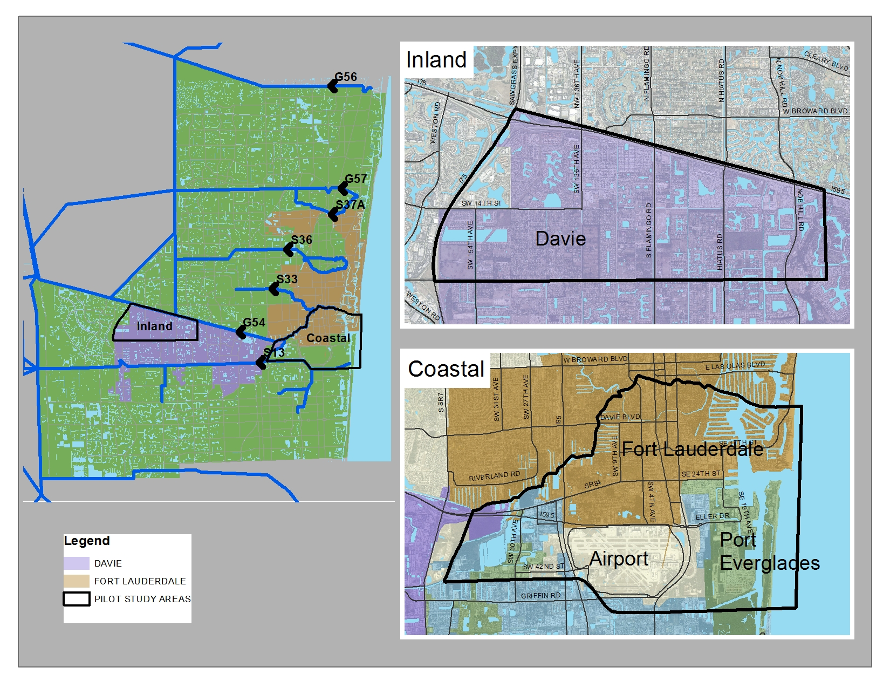
Study Areas

Slide 17
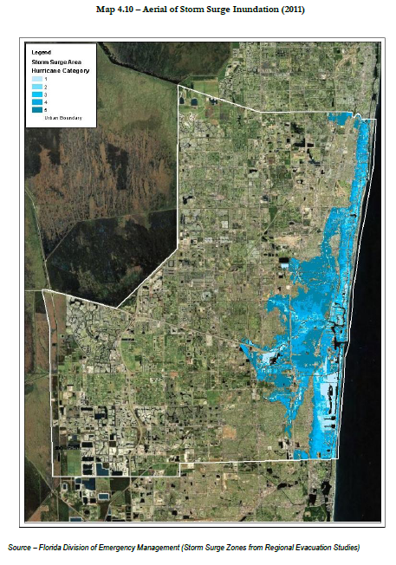
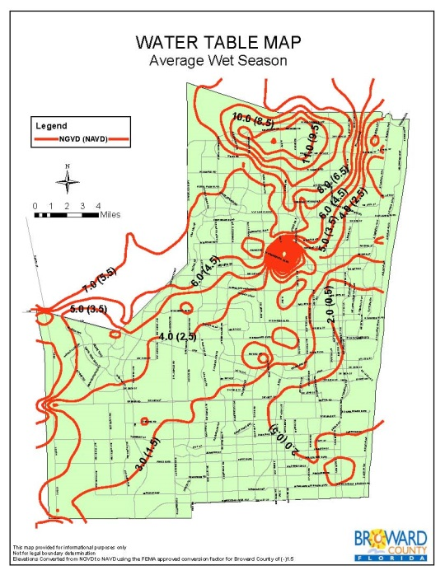
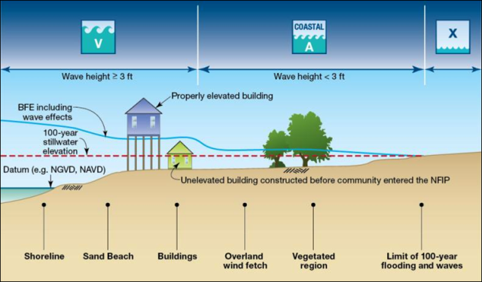
Related Tools and Efforts
Enhanced Hydrologic Baselines
Storm Surge Models
Coastal A Zone designations
Improved Standards
Notes:
While basic vulnerability maps provide us a snapshot of the areas of potential concerns, advanced modeling is being undertaken by Broward County in collaboration with the USGS to guide our adaptation strategies relating to water management issues. Modeling of wave action and storm surge are also critical to coastal zone management, but must be enhanced to account for the effects of sea level rise. FEMA’s modeling of wave run-up to support Coastal A Zone Flood Map Designations will substantially aid in further assessment of coastal vulnerabilities and planning needs.
These joint efforts will help to integrate modeled climate impacts into developing new design criteria for use in water management licensing, transportation planning, and establishment of base floor elevations necessary for our changing physical environment.

Slide 18
Formalization of AAA
2011 Community Planning Act
“Adaptation Action Areas”
“…study, define and designate several “Adaptation Action Areas” which are at-risk, multi-county, regions of the country, and other areas uniquely vulnerable and significantly impacted by rising sea level.”

Slide 19
Adaptation Action Areas at the Regional Scale?

Slide 20
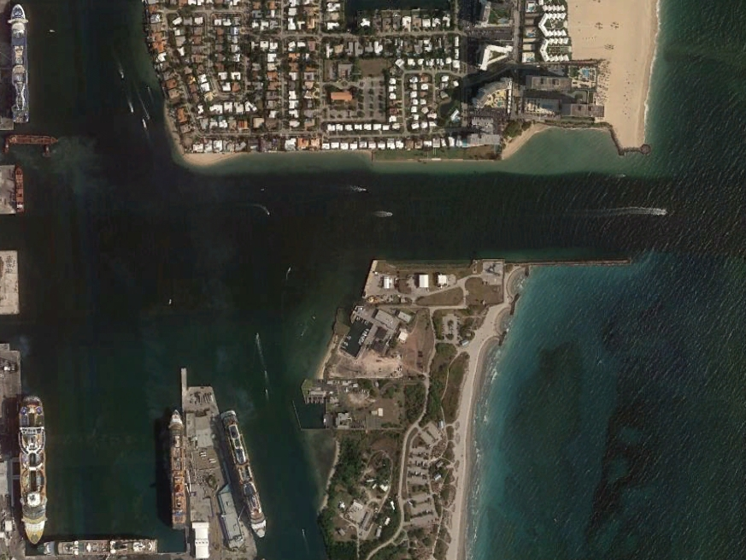
AAA Basis for Sand Bypassing at Port Everglades?
Port channel is a complete barrier to southward migration of sand
Artificial bypassing only means to restore sand flow south of inlet
Sand bypassing provides a long-term means for improving community resilience
Benefits the natural and built environments

Slide 21
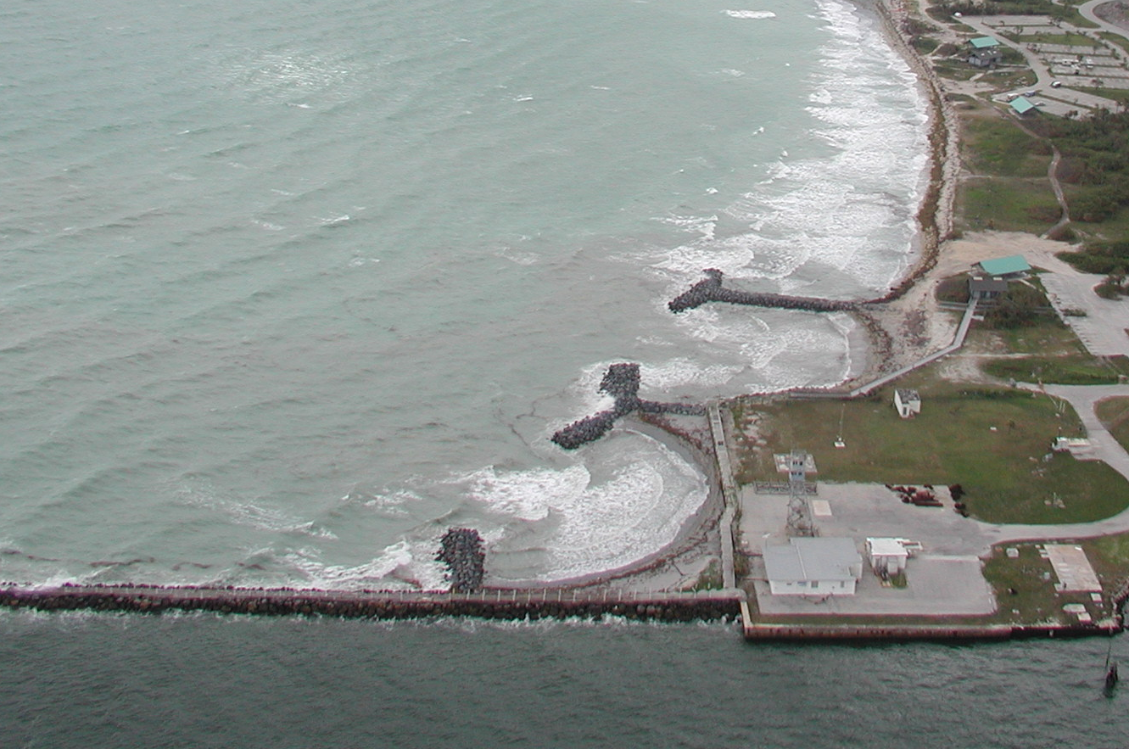
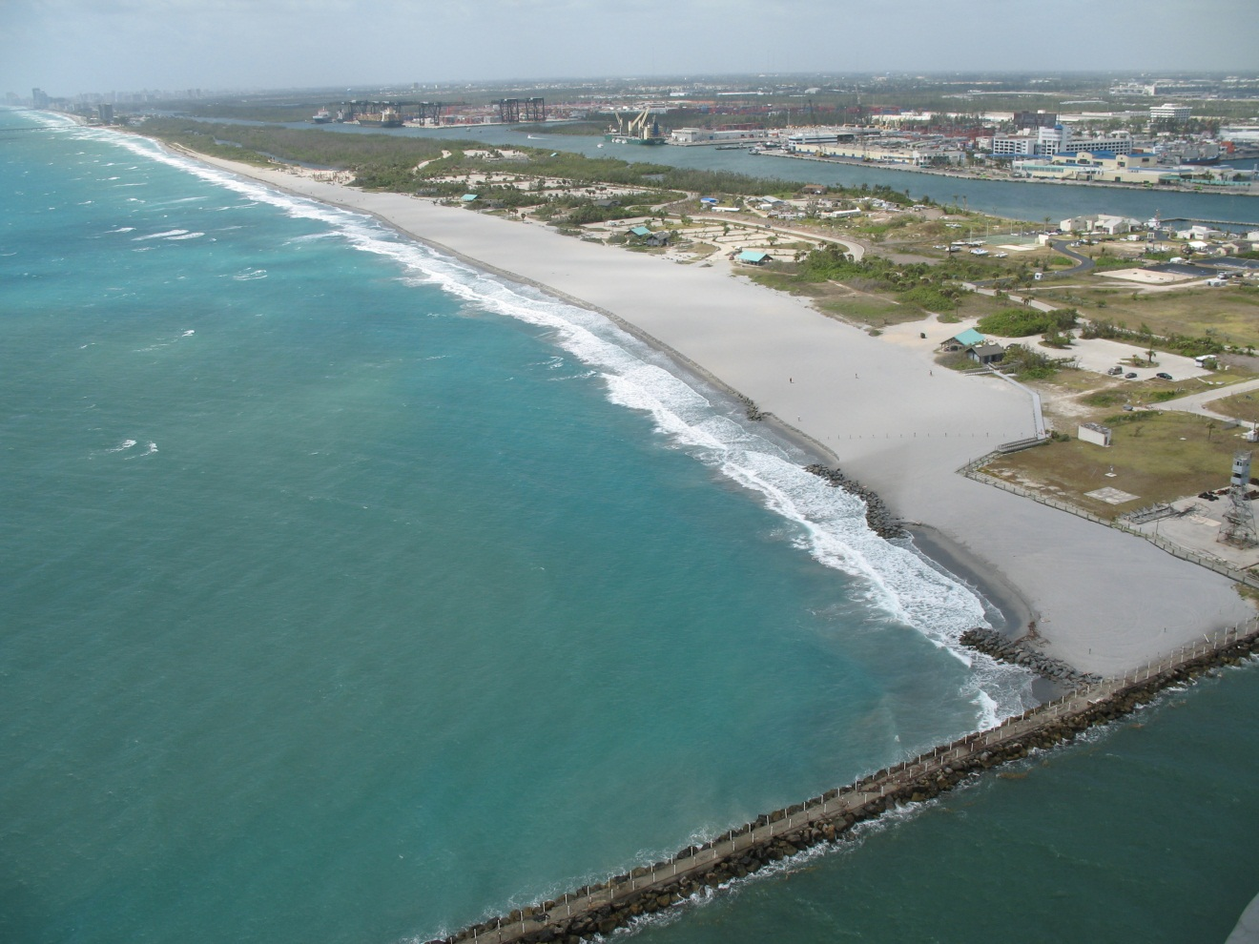
Maintained & Nourished Shoreline
(John U Lloyd State Park)
Eroded Conditions – South of Port Everglades Channel

Slide 22
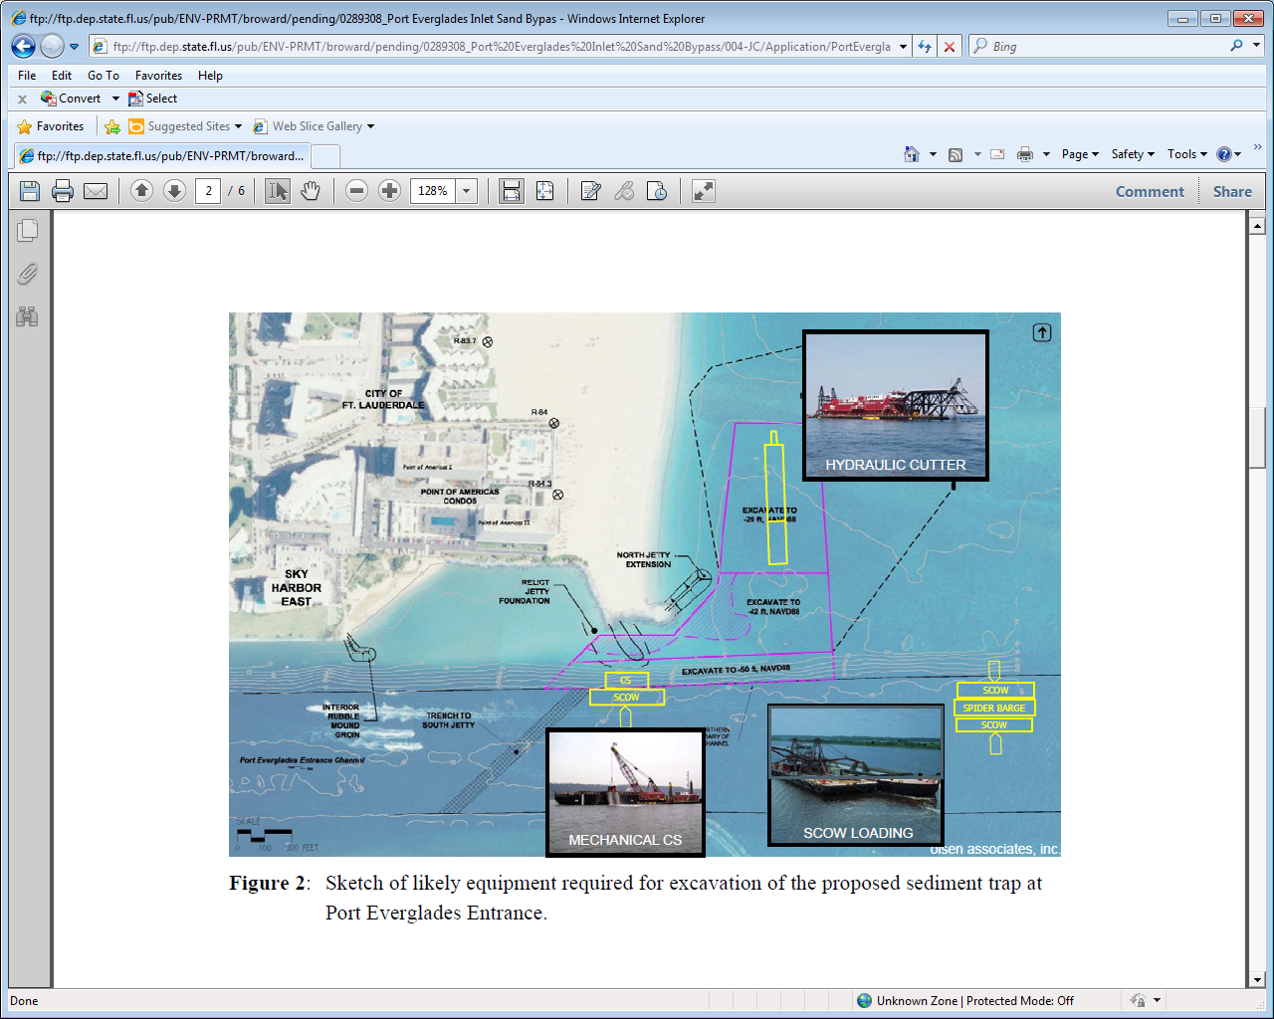
Sand Bypassing -
Proposed Port Everglades Sandtrap

Slide 23
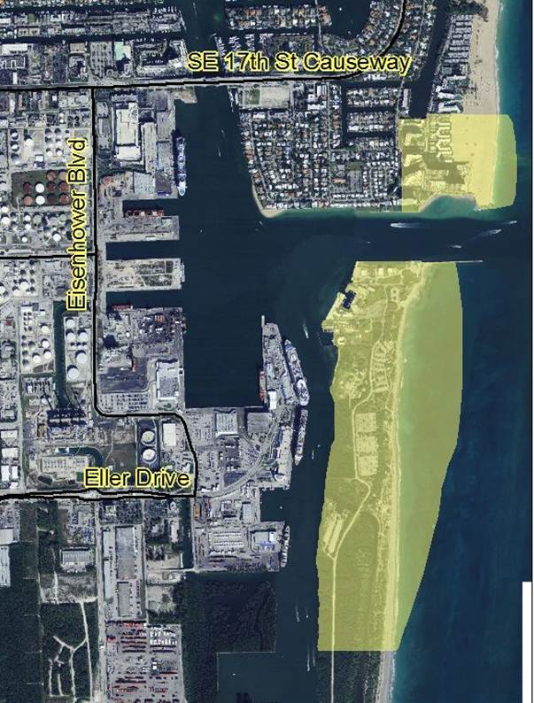
Port Everglades AAA?

Slide 24
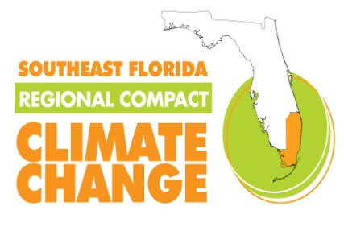



South Florida Resilient Redesign
August 8-11, 2014
Resilient design in the urban environment with an emphasis on adaptations for sea level rise, integration of natural infrastructure, and the development of transferable models
Supported by 50+ experts
  Architects
  Planners
  Hydrologists/geologists
  Resource managers
  Landscape designers
Agencies
  USGS
  SFWMD
  EPA
  TNC
  FIU, FAU, UM
  Dutch
  Local Government

Slide 25
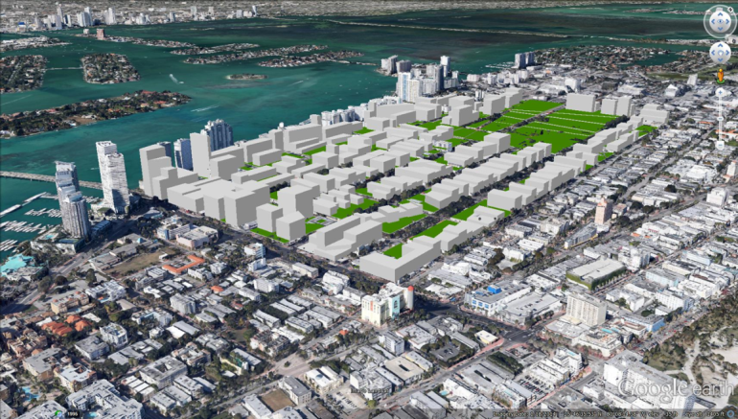
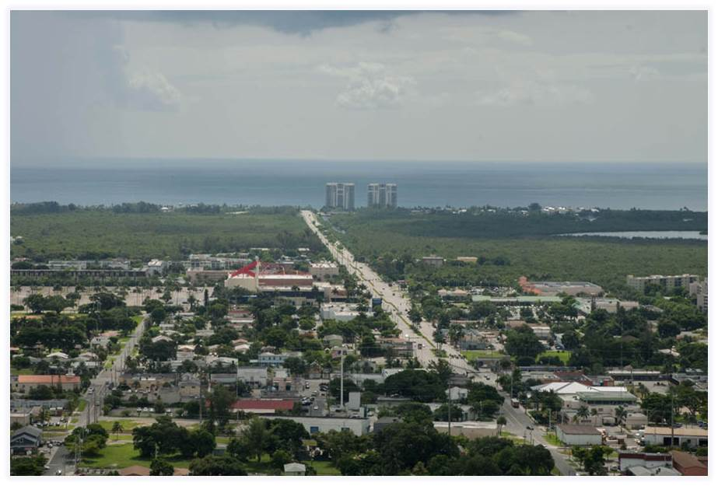
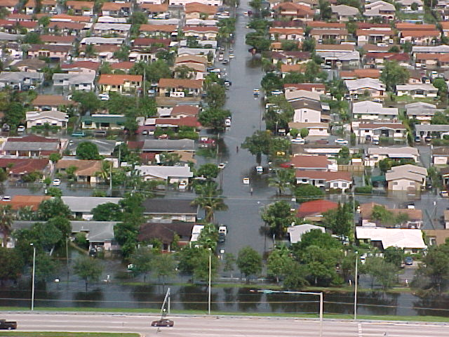
Three Southeast Florida Settings
Dense Urban – Miami Beach
Urban –
  Dania Beach, Broward
Suburban – Unincorporated Dade

Slide 26
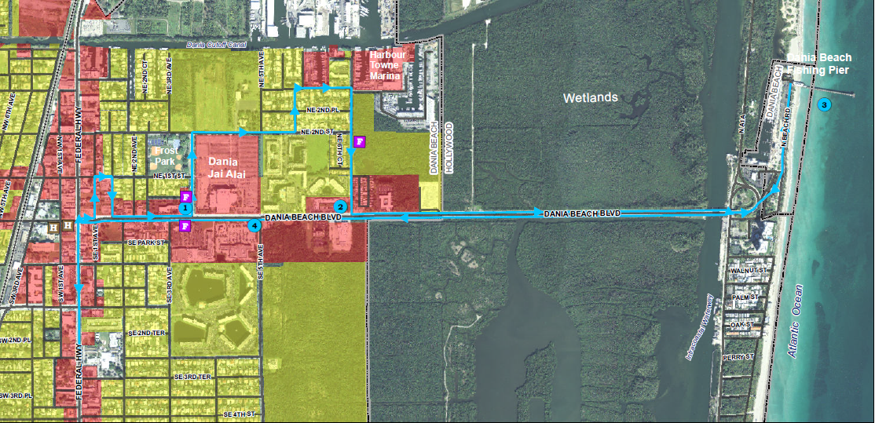
Urban: Dania Beach Boulevard
Notes:
Business/redevelopment would occur on Dania Beach Blvd corridor
Finished floors 4 ft above roadway
Neighborhood lower
Most of the “wealth” in community in NE and SE sections
Newest hosing in SE section
SE Section most vulnerable

Slide 27
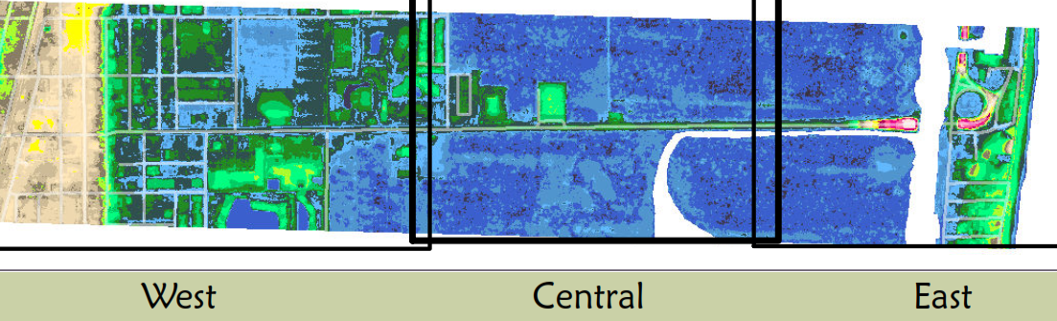
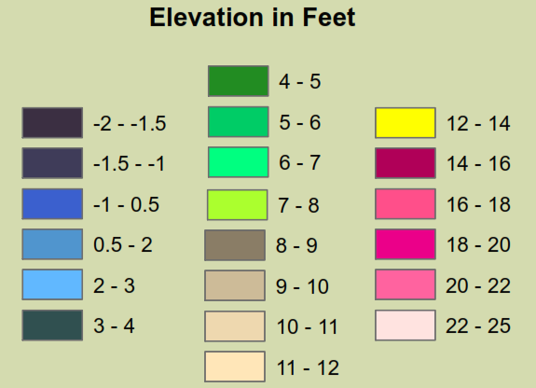
Site Topography
~6-7’
~7’
~6’
~11’
~-1’
NAVD

Slide 28
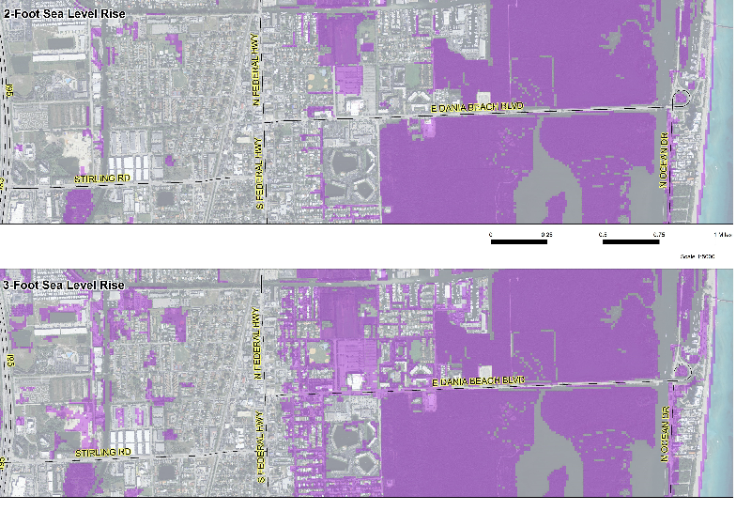
Vulnerability to Climate Change
2-foot Sea Level Rise
2-foot Sea Level Rise
2-foot Sea Level Rise
2-foot Sea Level Rise
2 Feet Sea Level Rise (30-70 year projection)
3-foot Sea Level Rise
3-foot Sea Level Rise
3 Feet Sea Level Rise (50-150 year projection)
Notes:
Lowest State Roadway A1A likely to be abandoned
SE Section did not exist until 1980s, when sheetflow was stopped.
Western Section also vulnerable
SE houses 6.5 ft.
NE Section houses 7.5 ft

Slide 29
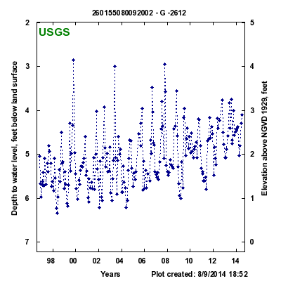
Coastal Groundwater Elevations
20 year trend
> 1 ft increase

Slide 30
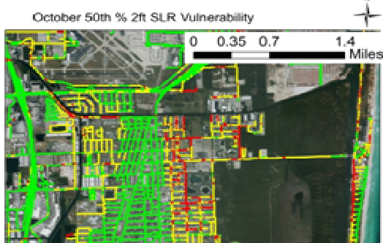
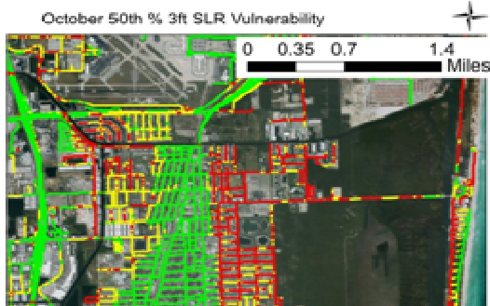
SLR Road Impacts
30
Case study results for Dania Beach using October 50th percentile SLR
Roads shown at 2 and 3 ft SLR
2-foot Sea Level Rise
3-foot Sea Level Rise
2 Feet of Sea Level Rise
3 Feet of Sea Level Rise

Slide 31
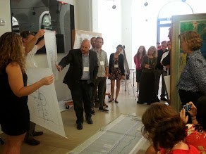
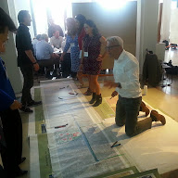
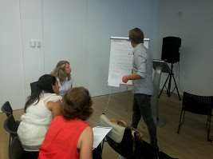
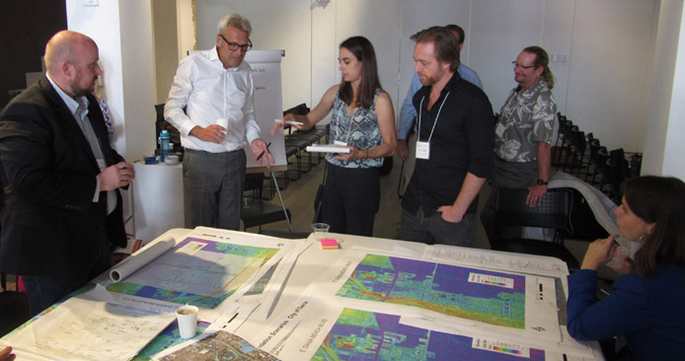
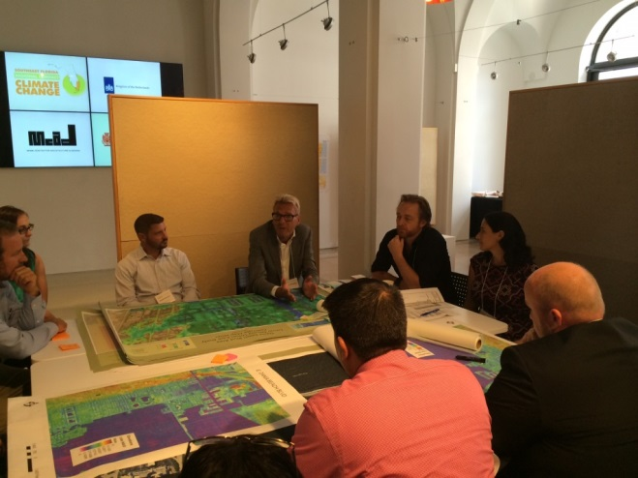
The Creative Process

Slide 32
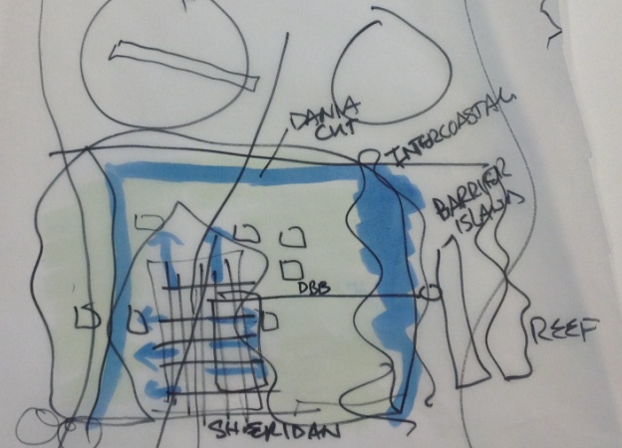
Understanding the Water System
South Florida Resilient Redesign

Slide 33
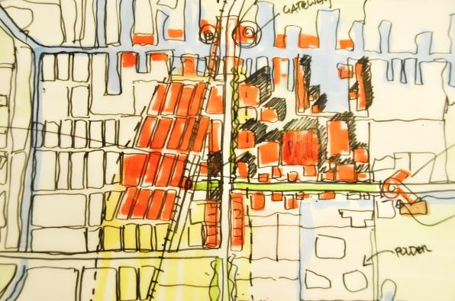



Design Concepts
City Center
Interconnectivity
City center on coastal ridge
Multi-purpose natural infrastructure
Polder flood control
Dune (barrier island) enhancement with underground parking
The Polder
Dune

Slide 34


Dania Beach Boulevard
Jai Alai
City Center
Dune
Promenade
Canal
TOD
Resiliency Center
Polder

Slide 35

Design Components and Pathways

Slide 36

The Resiliency Center: A Focal Point

Slide 37


Coastal Assets:
Dunes
Beach
Reef
Facilities

Slide 38

Community Flood Protection:
Polder
South Florida Resilient Redesign
Raised roads →levees
Canals
Cypress
Lower density
Living with water

Slide 39


Resilient Redesign Features
South Florida Resilient Redesign
Integration of urban and natural systems
Distributed water storage
Sustained beach nourishment
Dune augmentation
Reef enhancement
Natural buffers
Living with water
Combination of increased resiliency & practical beautification

Slide 40


Implementation: Adaptation Action Area?

Slide 41
Advancing Regional Resilience
County Contributions:
Technical Tools and
Investigations
Policy and Planning
Design Standards
Project Implementation
Partnerships and Advocacy

Slide 42

Climate Resilience – A National Strategy!

