Slide 1
RCAP Workshop #6

Slide 2
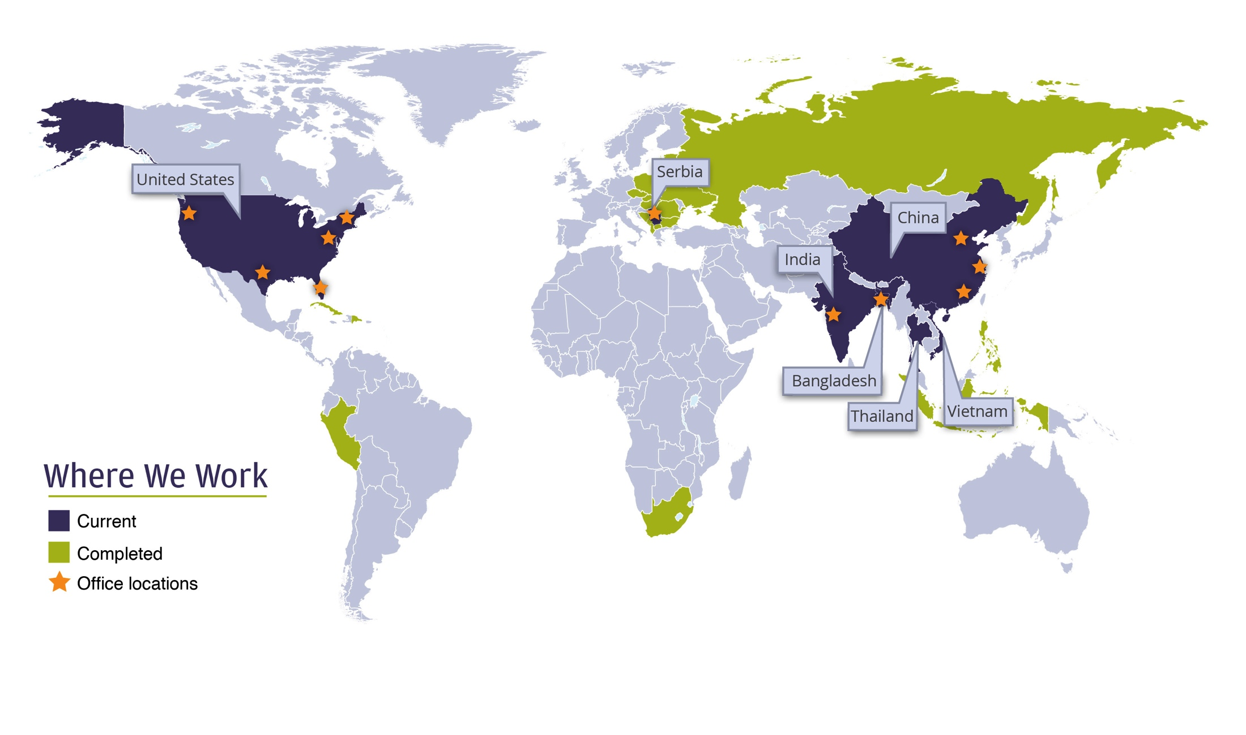
Who is the Institute for Sustainable Communities?
ISC’s mission is to help communities around the world address environmental, economic and social challenges to build a better future shaped and shared by all.
ISC has managed 99 projects in 30 countries … so far.
Notes:
ISC was founded in 1991 by former Vermont Governor Madeleine M. Kunin and her planning director George Hamilton, ISC has led transformative community-driven projects across the globe. We garnered early recognition for connecting civic participation with environmental problem solving, and over the years we have developed an approach that accelerates a community's ability to meet challenges head on.
.

Slide 3
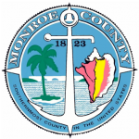
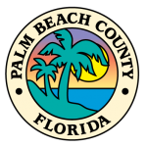
Southeast Florida Regional Climate Change Compact
Notes:
In Southeast Florida, ISC is working with four counties under the auspices of the Southeast Florida Regional Climate Change Compact to pioneer a regional climate governance model designed to enable local governments to set the agenda for climate change solutions while providing an efficient means to coordinate the engagement of state and federal agency engagement. The Compact has completed and published a five-year Action Plan that maps out an unprecedented and highly collaborative effort to respond to climate change on a regional scale.
voluntary and cooperative partnership between Palm Beach, Broward, Miami-Dade and Monroe Counties formed in Spring 2009 to address Climate Change.
• Led by Regional Steering Committee
Developed a Regional Climate Action Plan
Annual Climate Change Summits since 2009 (next Summit is October 1 & 2 in Miami Beach)
Local Government Workshops
• Developed Preliminary Inundation Mapping
Baseline regional sea level rise projections created to 2060

Slide 4
Thanks!
http://www.florida-stormwater.org/

Slide 5
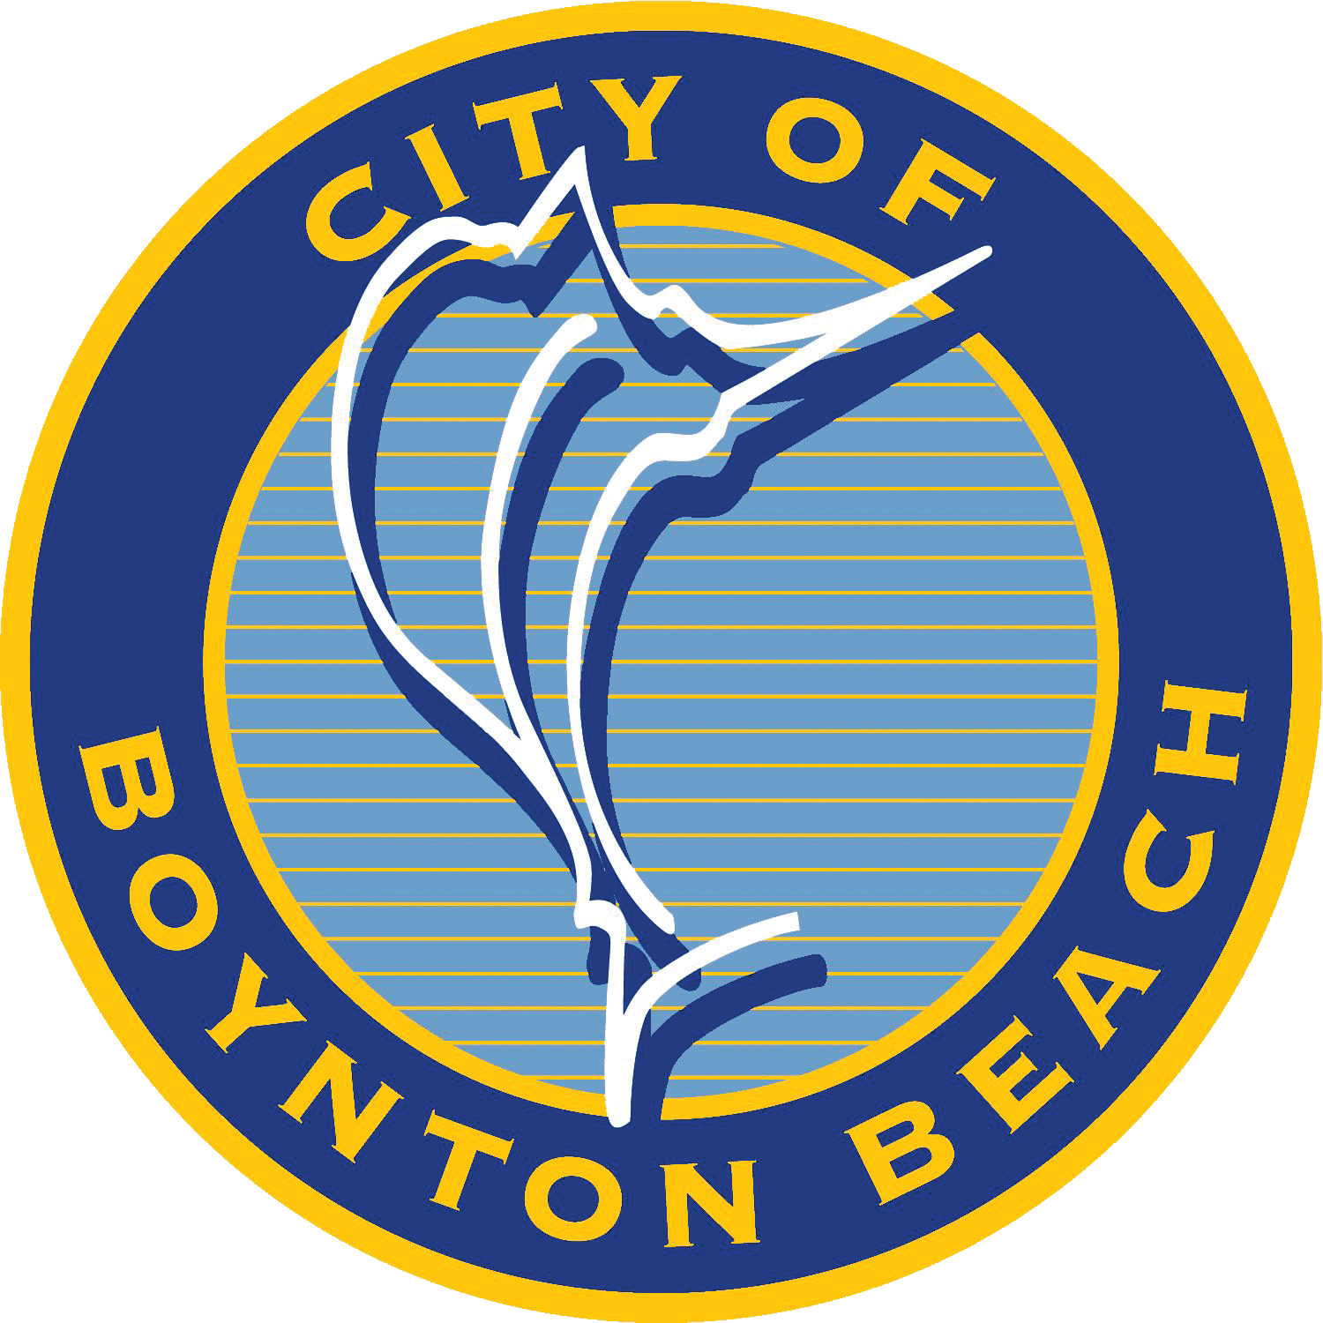
City of Boynton Beach Utilities Department
Easier
Utilities Department

Slide 6
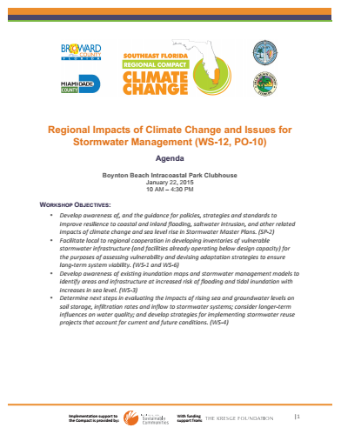
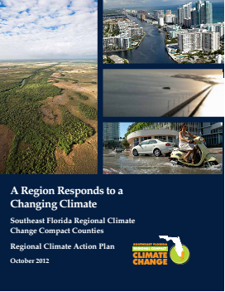
How Today Fits Into the RCAP

Slide 7
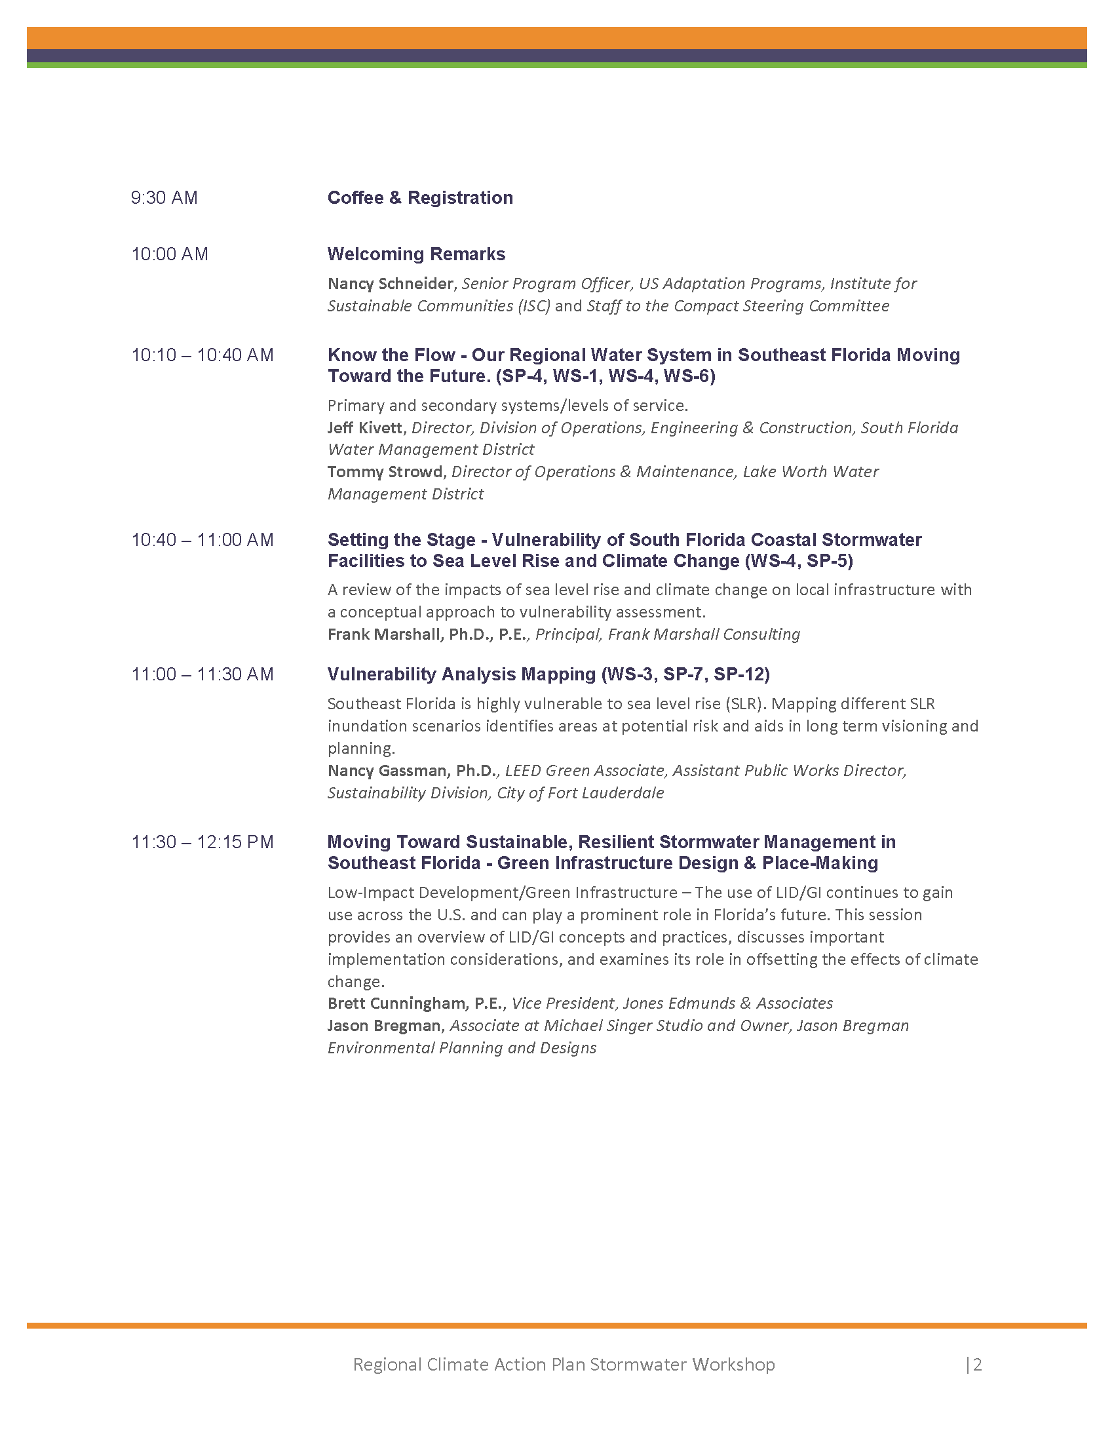
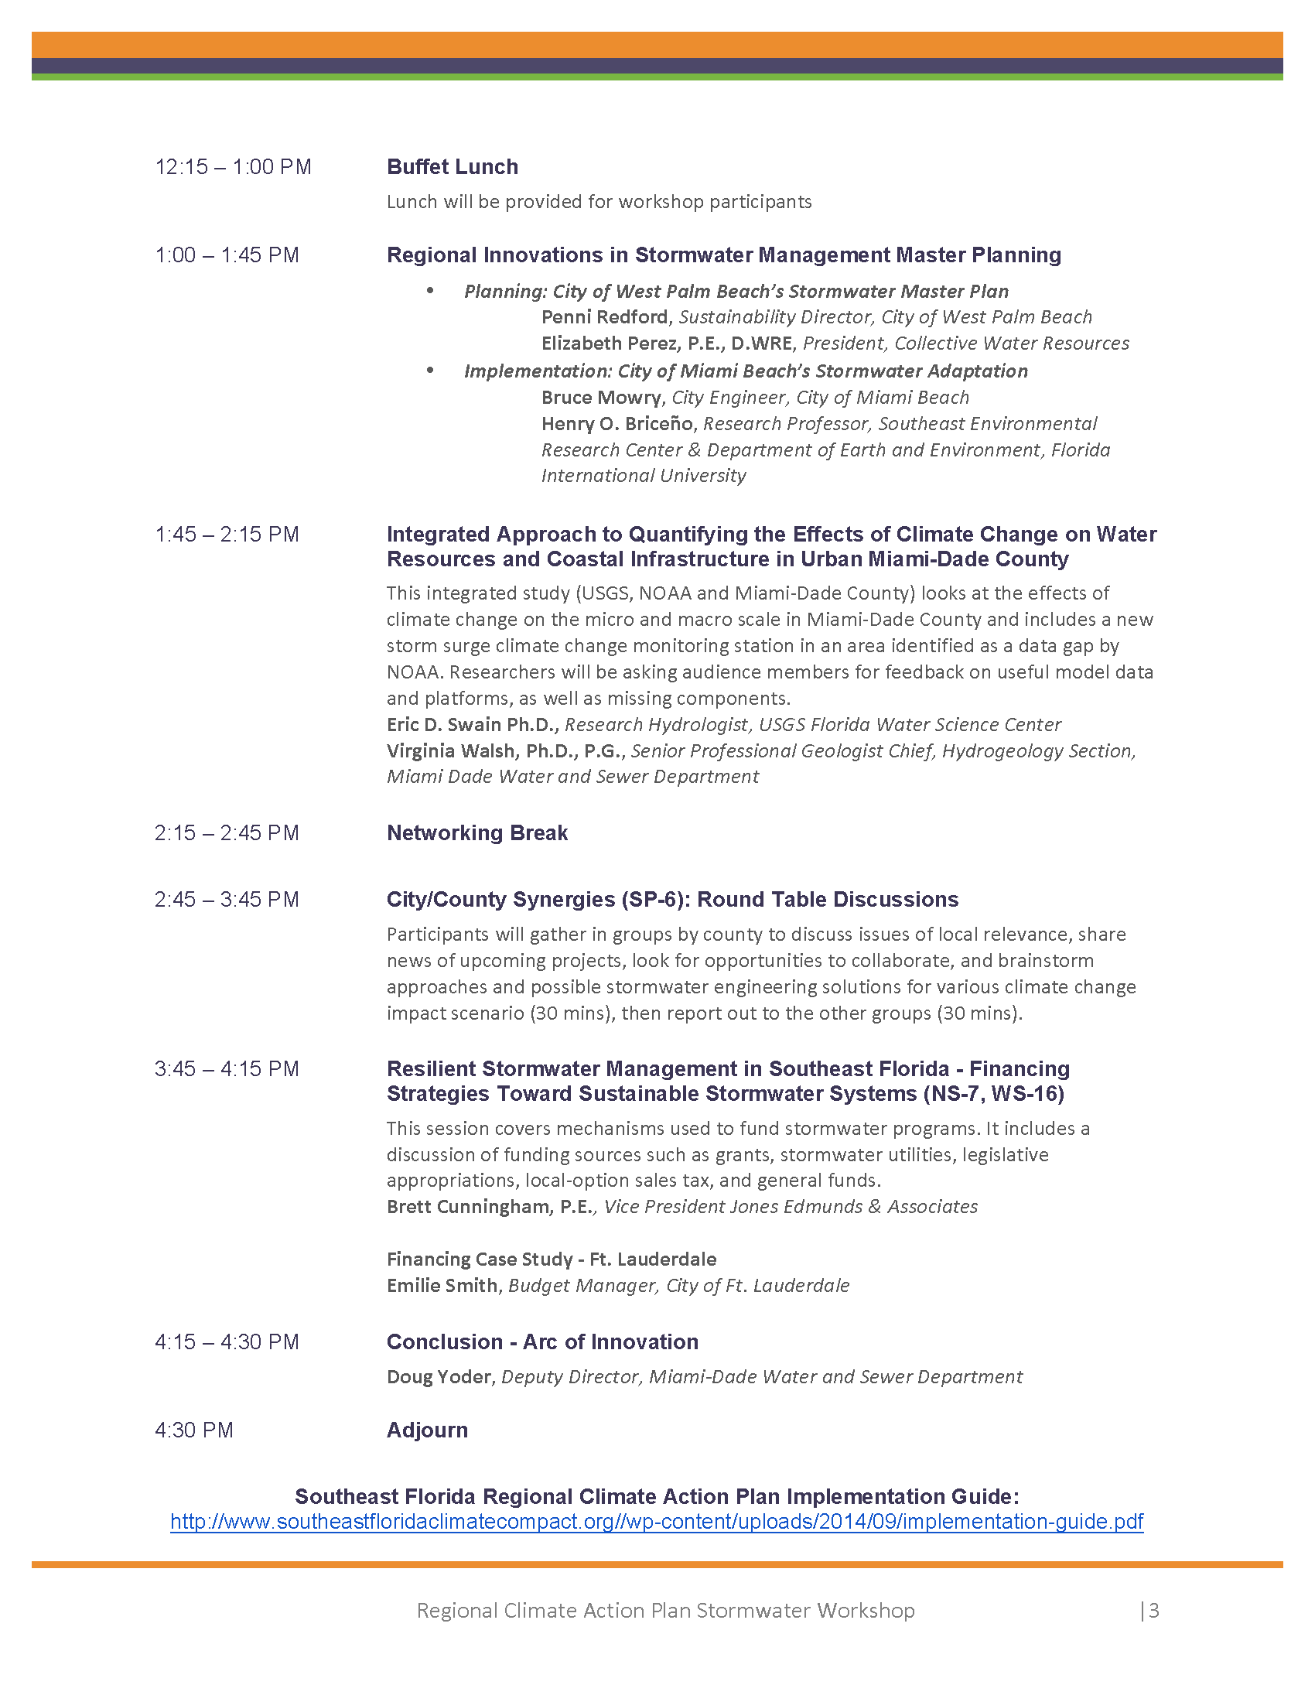
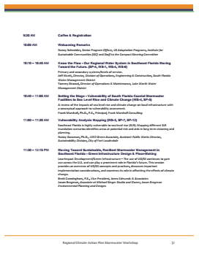
Agenda

Slide 8
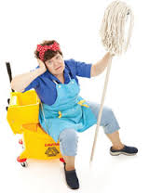
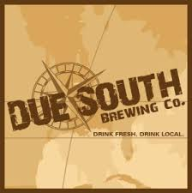
Some Housekeeping…
Name tags
Restrooms
Wifi
Breaks
Lunch
Happy Hour…

