Slide 1
The Southeast Florida Regional Climate Change Compact
8th Regional Climate Action Plan Workshop:
Energy Efficient Public Buildings

Slide 2
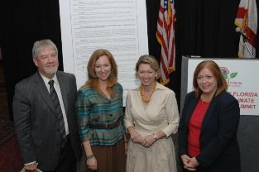
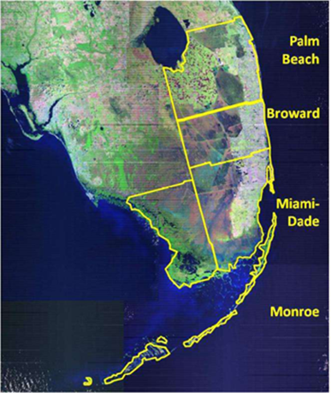
The Southeast Florida Regional Climate Change Compact
Fully Ratified January 2010
Commitments include:
Policy Collaboration
Develop Regional Tools
Unified SLR Projection
Inundation Maps
GHG Emissions Baseline
Create a Regional Action Plan
Mitigation and adaptation strategies
Convene Annual Summits
Notes:
South Florida is considered one of the most vulnerable areas to climate change and sea level rise.
In the spring of 2009, several South Florida counties and cities were making the rounds in the halls of Congress to advocate for climate policy. A great deal of work had been invested individually by each jurisdiction, however each had slightly different baseline emissions figures at different points of time and different sea level rise planning scenarios. The need for regional coordination became quite evident.
With 5.6 million residents in the four counties exceeding the population of 30 states and representing 30 percent of Florida’s population, there is an obvious and unique strength in the region’s size and in numbers.
The four Counties agreed to collaborate regionally on:

Slide 3
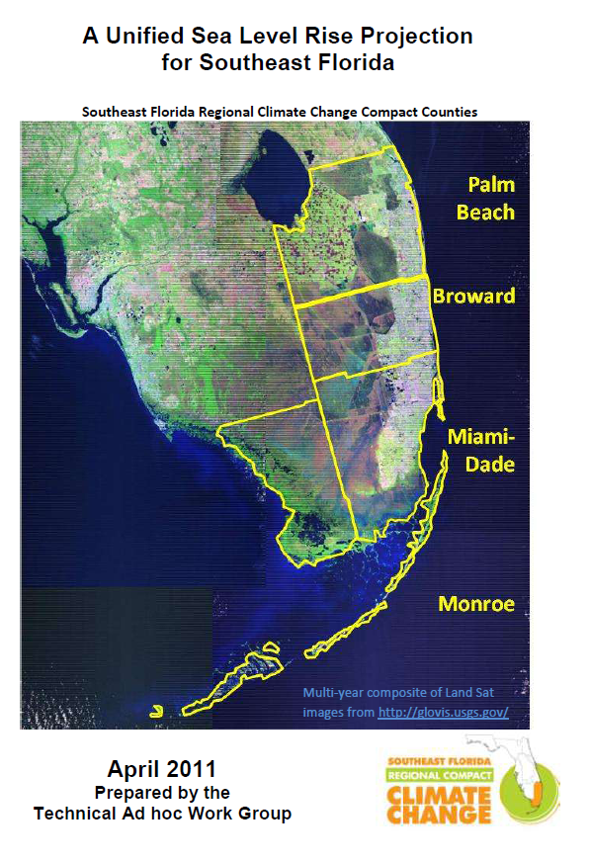
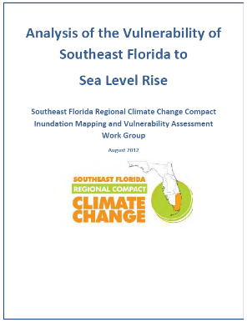
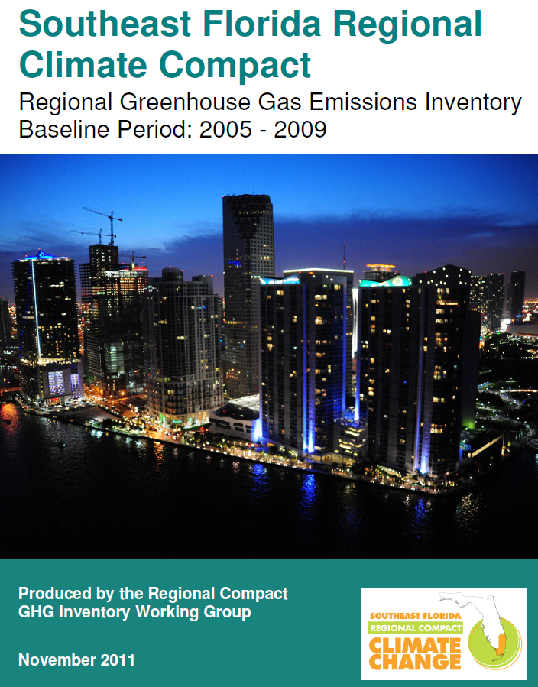
Technical Tools and Planning Documents
All documents available at http://southeastfloridaclimatecompact.org/
Notes:
These are the primary technical documents created to provide a technical foundation for the Compact’s work, and to inform the development of the RCAP. We welcome replicating our processes. In fact, each of these documents includes explanation of methodology and data sources used in development.
The 2011 Urban Mobility Report estimates delayed travel time in the Miami urban area (Miami-Dade, Broward, and Palm Beach Counties) ranked 7th in the nation, resulting in the consumption of approximately 141 million gallons of fuel, at a cost of approximately $3.3 billion.⁸
^{Vulnerability Assessment}
Airports are an example of the infrastructure assets evaluated.
In the example of road impacts to the right, access is blocked to the community. Access from road inundation is also an issue for select hospitals, airports, schools, and evacuation routes.
Inundation MappingRegional digital elevation model
1, 2, and 3 foot scenarios
Common method to express potential risk
Identifies areas with LiDAR elevation at the mean higher high water line
Vulnerability AnalysisPrioritized infrastructure for analysis
Tested geospatial analytical methods
Included uncertainty
GHG Emissions InventoryRegional analysis of emissions for 2005-2009
Focus on emissions from:
44% Transportation 28% Residential 26% Commercial 2% Industrial

Slide 4
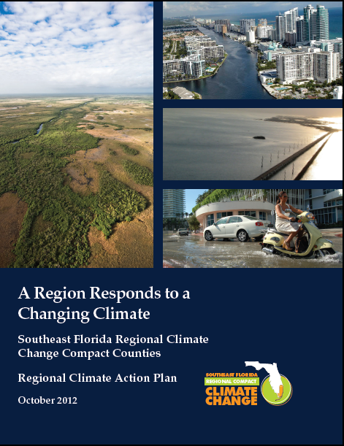
Southeast Florida Regional Climate Action Plan
100+ mitigation & adaptation recommendations
Sustainable Community and Transportation Planning
Water Supply, Management and Infrastructure
Risk Reduction and Emergency Management
Energy and Fuel
Natural Systems and Agriculture
Outreach and Public Policy
companion Implementation Guide also available
Notes:
Of course one of the greatest advancement has been the Southeast Florida Regional Climate Change Compact
4 Counties
Expanded to include our cities
Planning process with technical assistance from academics, agencies
Development of Action Plan
And now implementation

Slide 5
Compact RCAP (Regional Climate Action Plan)
Workshops
Training/Education
Guidance Documents
Webinars
Other assistance

Slide 6
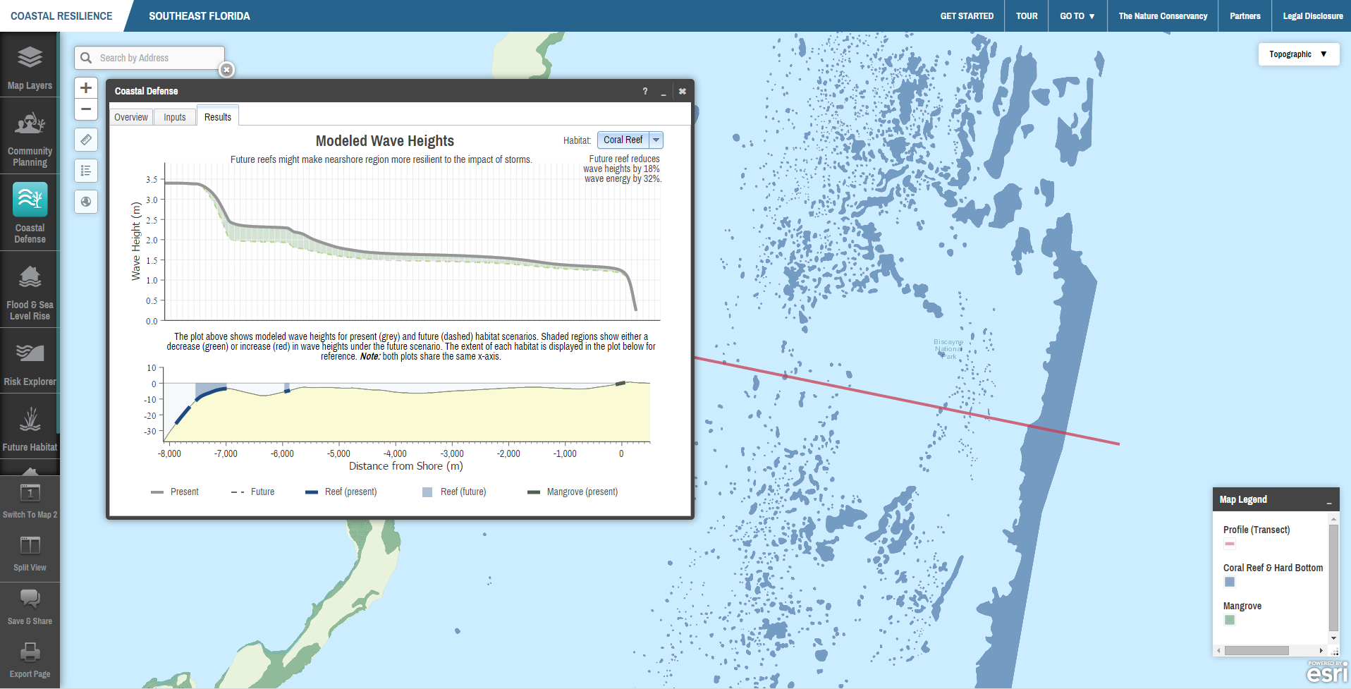
Coastalresilience.org and the Coastal Defense Tool

Slide 7
workshop topics
2013 workshops
incorporating CC/SLR into comprehensive, transportation, emergency management planning
community solar
2014 workshops
climate communications
water supply planning
resilient redesign
adaptation action areas
2015 workshops
stormwater (january 22)
transportation (april 30)
resilient redesign II (july)
energy efficient public buildings (sept)

Slide 8
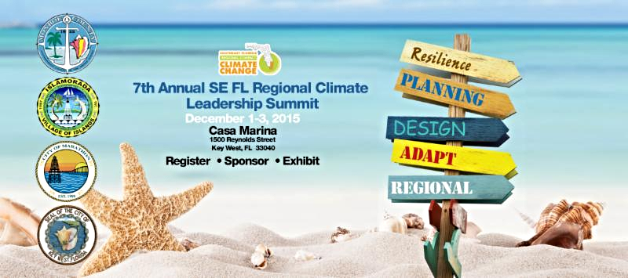
Regional Climate Leadership Summit
http://southeastfloridaclimatecompact.org/the-summit/

Slide 9
Today
9:00 – 9:15 am Welcome
9:15 – 10:00 am Orlando Success Story
10:00 – 10:45 am Harvesting Low Hanging Fruit – Easy Steps Anyone Can Do
10:45 - 11:00 am Networking Break
11:00 -11:30 am Webcast – DOE At Your Service: Understanding and Accessing Federal Tools, Programs and Resources - Better Buildings Initiatives.
11:30 – 12:15 Dollars and Cents: Making Energy Efficiency Cost Effective
12:15– 1:00 pm Buffet Lunch
1:00 - 1:30 pm Webcast - Energy Efficiency Technologies.
1:30 – 2:15 pm Tour of Broward College Health Sciences Simulation Center
2:15 – 3:00 pm What’s next: Implementing Lessons Learned
3 PM Adjourn

